Slide 1
Archibald Favell
Notes:
General notes:
Archibald Favell joined the British Army in September 1914. He enlisted with 2nd Battalion, The Royal Fusiliers (City of London Regiment). He married his wife, Lily, on 20 December 1914, just three days before he left for training in Malta, in preparation for the Gallipoli campaign. Archibald survived both Gallipoli and France, although he suffered exposure and typhoid fever. He was eventually discharged in 1919, and was deemed eligible for a pension as a result of a ’10 per cent disability’ sustained in the war. He experienced ‘recurrent attacks’ of symptoms associated with his typhoid fever.

Slide 2
This PowerPoint presentation contains a selection of images and archives which students can use to explore the story of one British soldier in the First World War. In the main, the materials come from the Collection of the National Army Museum (NAM). Occasionally these are supplemented by materials from outside the NAM to provide context.
These images can be used to build up a picture of an individual soldier’s experience of service in the First World War. These images can encourage literacy and visual literacy. Suggestions for questions you might discuss with your students are included in the notes.
Unless otherwise stated in the notes, the images can be freely used for non-commercial purposes within the classroom. You can use the entire presentation or choose individual images for use in other non-commercial contexts. When using individual images in other contexts, please always retain the attribution statements provided in this document (e.g. NAM. 2005-08-66-1).
By downloading this document and using these images you agree to these terms of use, including your use of the attribution statement specified for each object by NAM.

Slide 3
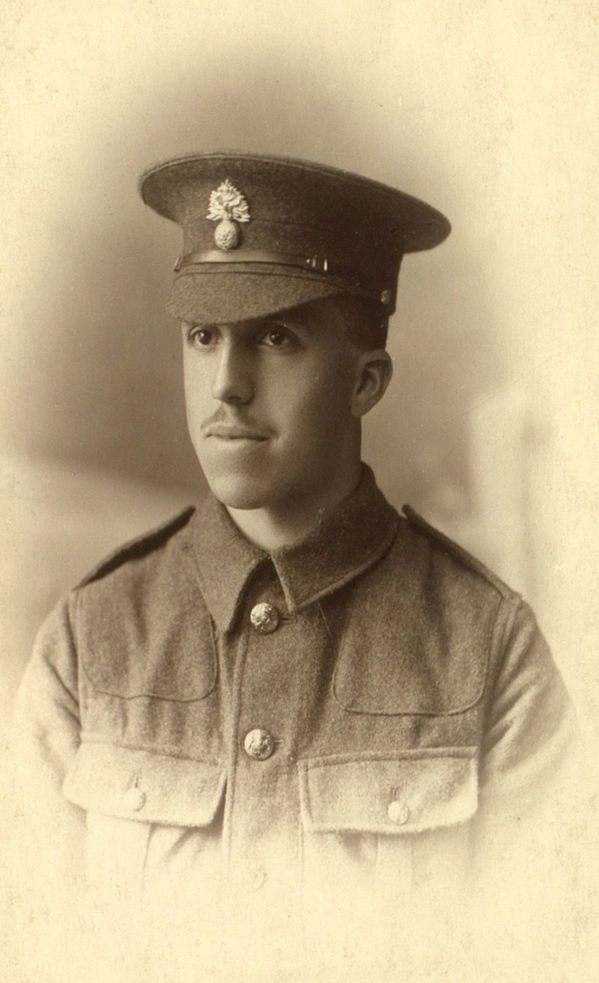
Notes:
Private Archibald Favell, November 2014
NAM. 1984-08-59-1
General notes:
Archie joined the Army on 8 September 2014, as part of a draft for the 2nd Battalion of The Royal Fusiliers. This unit was a Regular Army formation and returned to England from India in December 1914.
Archie was an accountant in the City – a profession which may have assisted his progress in the Army. He was around 25 when this picture was taken. He married his sweetheart Lily on 20 December 2014.

Slide 4
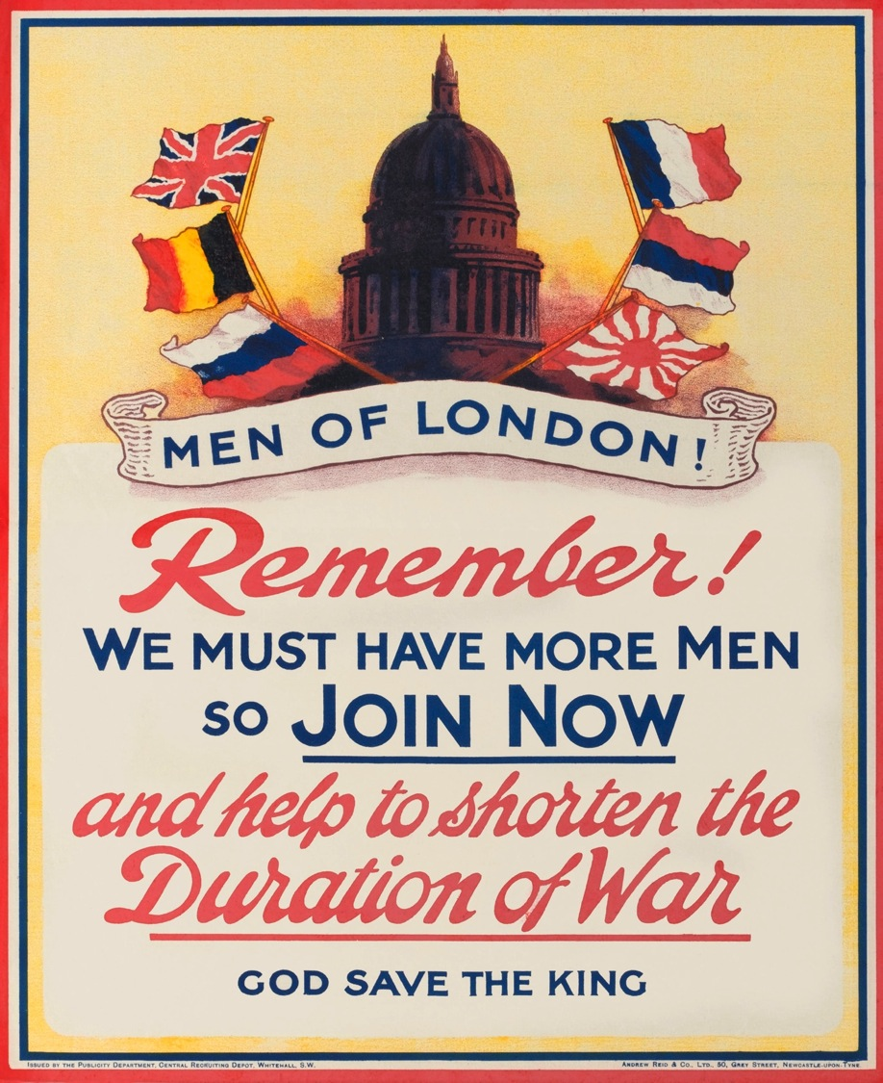
Notes:
Recruiting poster, 'Men of London! Remember! We Must Have More Men So Join Now’, 1914
NAM. 1977-06-81-2
General notes:
Posters such as this example from the Publicity Department, Central Recruiting Depot, were produced in the latter part of 1914 and throughout 1915. It depicts the dome of St Paul's Cathedral encircled with the flags of the Allied nations. The flags represent the Allied countries. Left side: United Kingdom, Belgium, Russia. Right side: France, Serbia, Japan.
Questions you might ask:
What nations are represented by the flags? Why are they featured?
What is the main reason given for joining the Army?
Why do you think it was initially thought important to recruit people from the same area/profession/community?
Why might that strategy have been seen to have backfired?
Compare the alliances in this war with those in the Second World War.

Slide 5
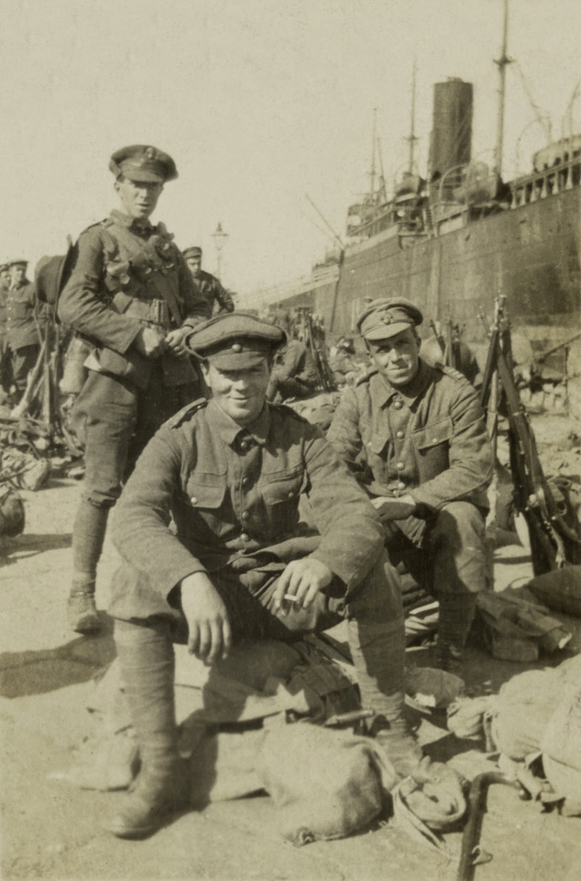
Notes:
Archibald Favell and colleagues next to a troop ship, 1915
NAM. 1995-04-27-6
General notes:
Archie (right) is photographed with two of his friends. It was probably taken after their arrival in Malta. Archie was to spend seven months in Malta learning to become a soldier, and training specifically for the forthcoming Gallipoli campaign.
The photograph depicts the standard uniform for Regular soldiers. Particularly noticeable are the puttees which are wrapped around the lower half of the leg, to support the muscles and vascular system and cover the top of the boot to prevent mud and stones entering. The soldiers in front and standing at the back are also wearing a short-lived design of cap, which got the nickname the ‘Cor blimey’. The strap across the top could be extended and brought down under the chin, with the doubled layer of material from the sides and back of the cap brim folded down over the back of the neck and ears.
Questions you might ask:
Why would elements of uniform change during a conflict?
What were hats replaced with (in the trenches) throughout the course of the war?
What is the purpose of puttees?
Read his diary entry for 19 March 1915. What is Archie’s complaint about his boots?

Slide 6
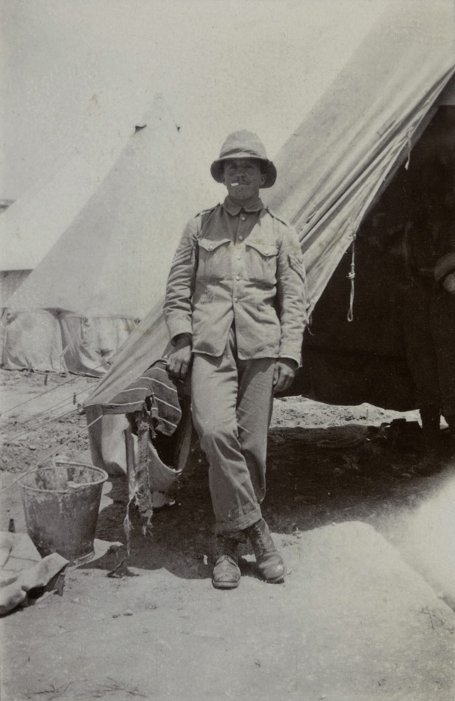
Notes:
Archibald Favell poses with a cigarette outside a tent, in Malta, 1915
NAM. 1995-04-27-26
General notes:
By this time, Archie has been promoted to sergeant, and has adopted a moustache. He has swapped his woollen serge uniform for a lighter cotton version, which would have been more suitable for the heat.
After training on Malta, Archie’s unit landed at Gallipoli on 25 April 1915, although he did not arrive until several months later with a draft of reinforcements. The fusiliers spent nearly seven months there, before stopping again in Alexandria, Egypt, for over a month. Archie’s pose looks very relaxed – perhaps he is becoming more accustomed to the life there, and the military routine – his diary also records this increasing ‘easiness’ – but a constant refrain is how much he misses Lily.
Questions you might ask:
What is different about Archie’s uniform in this picture?
Why do you think this change has been made?
What else do you notice about Archie’s pose/body language/general state of dress?
What is the purpose of training for soldiers? Why would the Army have chosen to run training in countries other than the UK?

Slide 7
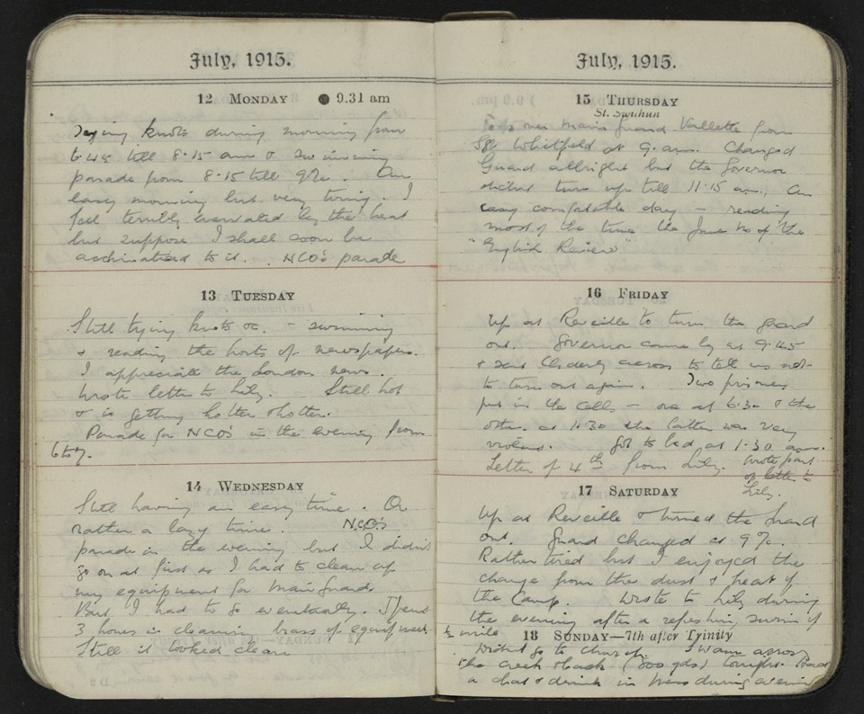
Notes:
Pages from Archibald Favell’s diary
NAM. 1984-08-60-1
Transcript:
July 1915
12 Monday
Tying knots during morning from [illegible] till 8.15am & [3 words illegible] parade from 8.15 till 9.00. An easy morning but very tiring. I feel terribly enervated by the heat but suppose I shall soon be acclimatised [sic] to it. NCOs parade.
13 Tuesday
Still tying knots – swimming and reading the hosts of newspapers. I appreciate the London news. Wrote letter to Lily. Still hot and is getting hotter and hotter. Parade for NCOs in the evening from 6 to 7.
14 Wednesday
Still having an easy time. Or rather a lazy time. NCOs parade in the evening but I didn’t go on at first as I had to clean up my equipment for main [illegible]. But I had to go eventually. I spent 3 hours in cleaning brass of equipment till it looked clean.
15 Thursday
[Three words illegible] Vallette from Sgt Whitfield at 9am. Changed guard allright but the Governor didn’t turn up till 11.15am. An easy comfortable day – reading most of the time the June no [number] of the “English Review”.
16 Friday
Up at Reveille to turn the guard out. Governor came by us at 9.45 and sent [name illegible] to tell us not to turn out again. Two prisoners put in the cells - one at 6.30 and the other at 1.30 the latter was very violent. Got to bed at 1.30 am. Letter of 4th from Lily. Another parcel of letters from Lily.
17 Saturday
Up at Reveille and turned the guard out. Guard changed at 9.00. Rather tired but I enjoyed the change from the dust and heat of the camp. Wrote to Lily during the evening after a refreshing swim of ½ mile.
18 Sunday
Will and I go to church. Swam across the arch[?] [illegible] (800 yards) tonight. Had a chat and drink in Mess during evening[?].

Slide 8
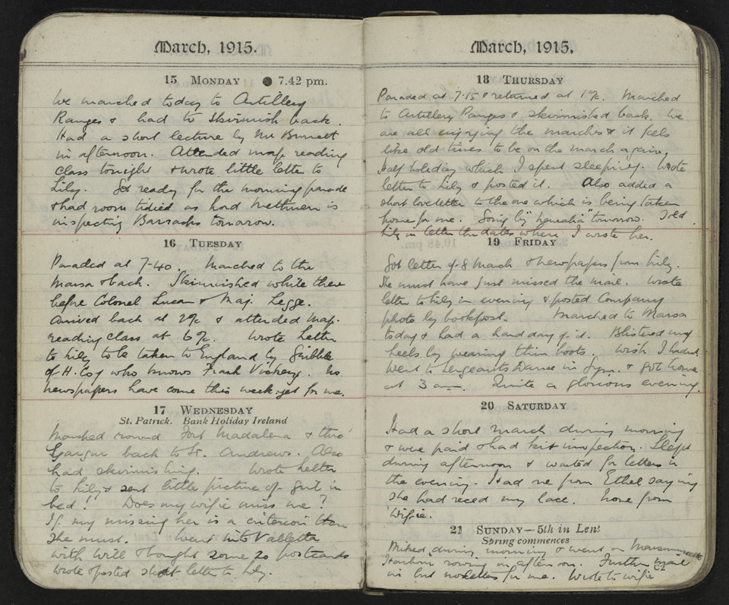
Notes:
Pages form Archibald Favell’s diary
NAM. 1984-08-60-1
Transcript:
March 1915
15 Monday
We marched today to Artillery Ranges and had to skirmish back. Had a short lecture by Mr Bennett in afternoon. Attended map reading class tonight and wrote little letter to Lily. Got ready for the morning parade and had room tidied as Lord Methuen is inspecting Barracks tomorrow.
16 Tuesday
Paraded at 7.40. Marched to the [illegible] and back. Skirmished while there before Colonel Lucan and Major Legge. Arrived back at 2.00 and attended map reading class at 6.00. Wrote letter to Lily to be taken to England by Gribble of H. Coy who knows Frank Vickery. No newspapers have come this week yet for me.
17 Wednesday
Marched toward Fort Madalena and through Garrison back to St Andrews. Also had skirmishing. Wrote letter to Lily and sent little picture of girl in bed! Does my wifie miss me? If my missing her is a criterion then she must. Went into Valletta with Will and bought some 20 postcards. Wrote and posted short letter to Lily.
18 Thursday
Paraded at 7.15 and returned at 1.00. Marched to Artillery Ramps and skirmished back. We are all enjoying the marches and it feels like old times to be on the march again. Half holiday which I spent sleeping. Wrote letter to Lily and posted it. Also added a short love letter to the one which is being taken home for me. Going by [“illegible”] tomorrow. Told Lily the dates when I wrote her.
19 Friday
Got letter of 8 March and newspapers from Lily. She must have just missed the mail. Wrote letter to Lily in evening and posted Company photo by backpost[?]. Marched to Manoa[?] today and had a hard day of it. Blistered my heels by wearing thin boots. Wish I hadn’t went to Sergeants Dance in gym. Got home at 3am. Quite a glorious evening.
20 Saturday
Had a short march during morning and were paid and had kit inspection. Slept during afternoon and waited for letters in the evening. Had one from Ethel saying she had reced [received?] my lace[?] None from wifie.
21 Sunday
Miked[?] during morning and went in [illegible name] Harbour rowing in afternoon. Further mail in but no letters for me. Wrote to wifie.

Slide 9
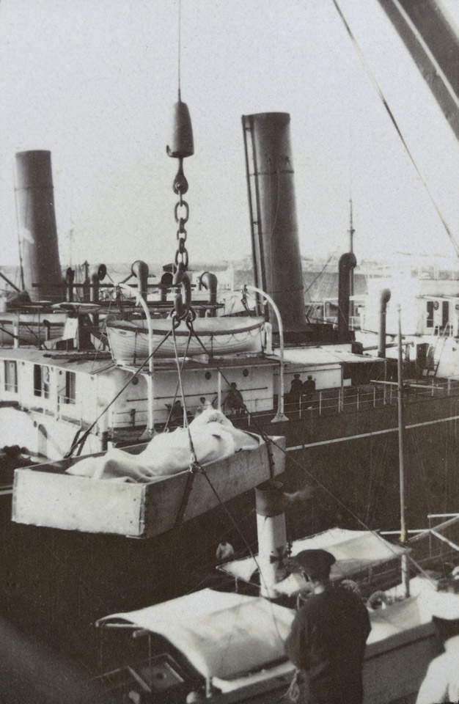
Notes:
Hospital ship in Malta, 1915
NAM. 1995-04-27-23
General notes:
The box in the foreground of the picture is actually a makeshift stretcher for offloading the injured at Malta. There may be a figure covered by a blanket in the stretcher. The large ship in the background is a hospital ship. These were often converted from smaller cruise ships.
Questions you might ask:
Why were hospital ships using Malta for offloading patients?
What might have been the effect on the morale of the training soldiers to have patients offloaded nearby?

Slide 10
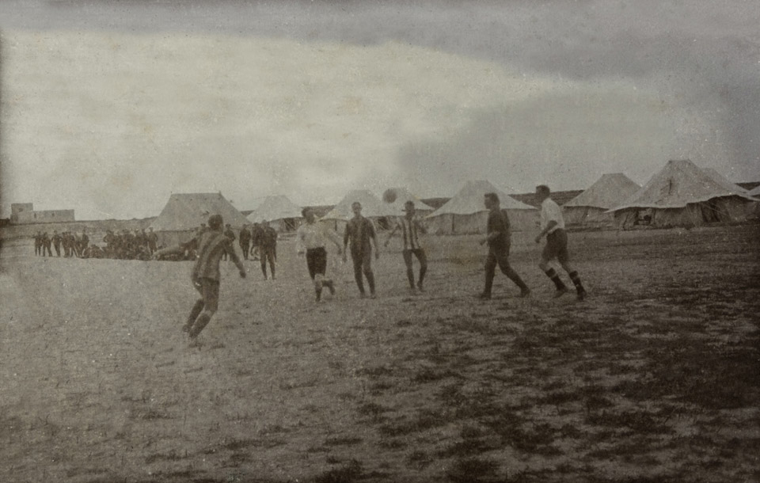
Notes:
Football at Malta, 1915
NAM. 1995-04-27-24
General notes:
Effort was made to keep the troops fit and disciplined. Team sports like football would have assisted with these aims, while also ensuring that men’s spirits were kept up.
Questions you might ask:
What are some of the soldiers playing?
What are the rest of the soldiers doing?
What is the point of playing football or other games when training for war?

Slide 11
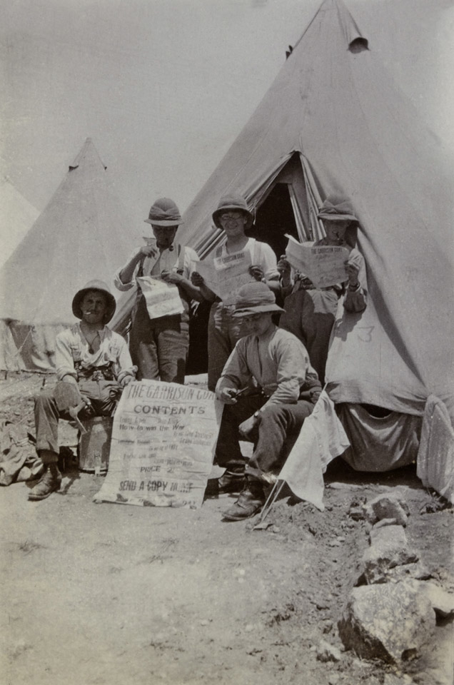
Notes:
Reading the latest war news, 1915
NAM. 1995-04-27-33
General notes:
Archie writes in his diary about Lily sending him the papers from London. He relishes the time he has to read them, even though by the time he received the papers they are usually a couple of weeks late. However, this group shot shows the men reading a paper called ‘The Garrison Goat’. With headlines like ‘How to win the war’ and an instruction to ‘send a copy home’, it seems likely that this paper was produced by soldiers for soldiers (possibly outside of official channels), and could have contained humorous and spoof articles and advertisements, intended to boost troop morale. A more well-known publication of this type was the ‘Wipers Times’, which was produced for a short time in the Ypres Salient.
Questions you might ask:
Why were newspapers (even out-of-date ones) so valuable to soldiers like Archie?
Why would soldiers have gone to the effort of producing their own newspapers?
Can you think of publications today which satirise or mock current events?
Do you think humour is an acceptable way to deal with difficult times or events? Why do you think soldiers might think it acceptable/necessary to laugh at their situation?

Slide 12
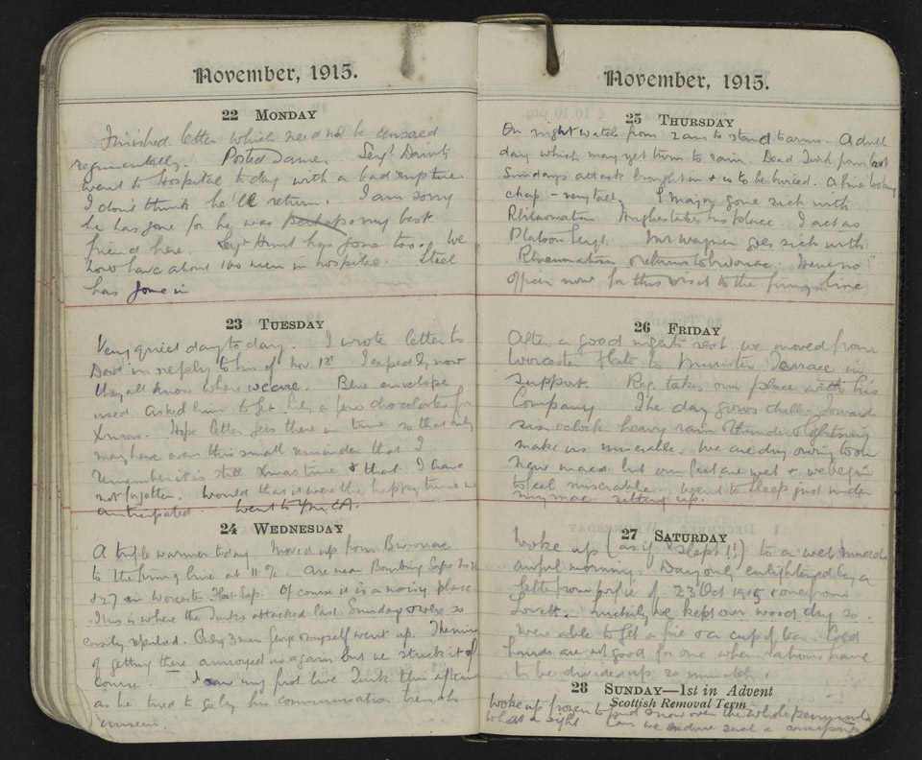
Notes:
Pages from Archibald Favell’s diary
NAM. 1984-08-60-1
Transcript:
November 1915
22 Monday
Finished letter which need not be censored significantly. Posted same. Sergeant Dainty went to hospital today with a bad rupture. I don’t think he’ll return. I am sorry he has gone for he was perhaps my best friend here. Sergeant Hunt has gone too. We now have about 100 men in hospital. Steel has gone in.
23 Tuesday
Very quiet day today. I wrote letter to Dad in reply to his of Nov 12th. I expect by now they all know where we are. Blue envelope used. Asked him to get Lily a few chocolates for Xmas. Hope letter gets there in time so that they may have even this small reminder that I remember it is Xmas time and that I have not forgotten. Would that it were the happy time anticipated. Went to YMCA [Young Men’s Christian Association].
24 Wednesday
A trifle warmer today. Moved up from bivouac to the firing line at 11.00. Are near Bombing Saps No 26 and 27 in Worcester Flat Sap. Of course it is a noisy place. This is where the Turks attacked last Sunday and were so easily repulsed. Only 3 men, Sergeant and myself went up. The means of getting there annoyed us again but we stuck it of course. I saw my first live Turk this afternoon as he tried to [illegible] his communication trench unseen.
25 Thursday
On night watch from 2 am to stand to arms. A dull day which may yet turn to rain. Dead Turk from last Sunday’s attack brought in to be buried. A fine looking chap – very tall. S Major got sick with rheumatism. Hughes takes his place. I act as Platoon Sergeant. Mr Wagner goes sick with rheumatism, returns to bivouac. Have no officer now for this visit to the firing line.
26 Friday
After a good night’s rest we moved from Worcester Flats to Munster Terrace in support. Reg takes our place with his Company. The day grows chill. Towards six o’clock heavy rain and thunder and lightning make us miserable. We are dry owing to our new macs but our feet are wet and we begin to feel miserable. Went to sleep just under my mac, sitting up.
27 Saturday
Woke up (as if I slept!!) to a wet muddy awful morning. Day only enlightened by a letter from wifie of 23 October 1915 and one from Lovell. Luckily we kept our wood dry so were able to get a fire and a cup of tea. Cold hands are not good for one when rations have to be divided up so minutely.
28 Sunday
Woke up frozen to find snow over the whole peninsula. What a sight. Can we endure such a [illegible]…
Questions you might ask:
Why is Archie upset by Sgt Dainty’s illness?
Why were letters censored?
Why do you think so many soldiers were in hospital?
Why do you think Archie was not able to tell his family where he was going? (How would they find out instead?)
What might Archie have expected this Christmas would be like when he first joined? (Look back at the recruitment poster, and the claim it made.)
What does Archie mean by ‘noisy place’?
Are you surprised by his reference to the enemy?
Why do you think letters from home are so important to Archie?

Slide 13
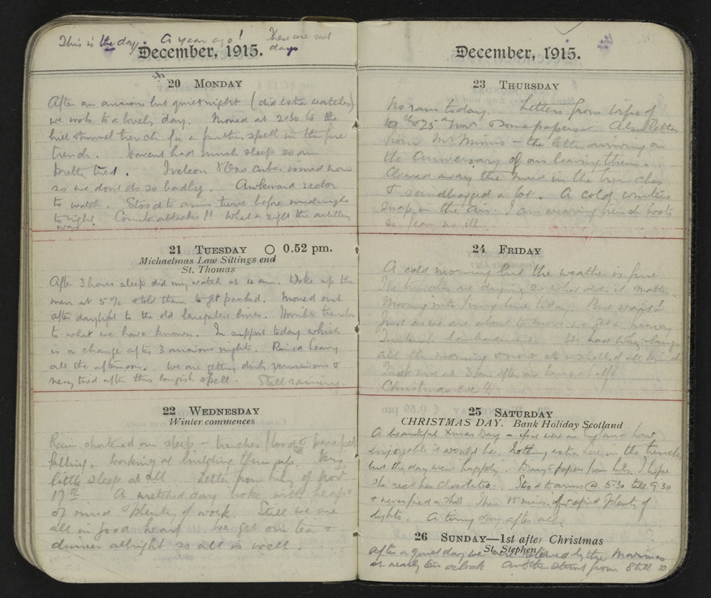
Notes:
Pages from Archibald Favell’s diary
NAM. 1984-08-60-1
Transcript:
This is the day. A year ago! These are sad days.
December 1915
20 Monday
After an anxious but quiet night (did extra watches) we woke to a lovely day. Moved at 2.30 to the hill and tunnel trench for a further spell in the fire trench. Haven’t had much sleep so am pretty tired. … and Oxo cubes issued now so we don’t do so badly. Awkward sector to watch. Stood to arms twice before midnight tonight. Counter attacks!! What a sight the artillery was.
21 Tuesday
After 3 hours sleep did my watch at 4am. Woke up the men at 5.00 and told them to get packed. Moved out after daylight to the old Lancaster lines. Horrible trench to what we have known. In support today which is a change after three anxious nights. Rained heavy all the afternoon. We are getting dirty, verminous and very tired after this longish spell. Still raining.
22 Wednesday
Rain shattered our sleep – trenches flooded and parapets falling, working at building them up. Letter from Lily of Nov 17th. A wretched day broke with heaps of mud and plenty of work. Still we are all in good heart. We get our tea and dinner alright so all is well.
23 Thursday
No rain today. Letters from wifie of 10th and 25th Nov and some papers. Also letter from Mrs Missus [his mother-in-law?]– the letter arriving on the anniversary of our leaving them. Cleaned away the mud in the trenches and sandbagged a lot. A cold winter’s snap in the air. I am wearing trench boots so fear no ill.
24 Friday
A cold morning but the weather is fine. The trenches are drying so what does it matter. Moving into firing line today. But wait! Just as we are about to move we get a heavy Turkish bombardment. We had whizz-bangs all the morning and now its shells of all kinds. Quiet now at 3pm after an hour and a half!! Christmas eve!!
25 Saturday Christmas Day
A beautiful Xmas day – if it were in England how enjoyable it would be. Nothing extra here in the trenches but the day went “happily”. Diary and papers from Lily. I hope she recd [received?] her chocolates. Stood to arms at 5.30 till 9.30 and never fired a shot. Then 15 mins of rapid, and plenty of lights. A tiring day after all.
26 Sunday – 1st after Christmas
After a quiet day we are relieved by the [5 words illegible] and the [illegible] from 8 till 10.
General notes:
‘The day’ Archie is referring to is his wedding day, so he is celebrating his first wedding anniversary in the trenches.
‘Stood to arms’, refers to the order to ‘Stand to arms’ or ‘stand to’ for short. Each man would be expected to stand on the trench fire step, rifle loaded, bayonet fixed. The theory ran that most enemy attacks were mounted either before dawn or shortly after dusk under cover of darkness. Consequently both sides took care to ensure adequate preparation at such times, manning the fire step an hour before dawn and dusk.
Questions you might ask:
What is ‘the day’ a year ago that Archie refers to?
What happens on Christmas Eve, and what is Archie’s reaction to it?
What makes the trenches here worse to those they have previously occupied?
Why might Archie be so interested in recording the weather?
What does it mean when Archie says they ‘stood to arms’? Why were they asked to do this first thing in the morning?
What would be your response if nothing actually happened? Since attacks actually were uncommon, why is the routine maintained? What is the alternative?

Slide 14
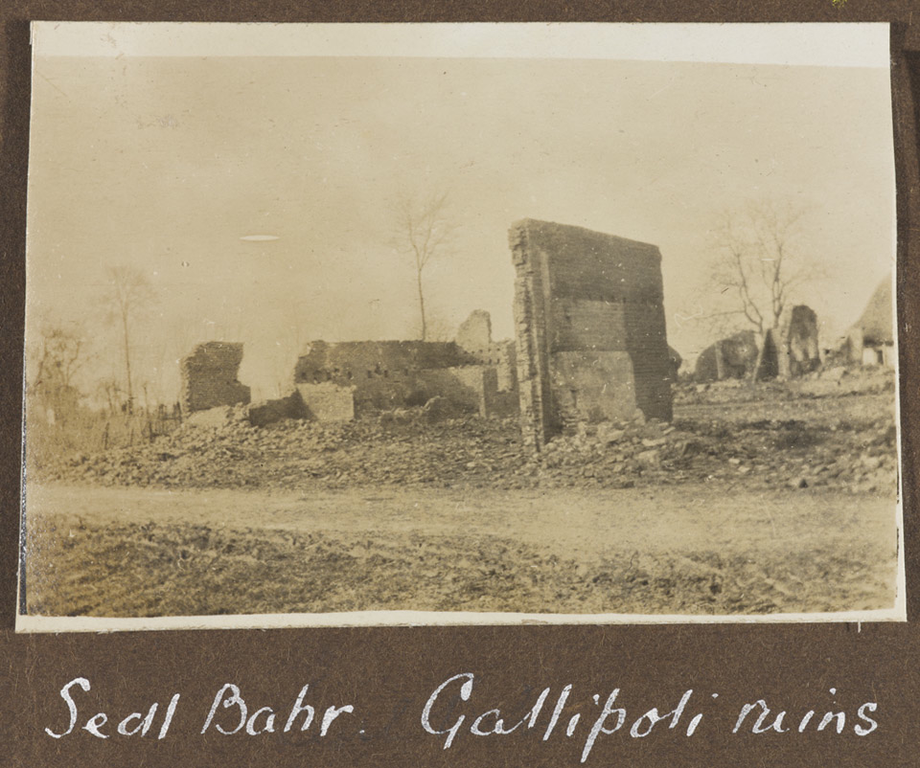
Notes:
Sedd el Bahr fortress, Gallipoli, 1915
NAM. 1995-04-27-7
General notes:
This photograph shows the damage caused by artillery in the Cape Helles area.
Questions you might ask:
What kind of weapons would cause this damage?
What would it be like to be under this kind of fire?
What could the soldiers do to protect themselves?

Slide 15
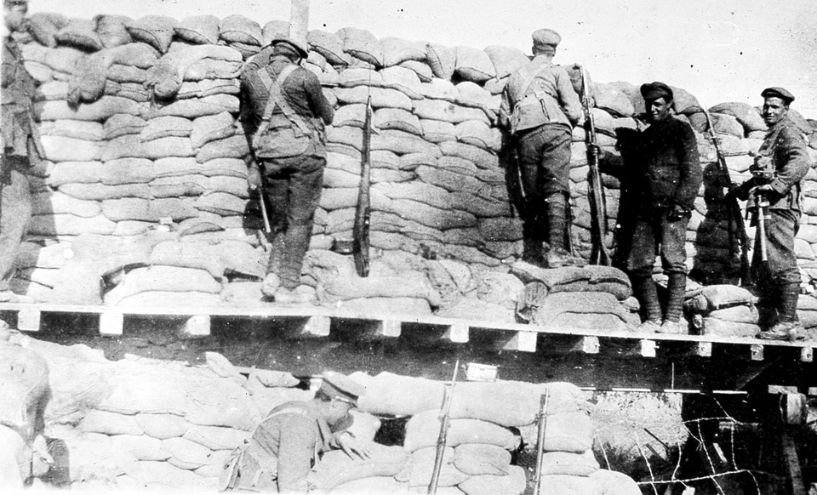
Notes:
Fortifications built at Gallipoli, 1915
NAM. 1995-04-27-27
General notes:
The Gallipoli peninsula (in modern-day Turkey) is an exposed area of land with little vegetation, and sandy soil. The Turkish troops who held the land had significantly higher ground than the Allies, so the invading troops built large defences from locally available materials – sand was plentiful. Because of the exposed nature of the terrain and the basic defences many men became very ill in the bitterly cold winter. Archie himself suffered from exposure, as revealed on his medical record after the war.
Questions you might ask:
What are the walls made of?
What is the purpose of the sandbags?
Why are so many sandbags required?

Slide 16
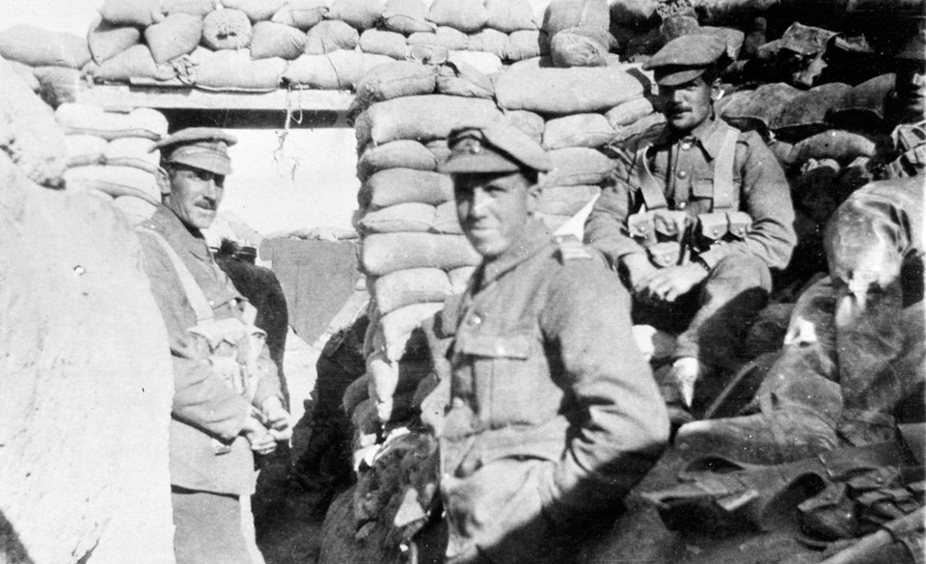
Notes:
In the trenches, 1915
NAM. 1995-04-27-5
General notes:
Archie Favell (centre of picture) with some of his fellow soldiers. You can see part of the sandy terrain to the left of the picture, while two of the soldiers seem to be sitting on a fire step constructed from sandbags.

Slide 17
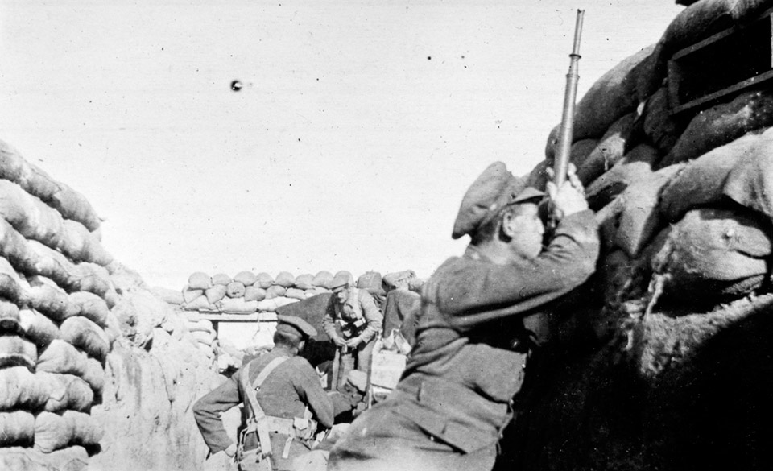
Notes:
A soldier uses a trench periscope, 1915
NAM. 1995-04-27-2
General notes:
Archie Favell took this photo of a soldier using a trench periscope. This allowed soldiers to make observations of enemy troop movements without putting their heads above the parapet. Archie also wrote in his diary about using a periscopic rifle. This was a modified rifle which enabled the shooter to take aim and fire, again without putting their head above the parapet. It was not standard issue.

Slide 18
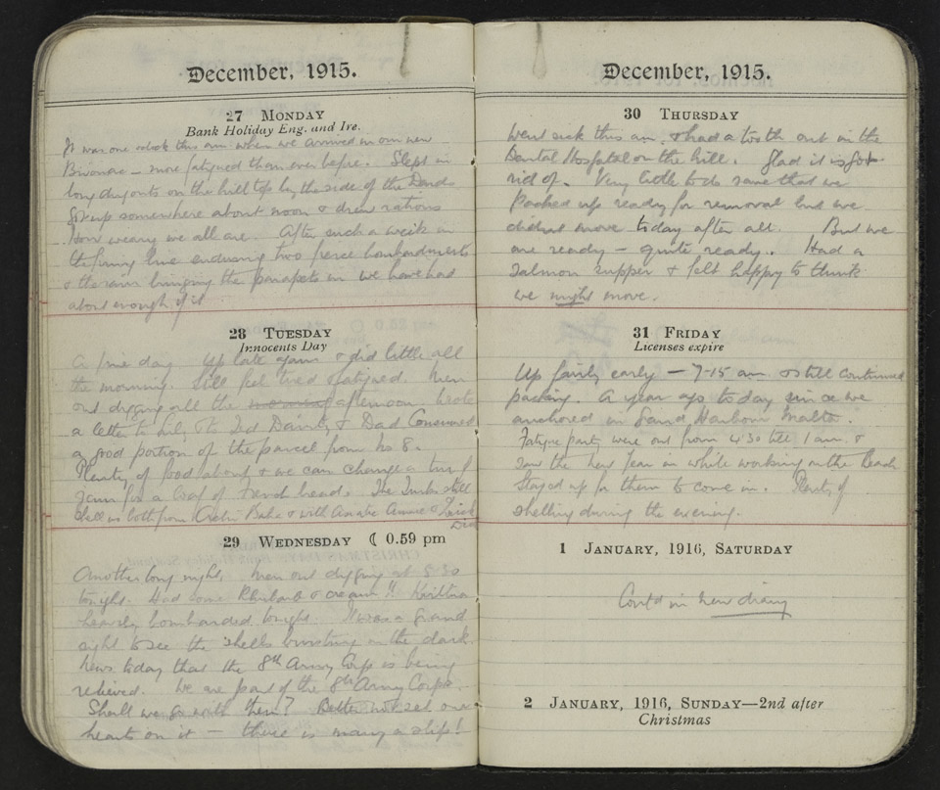
Notes:
Pages from Archibald Favell’s diary
NAM. 1984-08-60-1
Transcript:
December 1915
27 Monday
It was one o’clock this am when we arrived in our new bivouac – more fatigued than ever before. Slept in long dugouts on the hill top by the side of the Dards. Got up somewhere about noon and drew rations. How weary we all are. After such a week in the firing line enduring two fierce bombardments and the rain bringing the parapets in we have had about enough of it.
28 Tuesday
A fine day. Up late again and did little all the morning. Still feel tired and fatigued. Men out digging all the afternoon. Wrote a letter to Lily and to Ted Dainty and Dad. Consumed a good portion of the parcel from No 8. Plenty of food about and we can change a tin of jam for a loaf of fresh bread. The Turks still shell us both from Achi Bala and with [4 words illegible]
29 Wednesday
Another long night. Men out digging at 5.30 tonight. Had some rhubarb and cream!! Krithia heavily bombarded tonight. It was a grand sight to see the shells bursting in the dark. News today that the 8th Army Corps is being relieved. We are part of the 8th Army Corps. Shall we go with them? Better not set our hearts on it – there is many a slip!
30 Thursday
Went sick this am and had a tooth out in the Dental Hospital on the hill. Glad it is got rid of. Very little to do save that we packed up ready for removal but we didn’t move today after all. But we are ready – quite ready. Had a salmon supper and felt happy to think we might move.
31 Friday
Up fairly early – 7.15 am and still continued packing. A year ago today since we anchored on Grand Harbour Malta. Fatigue party were out from 4.30 till 1 am and saw the new year in while working on the beach. Stayed up for them to come in. Plenty of shelling during the evening.
1 January
Cont^{d} in new diary.
General notes:
Sadly Archie’s next diaries are not in the NAM Collection. However, we know that Archie’s service continued after the evacuation from the Gallipoli peninsula.
Eventually he ended up serving in France in 1917. You can work out a little of what happened to him there by reading the following slides.

Slide 19
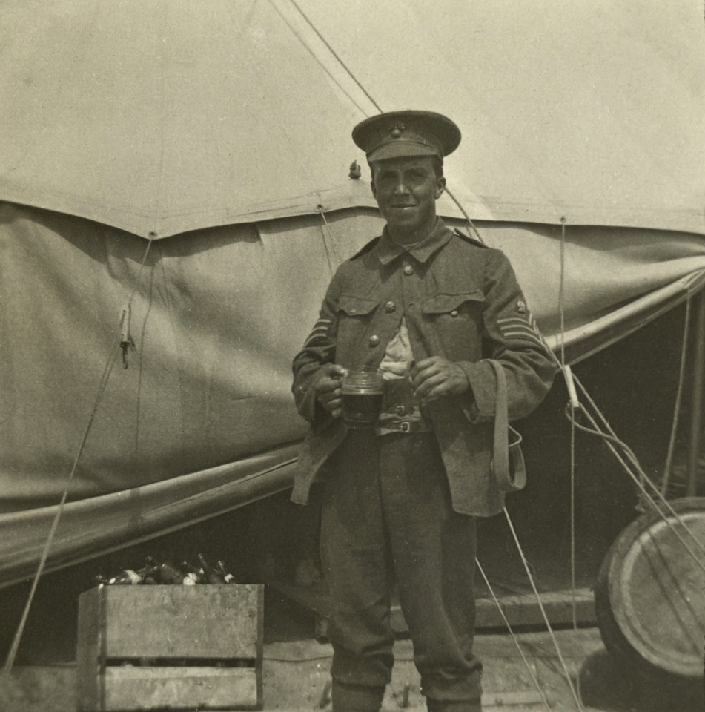
Notes:
Sergeant Archie Favell stands outside a tent, which possibly contains some of the supplies for which he was now responsible
NAM. 1995-04-27-64
General notes:
Favell wears the three chevrons topped with a small crown on his sleeves which mark his rank. He was then serving as Company Quarter Master Sergeant. This was the military appointment responsible for keeping and distributing supplies to his company of men. Favell had to ensure everyone was adequately supplied with food, accommodation and other supplies. It was a position of great responsibility, and Archie’s background as an accountant may have contributed to his being promoted to the role.
Questions you might ask:
What might some of the benefits of this role be?
What might be some of the challenges in this role?
Why would Archie’s background as an accountant have helped in this role?
Why is Archie dressed in this way?
What symbols on Archie’s uniform show that he is now more senior and responsible?
Why would you expect a soldier to be promoted?

Slide 20
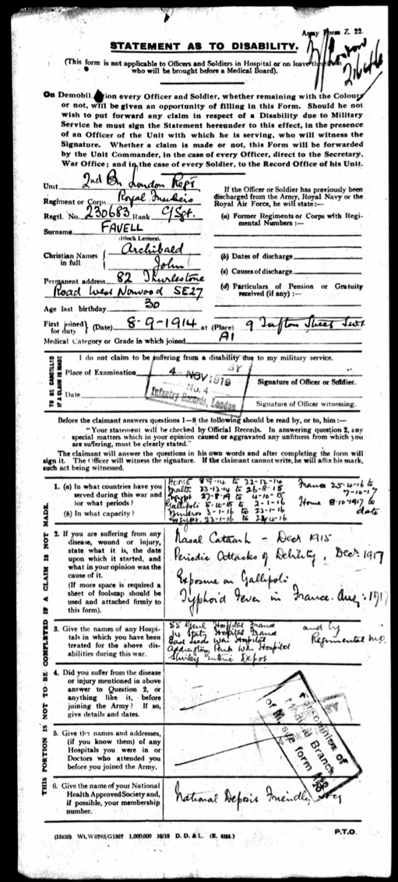
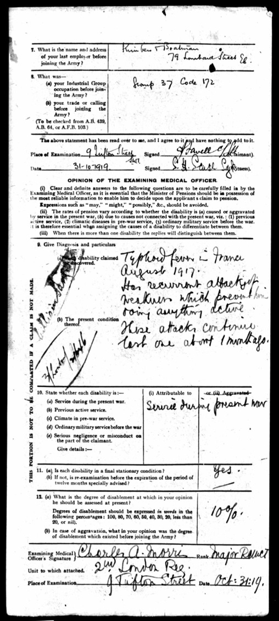
Notes:
Statement as to disability, from Archie Favell’s personal records (Ancestry.co.uk).
General notes:
On the paper on the left, Archie is asked to describe ‘any disease, wound or injury, state what it is, the date upon which it started, and what in your opinion was the cause of it’.
He writes: ‘Nasal catarrh – Dec 1915; Periodic attacks of debility – Dec 1917; Exposure on Gallipoli; Typhoid fever in France, Aug 1917’.
On the right, the examining medical officer reports his findings: ‘Typhoid fever in France August 1917. Has recurrent attacks of weakness which prevent him doing anything active. The attacks continue last one about 1 month ago. He then goes on to state that this disability is ‘Attributable to Service during present war’. He then says that the disability is a ‘final stationary condition’, and that Archie is accordingly disabled by 10 per cent of his normal function.
Questions you might ask:
How does typhoid fever affect the body?
What is the medical condition ‘exposure’?
How could these illnesses affect someone’s body long-term?
What does ‘recurrent attacks’ mean?
What do you think a 10 per cent disability means? How would it affect your life?
If Archie continued to experience these attacks for his whole life, which prevent him doing anything active, how would that affect him? How would it affect his working life? How could it affect his personal life?

Slide 21
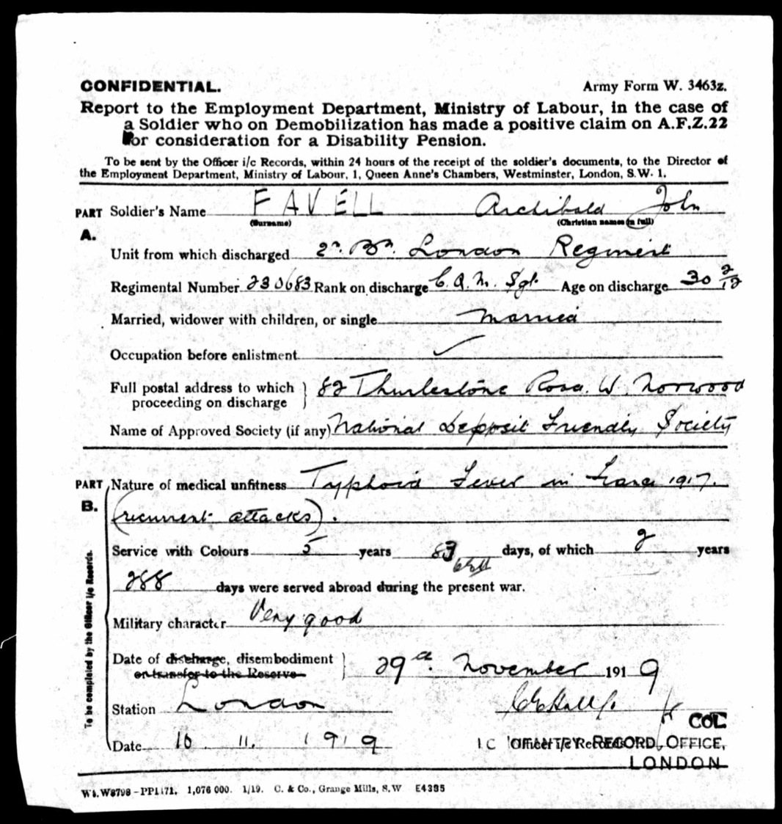
Notes:
From Archie Favell’s personal papers, (Ancestry.co.uk).
Questions you might ask:
Why do you think ‘military character’ is included on this form?
Why might having a description of Archie’s military character help the committee make a decision regarding a Disability Pension?
Is that fair? Should everyone who has been injured in service be eligible for the same pension?
How old is Archie when he is discharged?
How might this disability affect his life?

