Slide 1
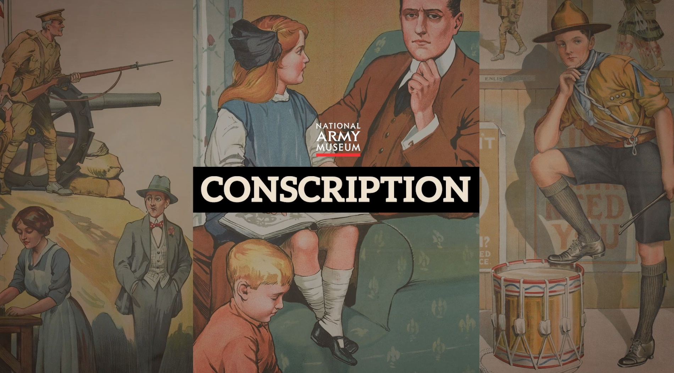
Notes:
This resource gives captioning information for the images used in the accompanying film.

Slide 2
This PowerPoint presentation contains a selection of images and archives which students can use to explore the story of conscription in the First World War and its legacy. Thge materials come from the Collection of the National Army Museum (NAM). Occasionally these are supplemented by materials from outside the NAM to provide context.
Unless otherwise stated in the notes, the images can be freely used for non-commercial purposes within the classroom. You can use the entire presentation or choose individual images for use in other non-commercial contexts. When using individual images in other contexts, please always retain the attribution statements provided in this document (e.g. NAM. 2005-08-66-1).
By downloading this document and using these images you agree to these terms of use, including your use of the attribution statement specified for each object by NAM.

Slide 3
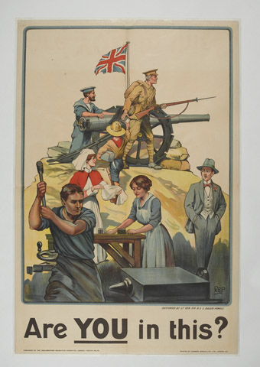
Notes:
Recruiting poster, ‘Are You in this?’, 1915
Chromolithograph after Lt Gen Sir R S S Baden-Powell, poster No 112 published by Parliamentary Recruiting Committee, printed by Johnson, Riddle and Company, London, July 1915
Talented artist, writer, former soldier, and founder of the Scout Movement, Sir Robert Baden-Powell designed this poster to remind people there were many ways in which they could contribute to the war effort. It depicts a civilian watching the patriotic activities of a sailor, a soldier, a boy scout, a nurse, and male and female munitions factory workers.
NAM. 1977-06-81-29

Slide 4
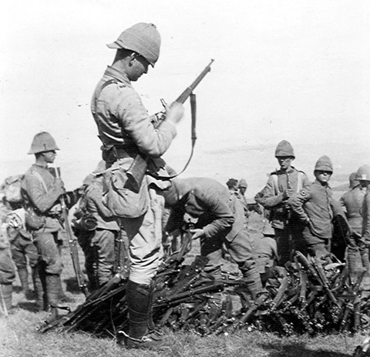
Notes:
Checking captured Boer weapons, 1900 (c).
Photograph, Boer War (1899-1902), 1900 (c).
A British soldier checks a Boer rifle before adding it to a pile of ordnance.
From an album of 64 photographs, including documents, compiled by H C Bertram, 4th Regiment Imperial Yeomanry, Boer War, 1900 (c)-1901.
NAM. 1966-10-57-44

Slide 5
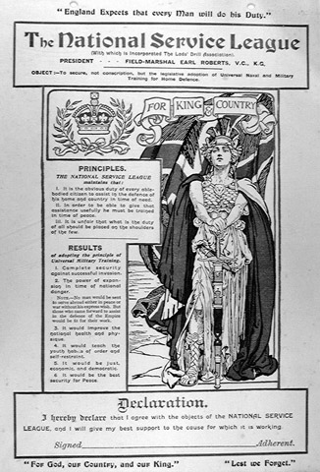
Notes:
Printed cards, two copies, nd.
Stating the aims of the National Service League. To be signed by an adherent and hung on the wall.
Both unsigned.
From a collection of printed pamphlets relating to the National Service League from 1908 (c).
NAM. 1974-07-65-8

Slide 6
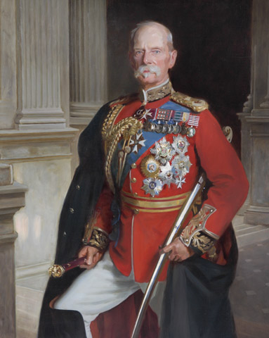
Notes:
Field Marshal Lord Roberts of Kandahar, Pretoria and Waterford VC KG KP GCB OM GCSI GCIE (1832-1914), 1904 (c).
Oil on canvas after the portrait by John Singer Sargent, 1904, in the National Portrait Gallery, by Frank Markham Skipworth (1854-1929), 1917.
Three-quarter-length, in field marshal’s full dress uniform with orders and medals, his sword under his left arm, standing in a pillared portico.
NAM. 1956-02-194

Slide 7
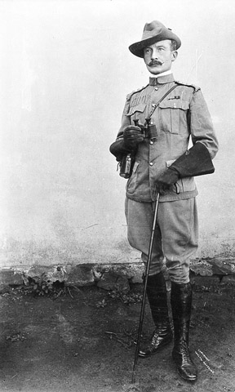
Notes:
Photograph of Col R S S Baden-Powell, full length, 1899.
Photographed by Taylor of Mafeking one Sunday during the siege.
From a group of two photographs relating to the Siege of Mafeking, 1899.
NAM. 1965-06-77-1

Slide 8
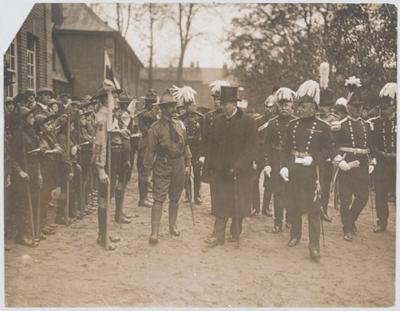
Notes:
Photograph of Viscount Haldane, Lord Warwick, inspecting boy scouts at Chelmsford, Essex, 1910.
One of eleven photographs collected by Col H Cooper CMG CBE, 1881-1912
NAM. 1970-03-30-10

Slide 9
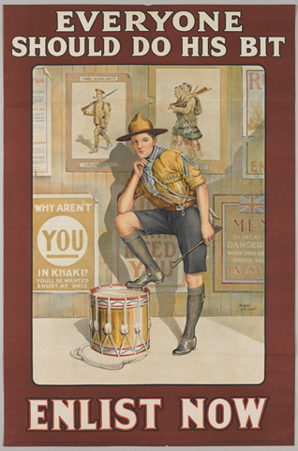
Notes:
‘Everyone Should Do His Bit Enlist Now’, 1915.
Recruiting poster after Baron Low, published by the Parliamentary Recruiting Committee, as Poster No 121, printed by Roberts and Leete, London, 1915.
Scouts and guides did indeed support the war effort in the First World War indirectly, for example by volunteering as messengers or in hospitals. But this poster appears to be aimed at scouts reaching the upper age limit of membership, 18.
NAM. 2005-11-222

Slide 10
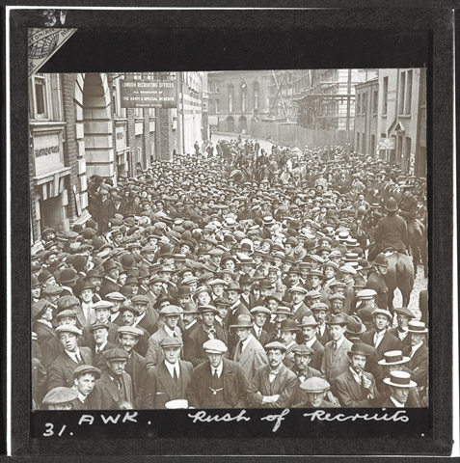
Notes:
Volunteers outside a London recruiting office, August 1914.
Although many people were shocked and fearful, on the whole the outbreak of war with Germany was greeted with popular acclaim in Britain. The public rallied around what they perceived to be a just cause. Around 30,000 men were enlisting every day by the end of August. Neither the Second World War nor more recent conflicts have generated anything like this degree of enthusiasm.
NAM. 1978-11-157-22-18

Slide 11
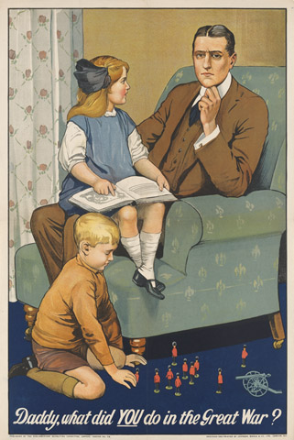
Notes:
Recruiting poster, 'Daddy, what did You do in the Great War?''.
Colour lithograph, after Savile Lumley, published by the Parliamentary Recruiting Committee March 1915, Poster No 79, designed and printed by Johnson, Riddle and Company Limited, 1915. One of a collection of 49 posters, World War One (1914-1918).
A guilt-stricken father sits in an armchair with his daughter on his knee while his son plays with toy soldiers.
NAM. 1977-06-81-16

Slide 12
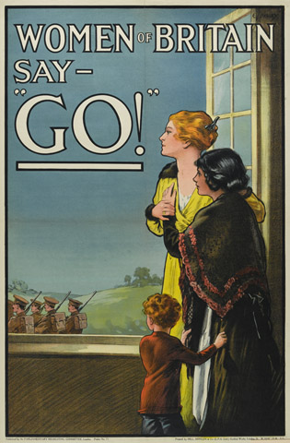
Notes:
‘Women of Britain Say - Go’.
This poster (No 75) was published by the Parliamentary Recruiting Committee, London, in March 1915. It was designed by Edgar James Kealey (1889-1977).
At face value this poster suggests that it is the duty of British women to put aside selfish reasons and encourage their menfolk to enlist. The apparently well-off young woman watching local recruits marching away is accompanied by two refugees, a boy and a girl, thereby implying a dual act of patriotism in both supporting the recruitment drive and offering her home to those escaping persecution on the Continent. But there was more to the image than this. The inclusion of refugees also hints at the implications of a German victory, a prospect made all the more alarming by the credence given by many to government endorsed atrocity propaganda regarding the treatment of civilians in occupied Belgium. With this is mind, telling your husband/brother/lover to ‘Go’ was more that just a duty, it was a matter of self-preservation.
For the eligible recruit targeted by this campaign the image of vulnerable women stoically seeing their loved ones off was also meant to elicit a sense of shame for not having joined up already. The message was reinforced by less subtle recruitment literature which openly questioned the motivation and manliness of those who chose to stay behind.
NAM. 1977-06-81-30

Slide 13
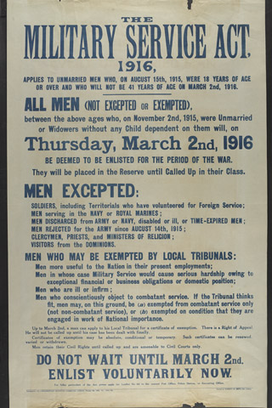
Notes:
The Military Service Act 1916.
Published by the Parliamentary Recruiting Committee, No 153.
Printed by Roberts and Leete, 1915 (c).
Associated with World War One (1914-1918).
NAM. 2014-07-32-1

Slide 14
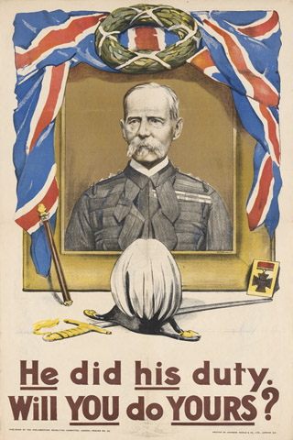
Notes:
'He did his duty. Will You do Yours?', 1914.
Chromolithograph recruiting poster, published by the Parliamentary Recruiting Committee as Poster No. 20, 1914.
Field Marshal Lord Roberts was probably Britain’s most famous soldier when the war broke out in 1914. He died of pneumonia at St Omer in France during a visit to Indian troops in November of that year. After lying in state in Westminster Hall, one of only two non-Royals to do so in the 20th century, the other being Winston Churchill, he was given a state funeral. Roberts had been a soldier for over 50 years and this poster appeals to recruits to follow his example of service and loyalty.
NAM. 1977-06-81-11

Slide 15
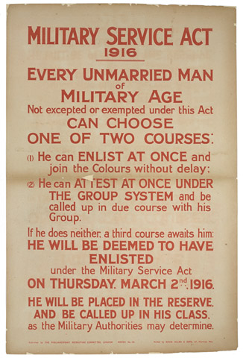
Notes:
Military Service Act 1916.
Lithographic posted published by the Parliamentary Recruiting Committee.
Printed by David Allen and Sons, nd.
Associated with World War One (1914-1918).
NAM. 2014-07-31-1

Slide 16
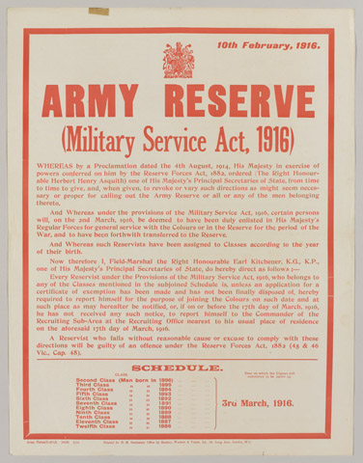
Notes:
Proclamation regarding Army Reserve (Military Service Act, 1916) Army Form D 471/1, dated 10.2.1916.
One of thirteen printed posters produced in Britain between August 1914 - March 1916.
NAM. 1977-06-80-11

Slide 17
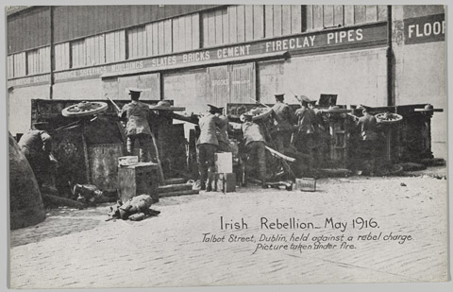
Notes:
‘Irish Rebellion, May 1916. Talbot Street, Dublin, held against a rebel charge. Picture taken under fire.’
Commercial postcard by Eason and Sons for the Daily Sketch, no date.
Associated with Ireland, Easter Rebellion (1916-1922), 1916.
NAM. 1961-12-594-15

Slide 18
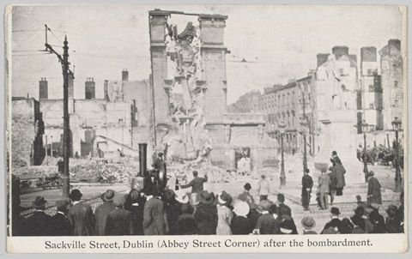
Notes:
‘Sackville Street, Dublin, (Abbey Street Corner) after the bombardment.’
Commercial postcard by Eason and Sons for the Daily Sketch, no date.
Associated with Ireland, Easter Rebellion (1916-1922), 1916.
NAM. 1961-12-594-14

Slide 19
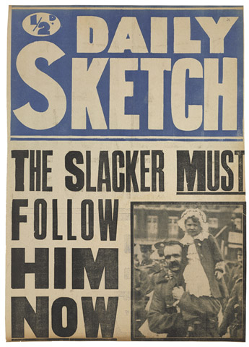
Notes:
The Daily Sketch was a British national tabloid newspaper. This news-stand poster from 1916, designed to market the newspaper, carries the headline ‘The Slacker MUST Follow Him NOW’.
NAM. 2014-07-37-1

Slide 20
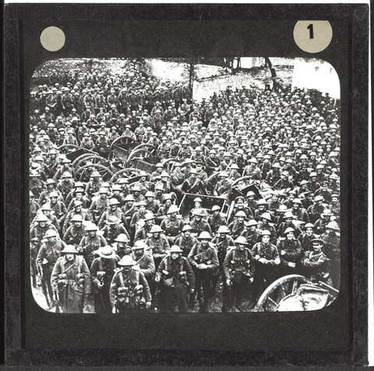
Notes:
Lantern slide from a box of 73 lantern slides, one of two boxes associated with World War One, Western Front, 1914-1916. Judging by the equipment and uniform, the photograph appears to have been taken in the latter half of 1916: if so, volunteers and conscripts may well be serving side by side, but they are indistinguishable.
NAM. 1978-11-157-24-43

Slide 21
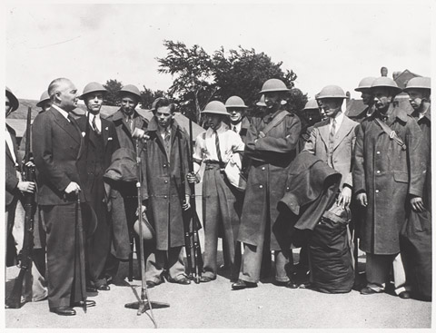
Notes:
Photograph of training in Britain, including the reception of recruits, medical examination, issue of kit, interior of barracks and physical training, weapons training, cooks and relaxing in the canteen.
One of 115 official World War Two photographs of Britain 1939-1940.
NAM. 1989-10-122-32

Slide 22
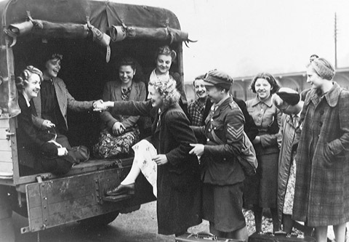
Notes:
One of 63 photographs relating to the recruiting and induction procedure for the Auxiliary Territorial Service, 1941-1942 (c).
Associated with World War Two, Home Front (1939-1945).
NAM. 1994-07-274-11

Slide 23
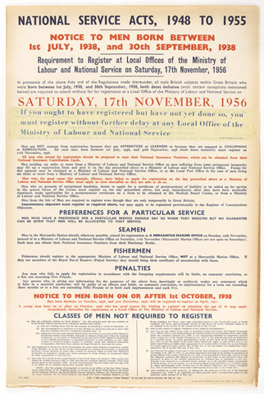
Notes:
'National Service Acts, 1948 to 1955. Notice to men born between 1 July 1938 and 30 September 1938. Requirement to register at local offices of the Ministry of Labour and National Service on Saturday 17 November 1956'.
Although Indian independence in 1947 meant that British units stationed there were now available for other duties, it actually reduced Britain’s global military capability, as it no longer had the huge Indian Army at its disposal. To solve this manpower shortage and meet the new post-war challenges the decision was made in 1947 to extend wartime conscription into an obligatory period of National Service for men of military age.
This poster includes full details of exempted categories and has a strip of paper pasted on stressing the urgency of registering, this perhaps reflects the fact that November 1956 was the month of the Suez Crisis.
NAM. 2002-09-5-1

Slide 24
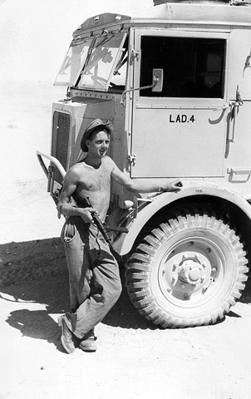
Notes:
Photograph of 74 LAD out on a desert exercise, shows Austin K5 trucks, use of camouflage, Mr Heygate and vehicle recovery, no date.
From a photograph album of photographs relating to the National Service of John Heygate with the Royal Electrical and Mechanical Engineers, 1952-1954, including service in the Canal Zone.
NAM. 2002-11-660-36

Slide 25
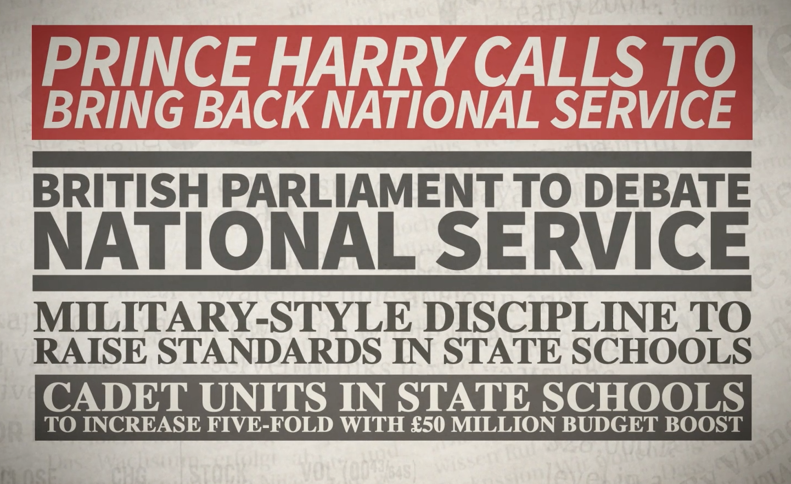
Notes:
http://www.telegraph.co.uk/news/uknews/prince-harry/11610690/Prince-Harry-calls-to-bring-back-National-Service.html
https://www.rt.com/news/national-service-uk-reinstatement-693/
http://www.telegraph.co.uk/education/educationnews/10550114/Military-style-discipline-to-raise-standards-in-state-schools.html
http://schoolsweek.co.uk/cadet-units-in-state-schools-to-increase-five-fold-with-50-million-budget-boost/

