Slide 1
Alfred Price
Notes:
General notes:
G/2914 Private Alfred Price served on the Western Front with 7th (Service) Battalion, The Buffs (East Kent Regiment), part of the British Expeditionary Force. He was wounded at the Battle of Trones Wood on the Somme on the evening of 13-14 July 1916 and died of his wounds the following day.
His family initially received a note from one of Alfred’s commanding officers written on 14 July, informing them that his wounds were not serious and that he would soon return to duty. However, after not hearing from him for seven weeks, they were eventually informed that he had actually died that day.
Price is commemorated on the Thiepval Memorial, Somme, France.

Slide 2
This PowerPoint presentation contains a selection of images and archives which students can use to explore the story of one British soldier in the First World War. In the main, the materials come from the Collection of the National Army Museum (NAM). Occasionally these are supplemented by materials from outside the NAM to provide context.
These images can be used to build up a picture of an individual soldier’s experience of service in the First World War. These images can encourage literacy and visual literacy. Suggestions for questions you might discuss with your students are included in the notes.
Unless otherwise stated in the notes, the images can be freely used for non-commercial purposes within the classroom. You can use the entire presentation or choose individual images for use in other non-commercial contexts. When using individual images in other contexts, please always retain the attribution statements provided in this document (e.g. NAM. 2005-08-66-1).
By downloading this document and using these images you agree to these terms of use, including your use of the attribution statement specified for each object by NAM.

Slide 3
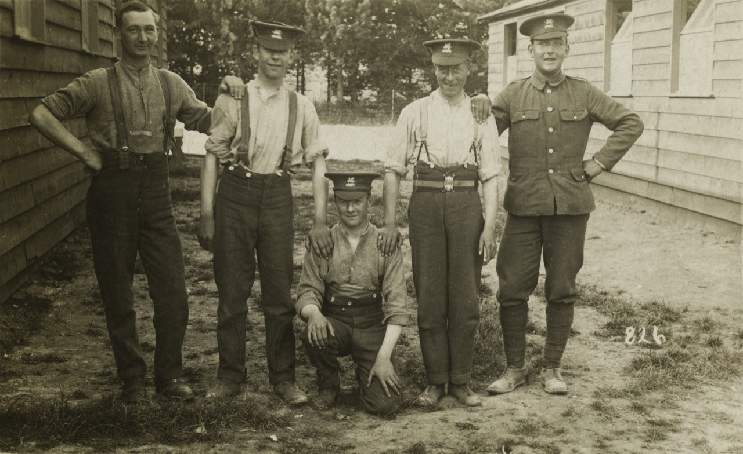
Notes:
Group photograph of five soldiers from The Buffs, c1916. Private Alfred Price is pictured second from the left.
NAM. 2001-07-344-2
General notes:
The 7th (Service) Battalion, The Buffs (East Kent Regiment) was raised at Canterbury in September 1914 as part of Kitchener's Second New Army and joined 55th Brigade of 18th (Eastern) Division. The latter initially concentrated in the Colchester area but moved to Salisbury Plain in May 1915. They proceeded to France in July and concentrated near Flesselles. In 1916 they saw action during the Somme Offensive.
The soldiers were part of Kitchener’s Army, or the New Army, so had volunteered for the duration of the war. Alfred and Private A Pegram (possibly one of the men in this picture) were part of the same unit. They were described as ‘chums’ and had volunteered together. Such community links were initially seen as a major recruitment incentive. Private A Pegram would later be expected to explain Alfred’s death to his family.

Slide 4
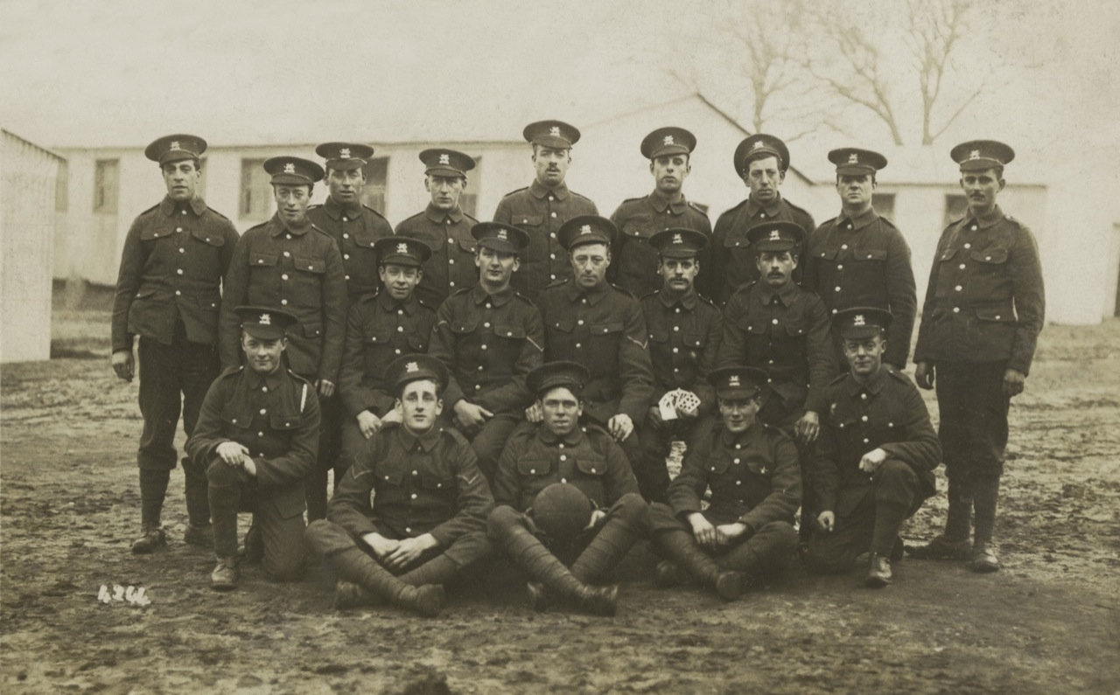
Notes:
Group photograph of soldiers from The Buffs, c1916
NAM. 2001-07-344-1
General notes:
Sometimes during training, local photographers would set up a stand on the training ground. This allowed the soldiers to purchase photographs of themselves to be turned into postcards to send home to their families and friends. The photographs were a mixture of formal and informal shots. They may have been an especially important record for those who had no prior military service, as they displayed not only the uniform, but the work and camaraderie of life as a soldier. This picture comes form Alfred’s collection.
Questions you might ask:
In this photograph can you identify Alfred Price or any of the other soldiers pictured in Slide 3?

Slide 5
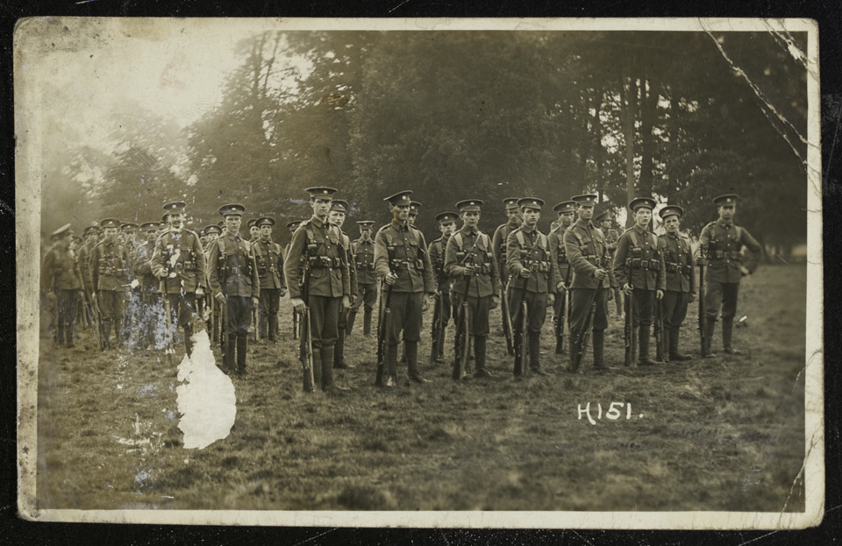
Notes:
Group photograph of men from The Buffs Regiment, c1916
NAM. 2001-07-344-3
General notes:
Training was essential to develop unit cohesion and military discipline, and prepare men to use and look after their equipment.

Slide 6
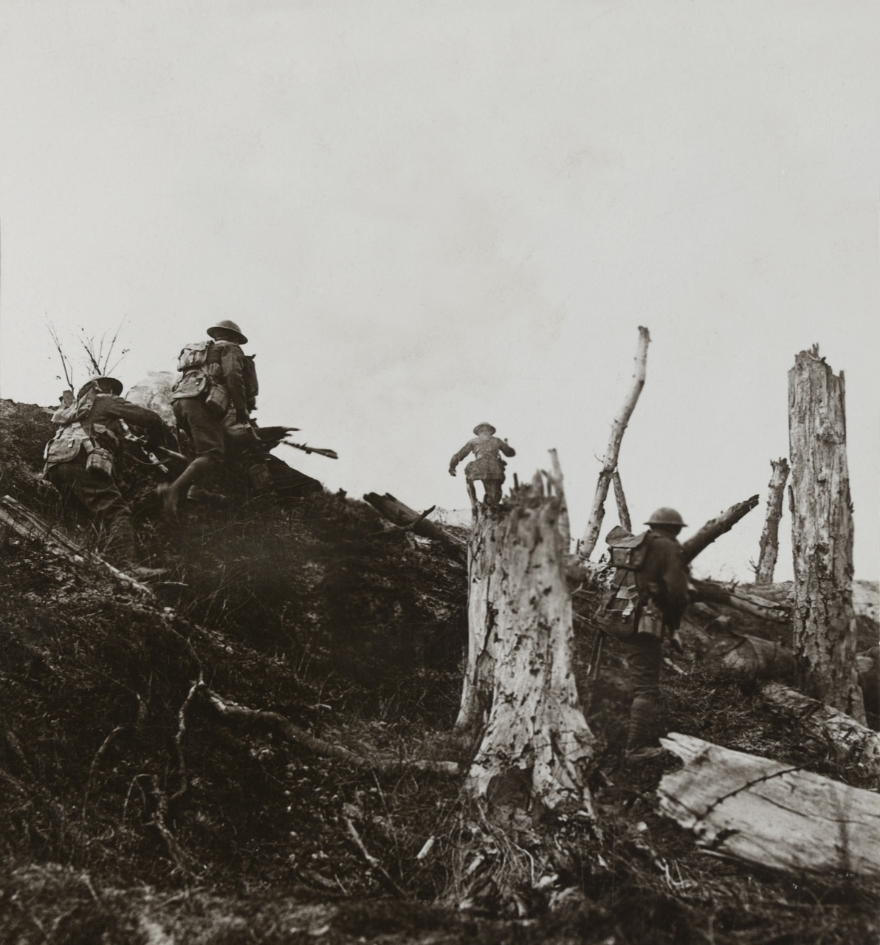
Notes:
'At dawn, in a determined rush, we carry the fortified Hun entrenchments in Trones Wood by assault’, 1916
Stereoscopic photograph
NAM. 2001-02-256-55
General notes:
The Capture of Trones Wood (8-14 July 1916) was an action fought by the British Fourth Army and the German Second Army, during the Battle of the Somme. The heavily-defended wood dominated the southern approach to Longueval and Trones Alley, a German communication trench which ran to nearby Guillemont.
The wood had dense undergrowth which restricted movement and made it difficult for the attacking troops to stay on course. During the battle the trees were brought down by shell-fire, becoming entangled with barbed-wire and strewn with German and British dead.
Like so many of the Somme battles, the fight for the wood became a slogging match with the Germans frequently mounting counter-attacks of their own. Eventually however, the 18th Division succeeded in taking it after a bloody struggle.
Questions you might ask:
What was the purpose of this action?
What difficulties did the terrain present?

Slide 7
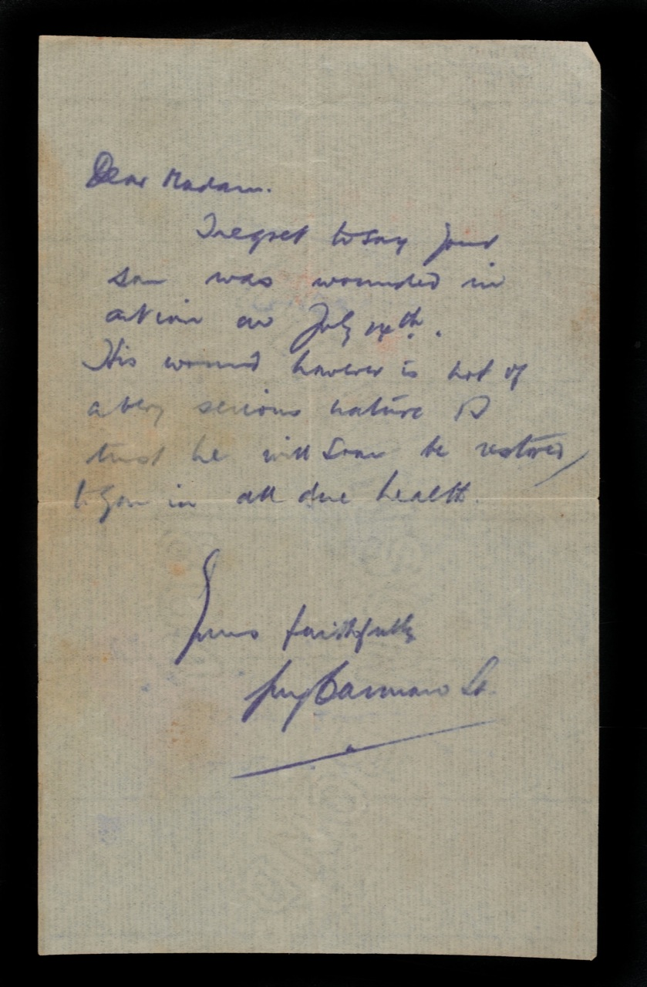
Notes:
Letter to Private Price’s mother informing her that Price was wounded on 14 July 1916, from his Platoon Commanding Officer, 1916
NAM. 2001-11-39-6
Transcript:
Dear Madam,
I regret to say your son was wounded in action on July 14th. The wound however is not of a very serious nature so I trust he will soon be restored to you in all due health.
Yours faithfully,
[Illegible]
General notes:
This was the first note that Alfred’s parents received. Written in haste, it would have been received within days. Sadly, no follow-up letters were sent for seven weeks.
Questions you might ask:
Why was this note written?
What could families do on receiving such news?
What would have been the effect of hearing nothing from their son or the authorities for seven weeks after this?

Slide 8
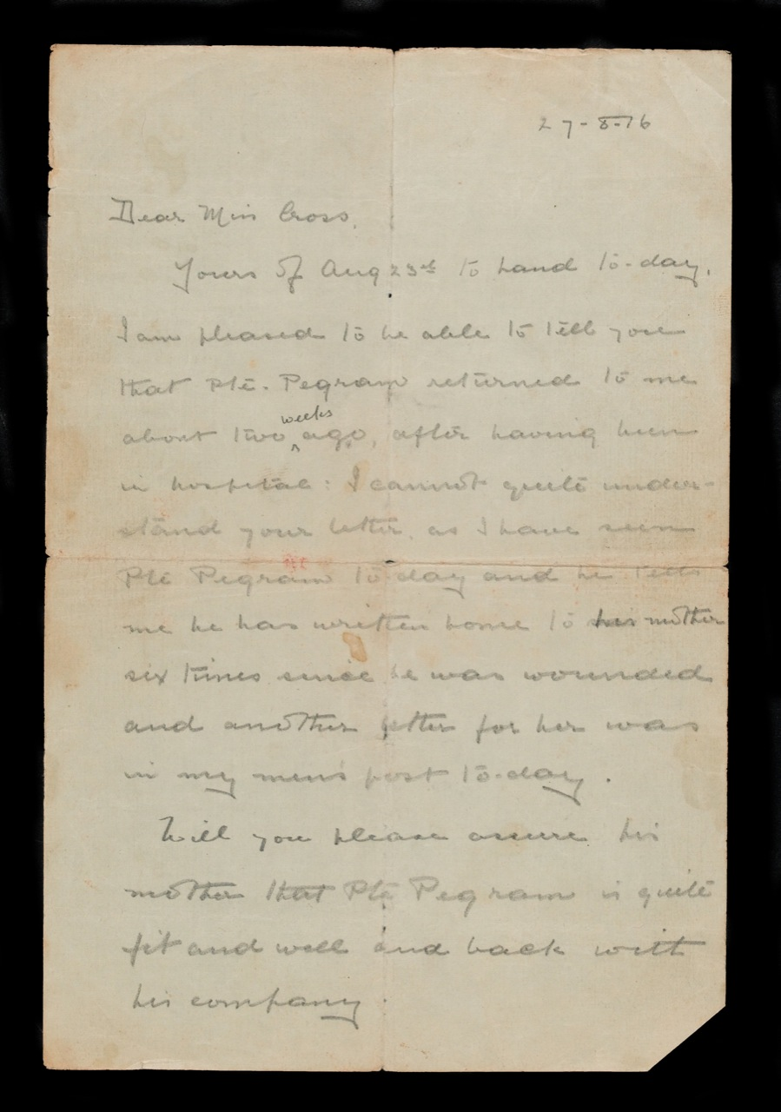
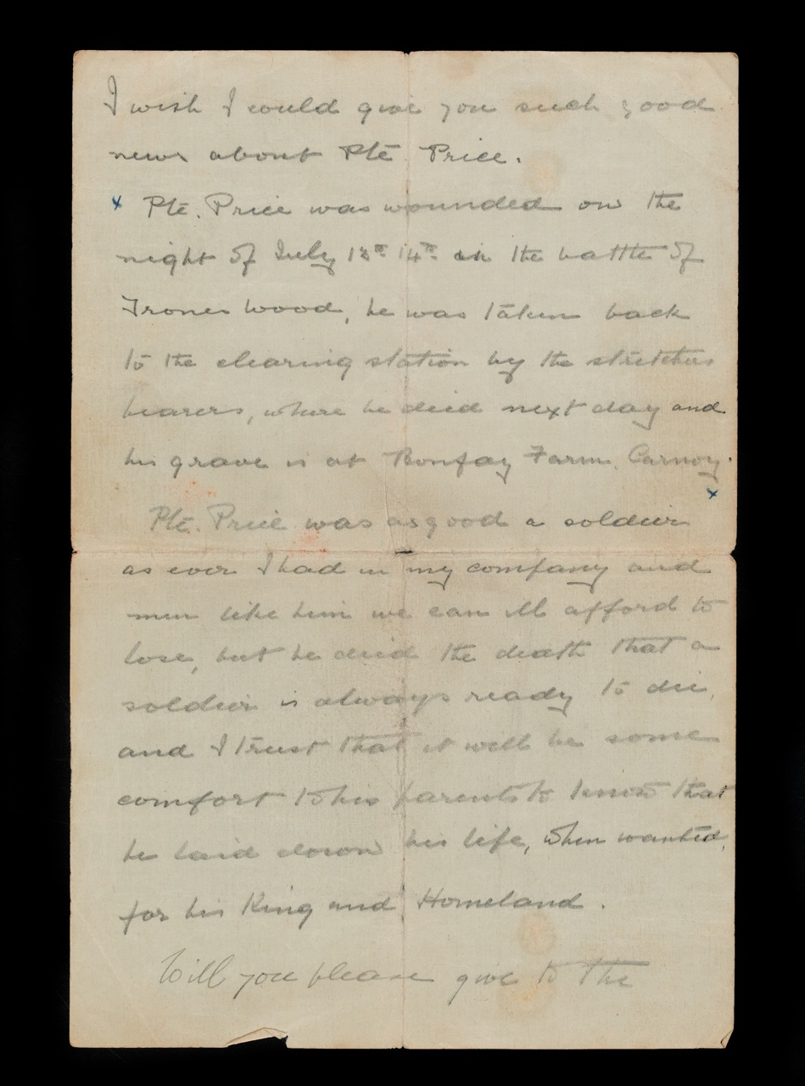
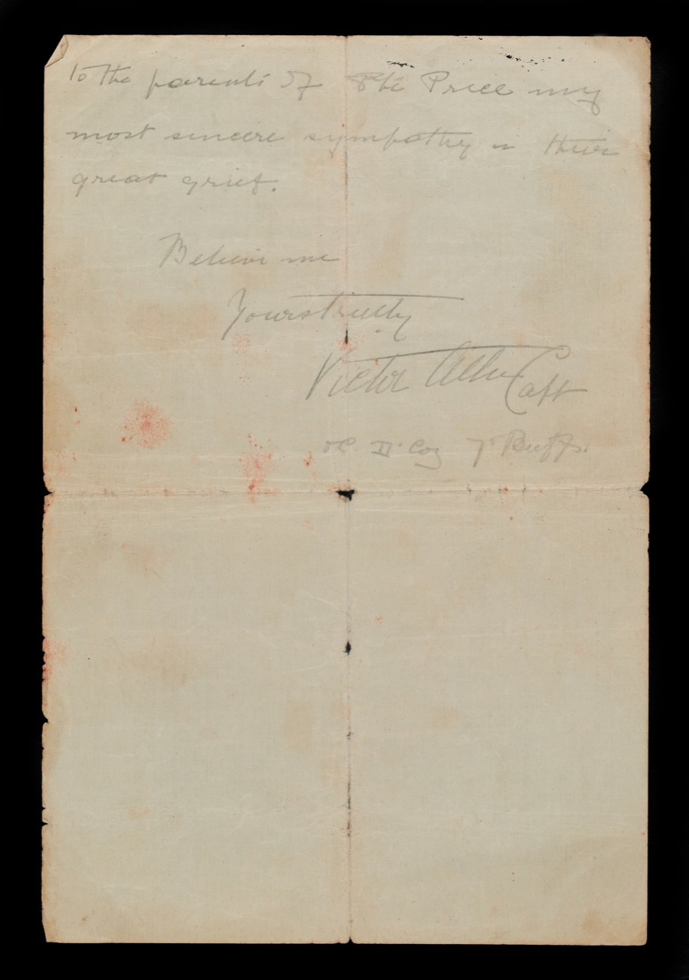
Notes:
Letter from Captain Victor Allen to Miss Cross, the daughter of Private Price’s employer, 27 August 1916
NAM. 2001-11-39-1
Transcript:
27.8.16
Dear Miss Cross,
Yours of Aug 23rd to hand today. I am pleased to be able to tell you that Pte Pegram returned to me about two weeks ago, after having been in hospital. I cannot quite understand your letter as I have seen Pte Pegram today and he tells me he has written home to his mother six times since he was wounded and another letter for her was in my men’s post today.
Will you please assure his mother that Pte Pegram is quite fit and well and back with his company.
I wish I could give you such good news about Pte Price.
Pte Price was wounded on the night of July 13th 14th in the battle of Trones Wood, he was taken back to the clearing station by the stretcher bearers, where he died next day and his grave is at Bonfary Farm, Carnoy.
Pte Price was as good a soldier as ever I had in my company and men like him we can ill afford to lose, but he died the death that a soldier is always ready to die and I trust that it will be some comfort to his parents that he laid down his life, when wanted, for his King and Homeland.
Will you please give to the parents of Pte Price my most sincere sympathy in their great grief.
Believe me
Yours truly
Victor Allen Capt
OC D Coy 7th Buffs
General notes:
The letter explains that Price was wounded on the night of 13-14 July 1916 at the Battle of Trones Wood and that he was taken by stretcher bearers to a casualty clearing station where he died the next day.
The awful experience of Alfred Price's parents was probably not an isolated incident. Being told your son was wounded only to discover he had succumbed quite quickly to his wounds would surely have been an experience of many. The correspondence between parents/next of kin and official channels shows they tried to be sensitive with information, but confusion in the initial stages meant mistakes were inevitable.
It seems that Miss Cross was asked to act as correspondent by the family. Although we cannot be sure, this implies that Alfred’s parents may have struggled with literacy, and requested the support of someone else.
Questions you might ask:
Why might this letter have been written to Miss Cross and not Alfred’s parents?
What could this imply about their education?
What impression of Alfred as a soldier does Capt Allen give? Why would he have chosen these words?

Slide 9
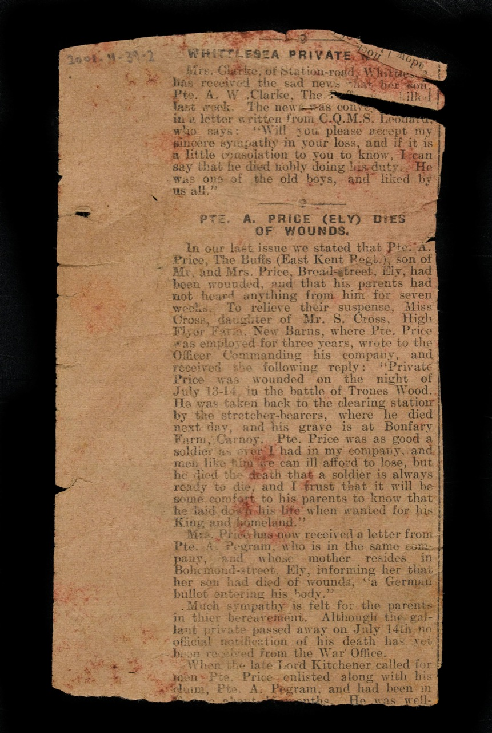
Notes:
Press cutting relating to the death of Private Price, published August or September 1916
NAM. 2001-11-39-2
Transcript:
PTE A PRICE (ELY) DIES OF WOUNDS
In our last issue we stated that Pte. A. Price, The Buffs (East Kent Regt), son of Mr and Mrs Price, Broad-street, Ely, had been wounded, and that his parents had not heard anything from him for seven weeks. To relieve their suspense Miss Cross, daughter of Mr. S. Cross, High Flyer Farm, New Barns, where Pte. Price was employed for three years, wrote to the Officer Commanding his company, and received the following reply: “Private Price was wounded on the night of July 13-14, in the battle of Trones Wood. He was taken back to the clearing station by the stretcher bearers, where he died the next day, and his grave is at Bonfary Farm, Carnoy. Pte. Price was as good a soldier as ever I had in my company, and men like him we can ill afford to lose, but he dies the death that a soldier is always ready to die, and I trust that it will be some comfort to his parents to know that he laid down his life when wanted for his King and homeland.”
Mrs. Price has now received a letter from Pte. A. Pegram, who is in the same company, and whose mother resides in Bohemond-street, Ely, informing her that her son had died of wounds, “a German bullet entering his body.”
Much sympathy is felt for the parents in their bereavement. Although the gallant private passed away on July 14th no official notification of his death has yet been received from the War Office.
When the late Lord Kitchener called for men, Pte. Price enlisted along with his chum, Pte. A. Pegram, and had been in …
General notes:
There was no recourse for a family to ask for an inquiry into an individual soldier’s death during the First World War. Correspondence could be directed to the regiment, and then the Imperial War Graves Commission, regarding the death of a loved one. However, beyond a date of death and a location, information was not that detailed.
Questions you might ask:
Do you think this was a local or national newspaper?
Why do you think the press followed up this story? Does this happen in society today?
Would families seek the assistance of the press to make sure something happened?
See slide 11 for figures of battle casualties. Does this help to explain why information may have been delayed?
What action would we expect to be taken if mistakes like this were made today?

Slide 10
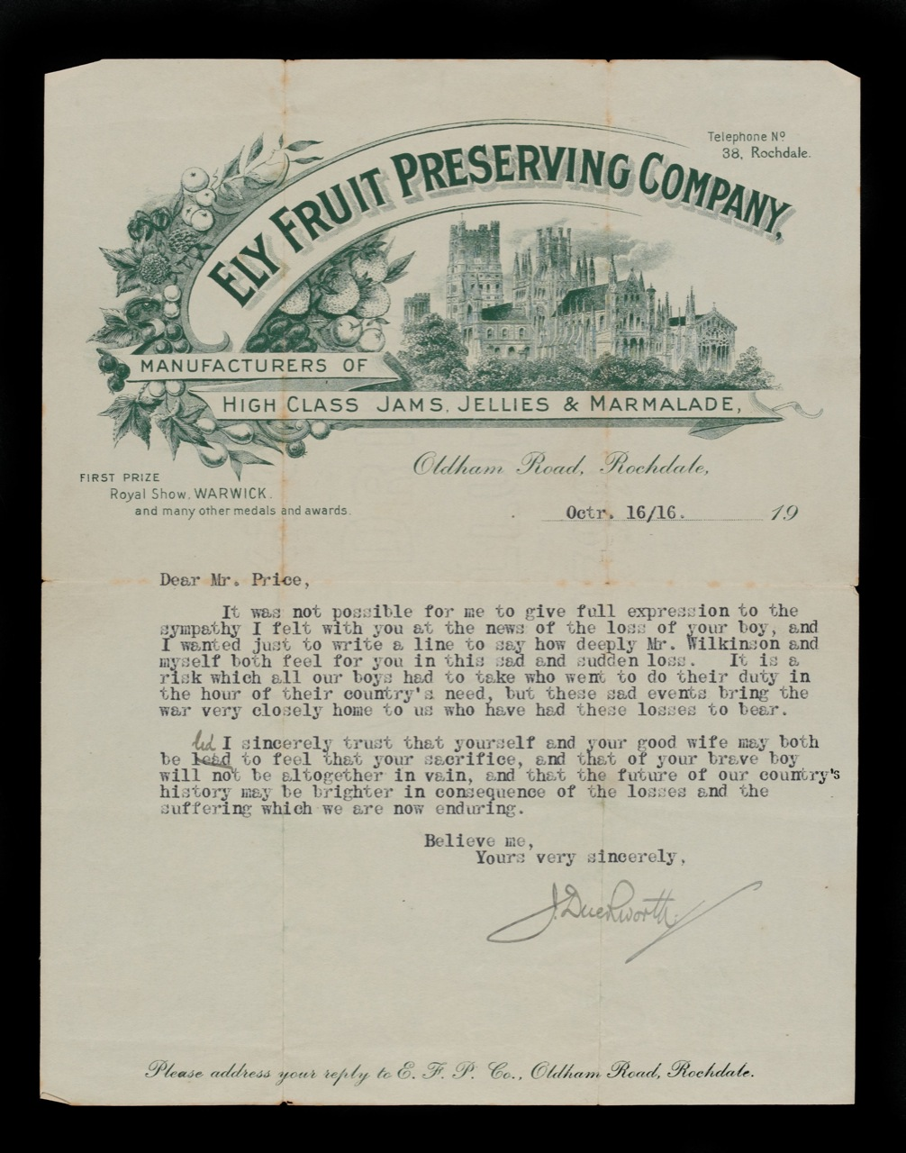
Notes:
Letter from Mr J Duckworth of the Ely Fruit Preserving Company, Oldham Road, Rochdale, Lancashire, offering his sympathy to Private Price’s father following the death of his son, 16 October 1916
NAM. 2001-11-39-3
Transcript:
Dear Mr. Price,
It was not possible for me to give full expression to the sympathy I felt with you at the news of the loss of your boy, and I wanted just to write a line to say how deeply Mr. Wilkinson and myself both feel for you in this sad and sudden loss. It is a risk which all our boys had to take who went to do their duty in the hour of their country’s need but these events bring the war very closely home to us who have had these losses to bear.
I sincerely trust that yourself and your good wife may both be led to feel that your sacrifice, and that of your brave boy will not be altogether in vain, and that the future of our country’s history may be brighter in consequence of the losses and the suffering which we are now enduring.
Believe me,
Yours very sincerely,
J. Duckworth
General notes:
It is not entirely clear who the writer is in the life of Mr and Mrs Price. However, it does give a good indication of the ways in which people supported each other at the time, and shows how some people in society felt about the inevitable loss of young men and women in the conflict.
Questions you might ask:
What words does Mr Duckworth use to describe Alfred’s service?
What does Mr Duckworth hope will be the outcome of the sacrifices of people like Alfred and his family?
Do you agree with the sentiments expressed in this letter?

Slide 11
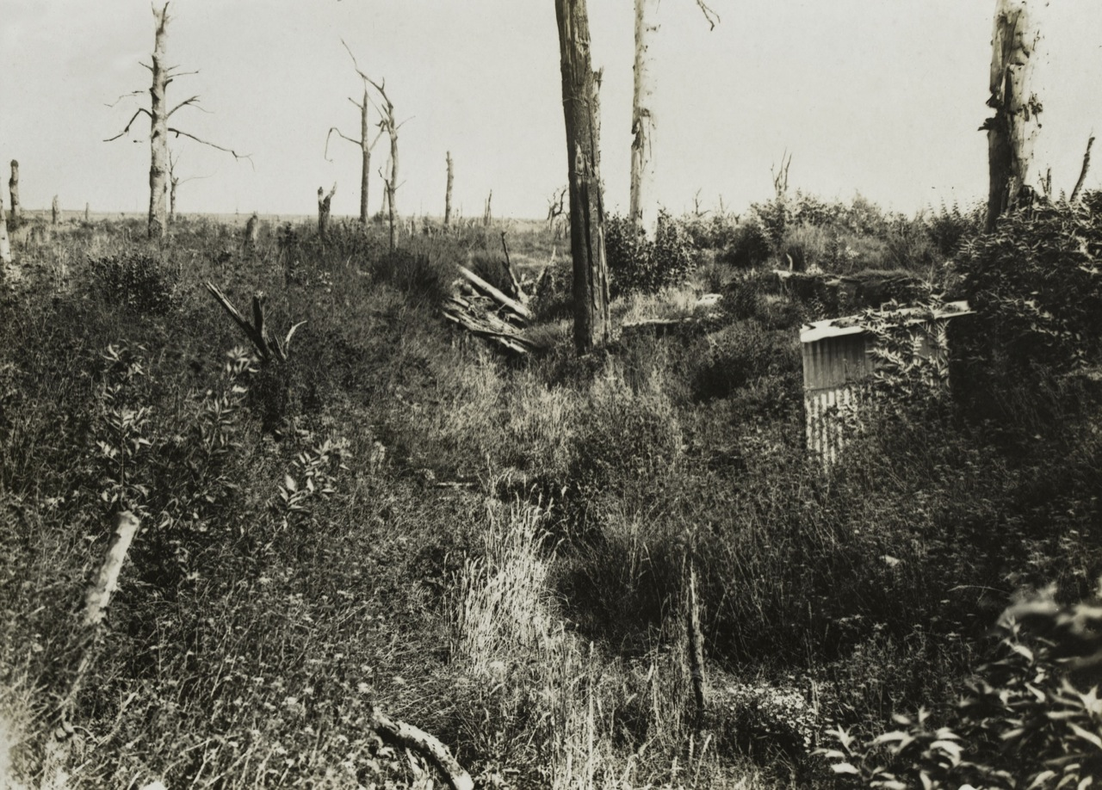
Notes:
‘Scene in Trones Wood as it appears today’, Autumn 1917.
NAM. 2001-01-277-21
General notes:
The Battle of the Somme was fought between July and November 1916, with 1 July being marked out as the day for the initial infantry offensive. Some 420,000 Commonwealth casualties were suffered during the battle, of whom around 125,000 are thought to have been killed. French casualties were more than 200,000. The German Army fought to regain the territory lost and suffered casualties roughly equal to the British. Some estimates claim even greater losses of around 600,000. In total, more than 1,000,000 men were wounded, captured or killed on the Somme in 1916.
Although still battle-scarred, and marked with corrugated iron and broken trees, what can be seen is a profusion of grasses and new growth. Although the wood, the scene of battle, would not return to its former state, it did not taken long for nature to reassert itself.

Slide 12
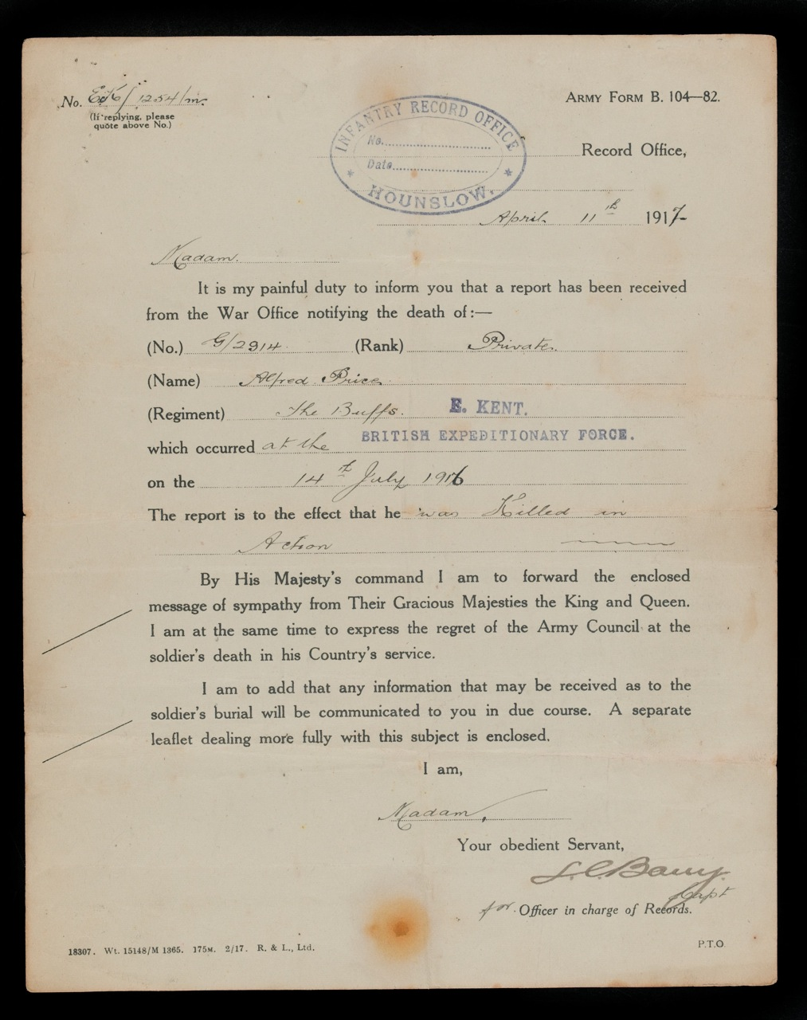
Notes:
Army Form B 104-82, informing Private Price’s mother on 11 April 1917 that a report has been received from the War Office notifying the death of Alfred Price on 14 July 1916
Produced by Infantry Record Office, Hounslow
NAM. 2001-11-39-4
General notes:
The report shows Private Price ‘Killed in Action’, and yet the timeline mentioned by his platoon and company commanding officers suggests that really his death was as a result of wounds. Unfortunately, it was quite common for there to have been confusion over how and where a man died. There are countless examples of major discrepancies relating to the recording of soldiers’ deaths. Death certificates produced following the First World War can contain partial or mistaken information and many were produced when a man had not died at all. Also, evidence indicates that in some cases a fallen man's comrades lied to his relatives to give them a more sanitised version of their deaths.
Questions you might:
Can you work out the length of time between Alfred’s death and the official notification? Why might such a long time have elapsed?
Why is this a standardised form?
Why was it important for the official report to explain how Albert was killed?
Does this report match the accounts the Price family already had?
Why might this letter have been especially difficult for Alfred’s family to receive?

Slide 13
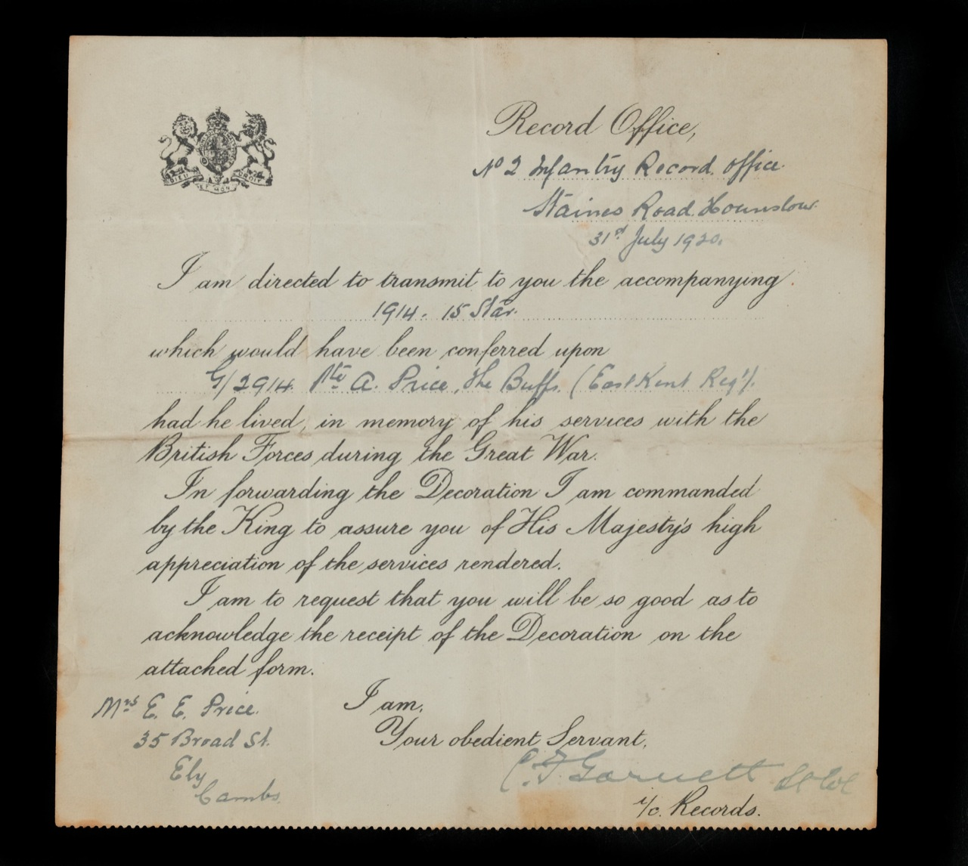
Notes:
Letter from the Record Office posthumously transmitting the 1914-15 Star to Private Alfred Price, 31 July 1920
NAM. 2001-11-39-7
Transcript:
I am directed to transmit to you the accompanying 1914-15 Star which would have been conferred upon G/2914 Pte A. Price, the Buffs (East Kent Reg’t) had he lived, in memory of his services with the British Forces during the Great War.
In forwarding the Decoration I am commanded by the King to assure you of His Majesty’s high appreciation of the services rendered.
I am to request that you will be so good as to acknowledge the receipt of the Decoration on the attached form.
I am,
Your obedient Servant,
C.F Garrett Lt Col
c/o Records
Mrs E.E. Price
35 Broad St
Ely
Cambs
General notes:
The 1914-15 star could be given to those soldiers who had served in any theatre of war between 5 August 1914 and 31 December 1915. It is not an award for gallantry, but a recognition of service. The medals were first awarded in December 1918. The majority of medals were issued automatically during this period.
Questions you might ask:
What does this medal acknowledge?
What does it tell you about Alfred’s service?
Why might there have been a delay in issuing this medal?

Slide 14
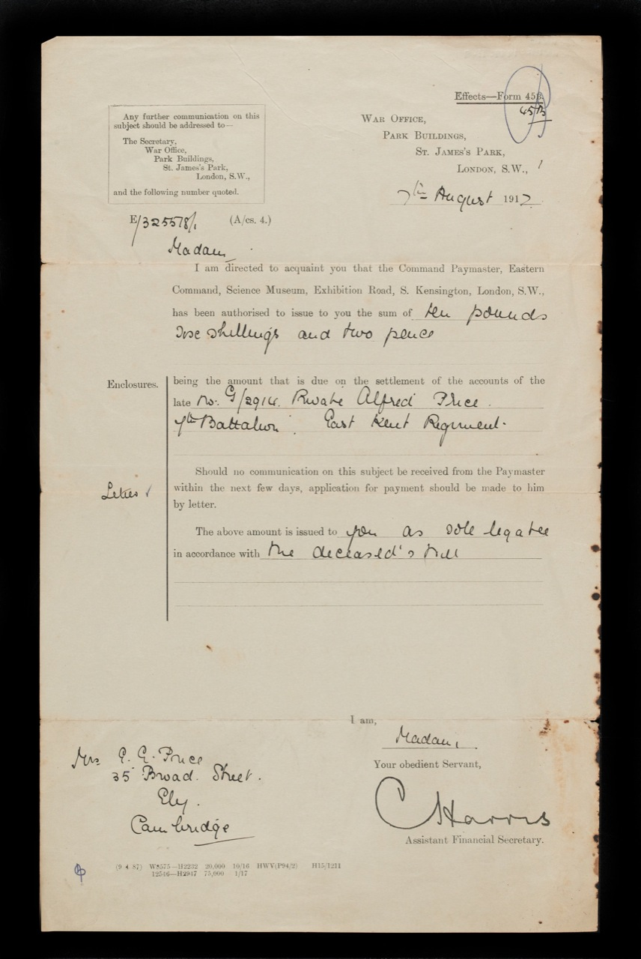
Notes:
Letter from The War Office informing Private Price’s mother that she will receive the sum of £10 6s 2d from the accounts of Alfred Price, 7 Aug 1917
NAM. 2001-11-39-5
Part transcript:
The above amount is issued to you as sole legatee in accordance with the deceased’s will.
General notes:
Alfred had made his mother his sole beneficiary in case of his death. Without dependents of his own, Alfred could potentially have been sending part of his pay home, to help support the family. As he was working before he joined the Army, it is possible that his wage contributed to the running of the family home. Bearing in mind the loss of this income through his death, he clearly wanted to make sure his mother was supported in some way. This money would have been saved from his wages as a soldier. Many men found that the demands on their funds were few while on active service, as they already had food, clothing, equipment, and shelter (in billets, when not in trenches) provided.

Slide 15
Notes:
Memoriam card for the memorial of the Unknown Warrior who was to be interred in Westminster Abbey, 11 November 1920
Printed by East London Printing Company
NAM. 2001-11-39-8
General notes:
The tomb of the Unknown Warrior is located in Westminster Abbey, London. The idea was championed by Reverend David Railton, who had served as a British Army chaplain on the Western Front. He felt that it was important that the funeral of one unidentified soldier was recognised at a national level, to symbolise the burials and funerals of all the unidentified soldiers. Countries like Canada, Australia and France also have similar graves and memorials in national institutions.
Alfred is officially commemorated on the Thiepval Memorial, France. The memorial bears the names of those who fell in the area during the First World War. It has 72,195 names inscribed on it. Those named on the memorial are not buried in marked graves.
Local communities often undertook to commemorate the fallen from their area. For many families, there was no chance to visit the graves of their loved ones in France and Belgium, due to the significant financial burden. In Alfred’s case, according to notes in the NAM’s records, after World War One the Price family collected money so that their mother could visit his grave, but as she prepared to visit she learnt that it had been destroyed and she collapsed and died in her daughter’s arms.
Questions you might ask:
Why do you think Alfred’s family would have collected this card for this event?
Why was this event of personal significance for them?
Why do you think this sentiment (Thy Will be done) was chosen for the memorial card? How could it help some families?
Why was Westminster Abbey chosen as a location?
Why have other nations chosen to adopt their own ‘Unknown Warriors’?
Do you think this is a valuable way to commemorate the men and women who died in the First World War?
Why were fallen soldiers commemorated where they fell? In what ways was commemoration different to previous conflicts?
Why would communities choose to build local memorials? Where is the community memorial in your area? Is it prominently located? Was it? When is it visited now?
Do you think it’s important these memorials are preserved?

