Slide 1
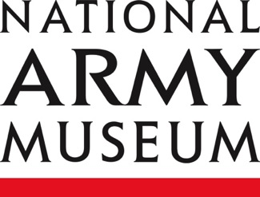
Gallipoli 1915
Notes:
This resource gives captioning information for the images used in the accompanying film.

Slide 2
This PowerPoint presentation contains a selection of images from the NAM’s photographic collection. The images are designed to be used in conjunction with the associated video and teachers’ notes.
Unless otherwise stated in the notes, the images can be freely used for non-commercial purposes within the classroom. You can use the entire presentation or choose individual images for use in other non-commercial contexts. When using individual images in other contexts, please always retain the attribution statements provided in this document (e.g. NAM. 2005-08-66-1).
By downloading this document and using these images you agree to these terms of use, including your use of the attribution statement specified for each object by NAM.

Slide 3
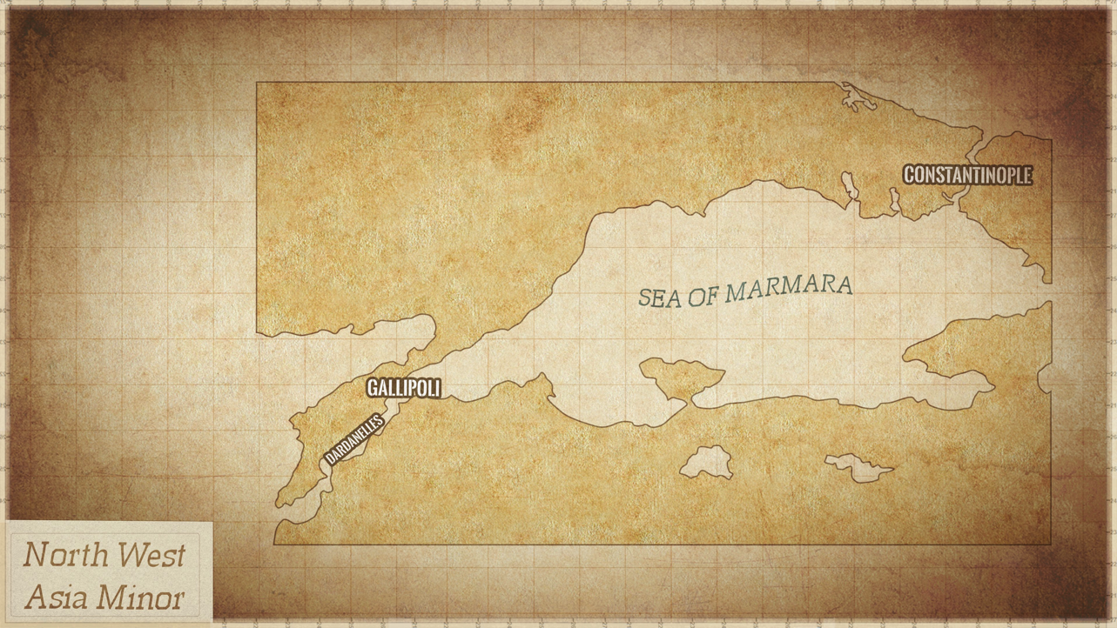

Slide 4
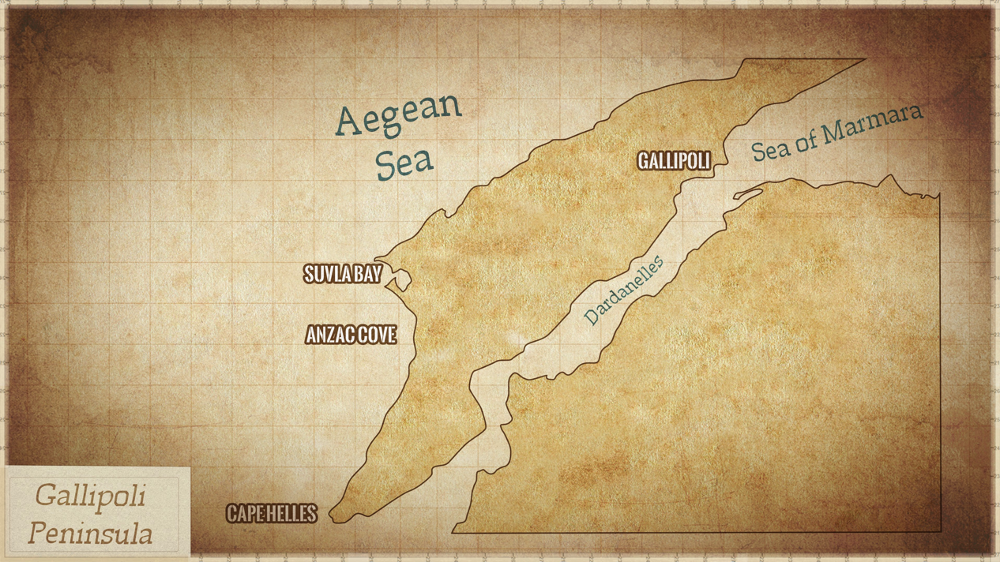

Slide 5
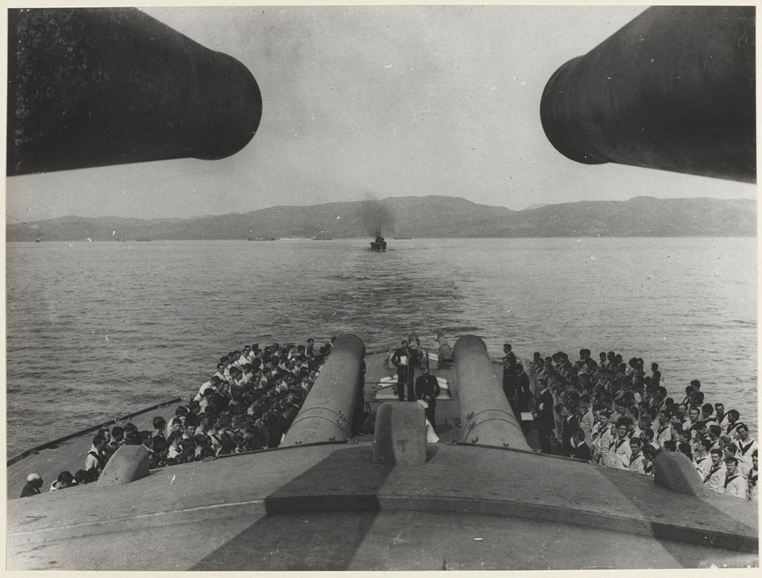
Notes:
Church service on HMS ‘Queen Elizabeth’, 1915
NAM. 1965-10-209-9
A church service being conducted beneath the forward 15-inch guns of HMS 'Queen Elizabeth' while she was steaming off the coast of the Gallipoli peninsula. Launched in 1913, the oil-powered vessel was a super dreadnought class battleship. In April 1915 she provided fire-support to the troops landing at Cape Helles.
Soldiers had a range of responses to religious faith and services in the First World War. Some soldiers found faith, or had it renewed in conflict, while others came to lose their faith altogether. Religious services still form a part of preparations for conflict operations.

Slide 6
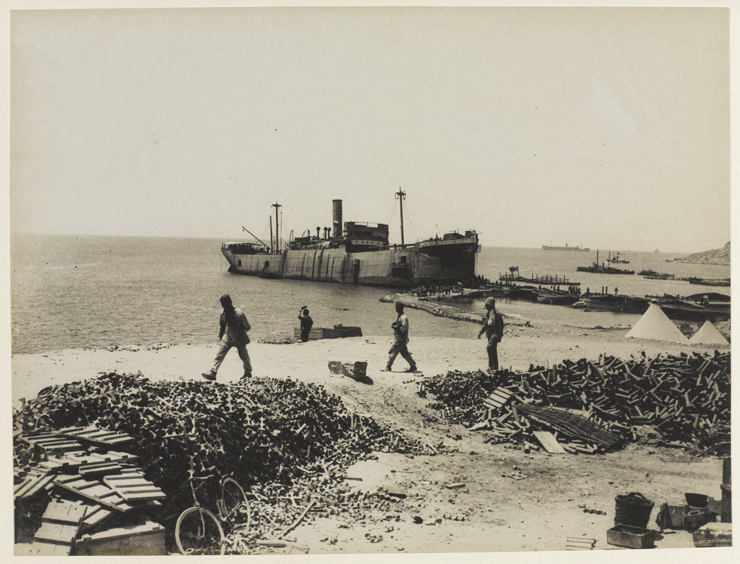
Notes:
The converted steamer ‘River Clyde’, anchored at V-Beach, 1915
NAM. 1965-10-209-13
From an album compiled by Captain CC Harland MC, Hampshire Regiment and 5th Staffordshire Regiment.
The SS 'River Clyde' was a 4,000 ton ex-collier that was used to land around 2,000 troops at Cape Helles, Gallipoli, on 25 April 1915. Holes had been cut in her steel hull to provide ports from which the troops would emerge on to gangways and then to a bridge of smaller boats linking the ship to the beach. Several attempts were made to get ashore, but all failed with heavy losses inflicted by the Turkish defenders. The surviving soldiers waited until nightfall before landing. The 'River Clyde' remained beached at Helles as a dock and breakwater. As well as being used for storage she also housed a field dressing station.

Slide 7
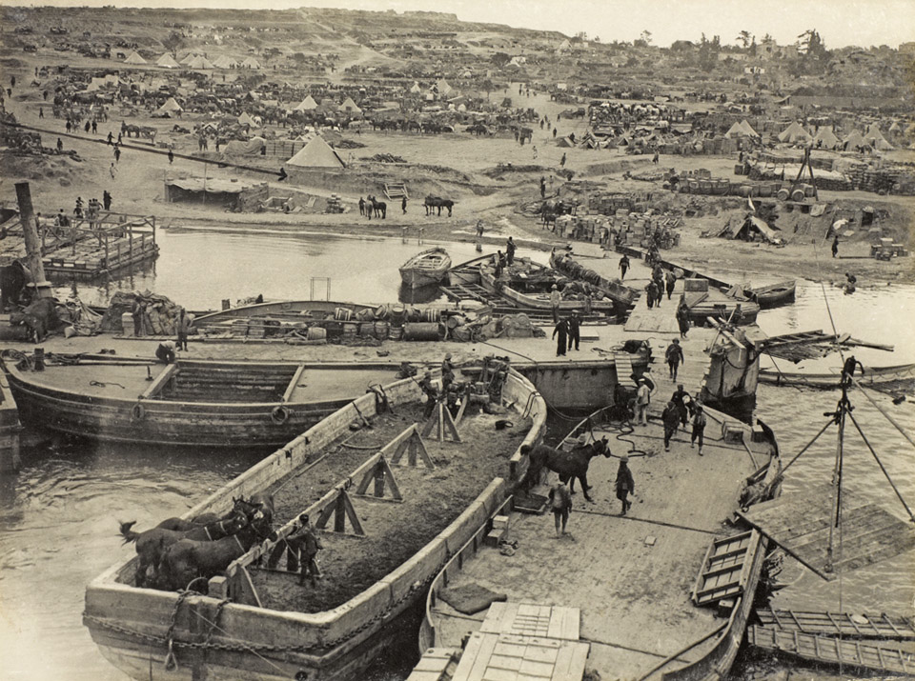
Notes:
‘V’ Beach from the ‘River Clyde’, Dardanelles, 1915
NAM. 1965-10-209-14
Photograph from an album of 49 photographs entitled, 'The War 1914-1918', by CA Milward, containing official war photographs associated with World War One, Gallipoli, Western Front and Mesopotamia (1914-1918).
On 25 April 1915 1st Battalion The Royal Munster Fusiliers plus two companies of 2nd Battalion The Royal Hampshire Regiment landed at 'V' Beach. While some men were towed in barges many more disembarked from ports cut in the sides of the troopship SS 'River Clyde'. They then moved on to barges linked to the shore.
The attackers faced heavy machine-gun and rifle fire from Sedd-el-Bahr fortress. Out of the first wave of 200 men, only 21 made it ashore. The Turks desperately tried to drive the British off the beach, but they held on and eventually gained a foothold. The following day the 15-inch guns of HMS 'Elizabeth' destroyed the fort, but the battalions that had landed at 'V' Beach had suffered around 70 per cent casualties.
There were 6,100 horses embarked for the Gallipoli campaign.

Slide 8
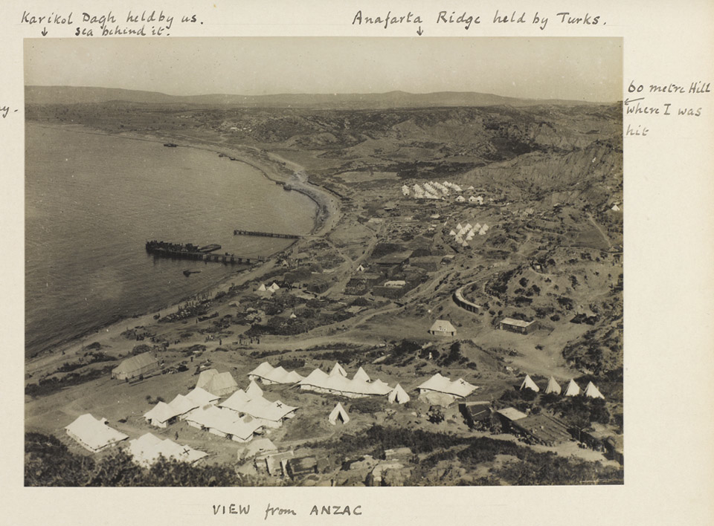
Notes:
View from ANZAC’, North Beach, north of Anzac Cove, 1915
NAM. 1965-10-209-26
Photograph from an album of 49 photographs entitled, 'The War 1914-1918', containing official war photographs from a series by CA Milward. Captioning on the photograph refers to ‘Anafarta Ridge held by Turks’, ‘Karikol Dagh held by us’ and ‘60 Metre Hill where I was hit’.
The vessel moored at the pier is a hospital barge which was used to carry wounded men out to nearby hospital ships moored in deeper water. The white tents in the foreground belong to the 1st Australian Stationary Hospital, a unit that had moved to Anzac from Lemnos Island in early November 1915.

Slide 9
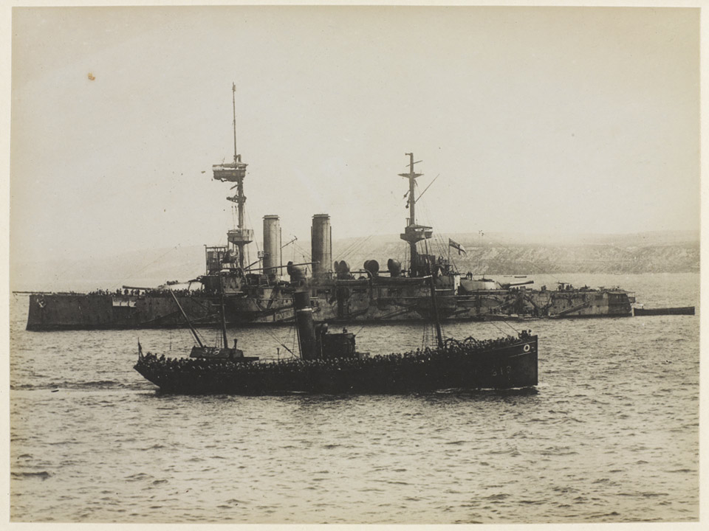
Notes:
1/6th Battalion The Lancashire Fusiliers in a trawler en route to 'W' Beach, May 1915
NAM. 1965-10-209-7
'W' Beach was one of the two main landing areas on Cape Helles during the assault of 25 April 1915. By the time this photograph was taken the Allies were well ensconced at Helles and reinforcements, including the 1st/6th Battalion, were regularly arriving. Their trawler is pictured passing the battleship HMS 'Implacable'.

Slide 10
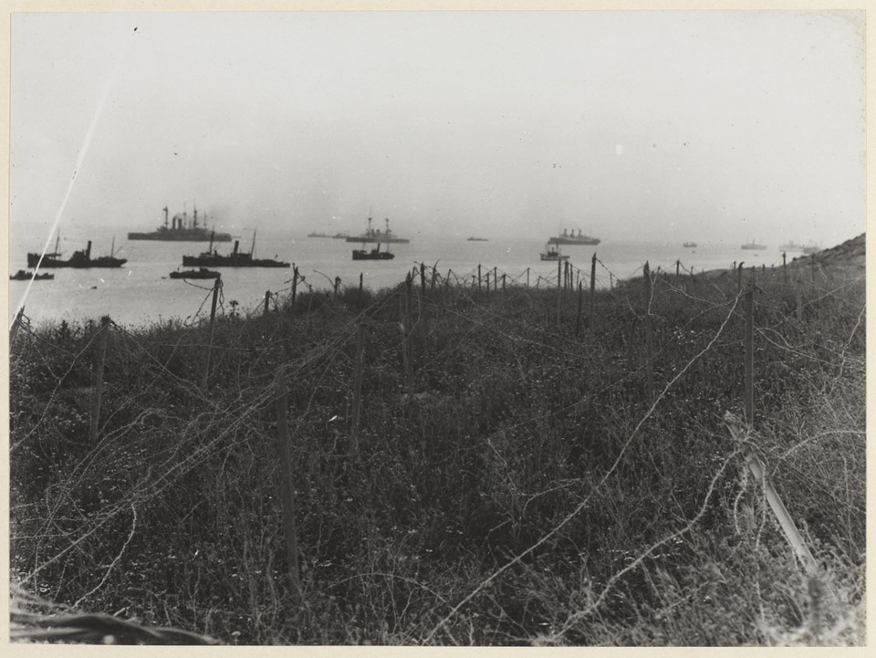
Notes:
Barbed wire near Sedd-el-Bahr, 1915
NAM. 1965-10-209-10
Sedd-el-Bahr was a fortified village at Cape Helles. On 25 April 1915 soldiers from the 86th and 87th Brigades landed at nearby 'V' Beach and were subjected to heavy fire from the Turkish defenders ensconced there. In this image Allied shipping is visible in the distance.
The wire in this photograph is staked to the ground in a tightly packed series of rows, which would ensnare and slow down advancing troops. Barbed wire was originally invented in the US to be used in fencing in cattle.

Slide 11
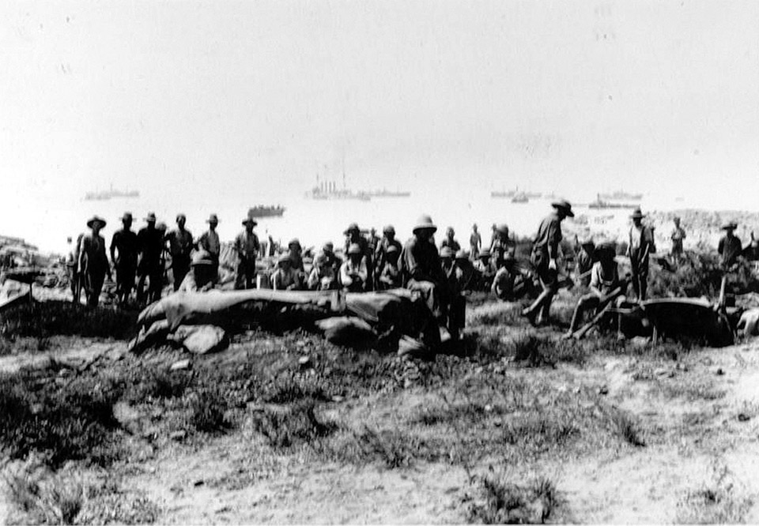
Notes:
Soldiers at Anzac Cove, Gallipoli, 1915
NAM. 1965-10-209-23
On 25 April 1915 soldiers of the Australian and New Zealand Army Corps (ANZAC) landed on the Gallipoli peninsula in Turkey. The small cove in which they landed soon became known as Anzac Cove.

Slide 12
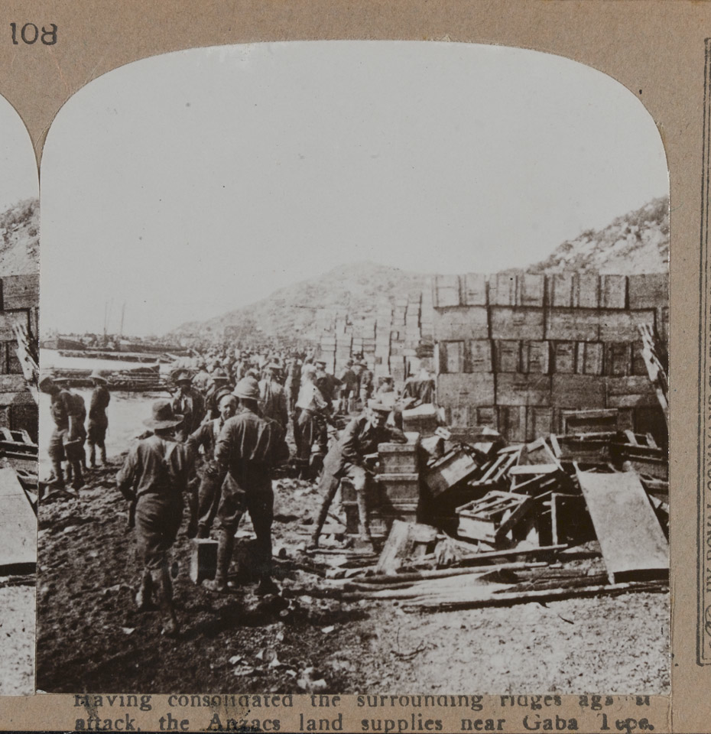
Notes:
Supplies at Anzac, 1915
NAM. 1972-08-67-2-108
Having consolidated the surrounding ridges against attack, the Anzacs landed supplies near Gaba Tepe.
This photograph shows supplies and ammunition stockpiled on the beach at Anzac Cove. Gallipoli was the first major military action fought by Australian and New Zealand forces during the war.

Slide 13
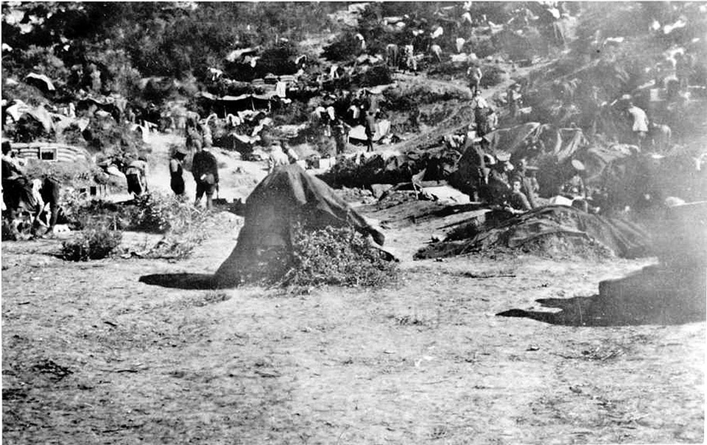
Notes:
Troops in their dugouts in the hills, c1915
NAM. 1979-08-66-106
Despite repeated attempts to break out, throughout the summer and autumn of 1915 the Allies remained trapped around their three beachheads at Helles, Anzac Cove and Suvla Bay. Each of these was overlooked by high ground commanded by strong Ottoman forces and was under constant artillery and sniper fire. The soldiers lived and fought in appalling conditions. Casualties from heat and disease overwhelmed the inadequate medical facilities.

Slide 14
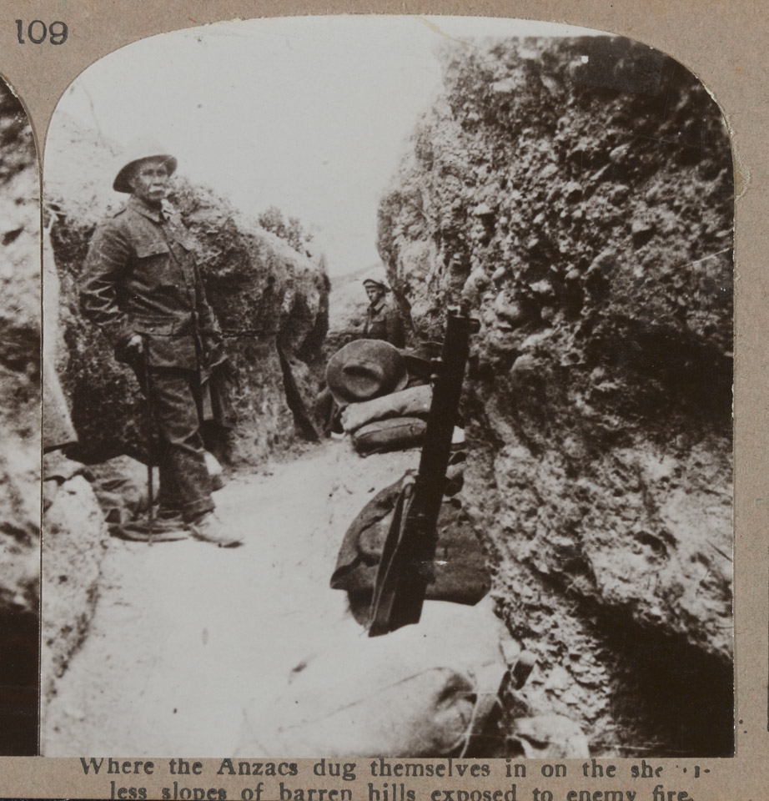
Notes:
‘Where the Anzacs dug themselves in on the shelterless slopes of barren hills exposed to enemy fire', 1915
NAM. 1972-08-67-2-108
Soldiers from Australia and New Zealand, the 'ANZACs', landed near Gaba Tepe (later renamed Anzac Cove) on 25 April 1915. Despite repeated attempts to break out and link up with the landing further south at Cape Helles, the campaign became bogged down. Lieutenant-General Sir Gerald Ellison visited Anzac on 24 July 1915 and reported:
'As we approached ANZAC we could see the shore and the landing jetty being heavily shelled from both flanks and unfortunately one of the shells got home and caused serious casualties. Some 12 or 14 men being hit. Landing parties, bathers and those employed in the beach depots are never safe at any time from incidents of this kind. Of course the bulk of the landing of men and stores has to be done at night, but a certain amount goes on pretty well all day. Close to the jetty are General Birdwood's Headquarters and there is quite a town of dug outs and shelters all huddled together on the face of the small ridge of cliff about 300 feet high and 500 yards long which immediately commands the landing place... We proceeded to the top of the interior line of cliff [and] speaking roughly we had facing us on the small plateau where we stood (which is honeycombed with deep trenches) an amphitheatre of cliffs from 2 to 3 miles in extent.
The whole face of this great cliff of hard yellow mud is literally one mass of little caves occupied by the Australian and New Zealand contingents. Zig-zag paths run up the few steep salients that jut out from the cliffs to the ravine below and from these salients row upon row of paths have been cut in the face of the cliff and beyond them again are the shelters where the men live. The very summit of the cliff is our advance fire trench, and very often the Turkish trenches are not more than 15 to 20 yards away from this trench. In such circumstances the difficulties of communication can well be imagined but no one with whom I spoke seemed in the least afraid of what any Turkish attack could do. They have already beaten off two serious attacks with enormous loss and feel absolutely convinced that they can take on any number that come to attack them. I do not think I have ever met a more cheery lot of fellows than those I encountered in and around ANZAC'. NAM. 1987-04-35-214

Slide 15
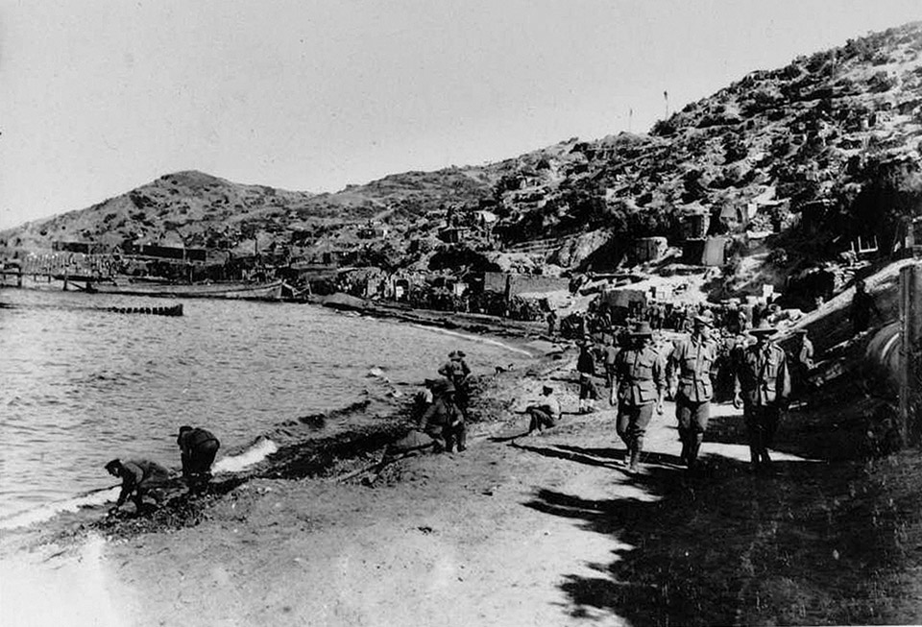
Notes:
Troops at Anzac Cove, 1915
NAM. 1979-08-66-137
Despite repeated attempts to break out and link up with another landing further south at Cape Helles, their campaign became bogged down. Anzac was finally evacuated in December 1915.

Slide 16
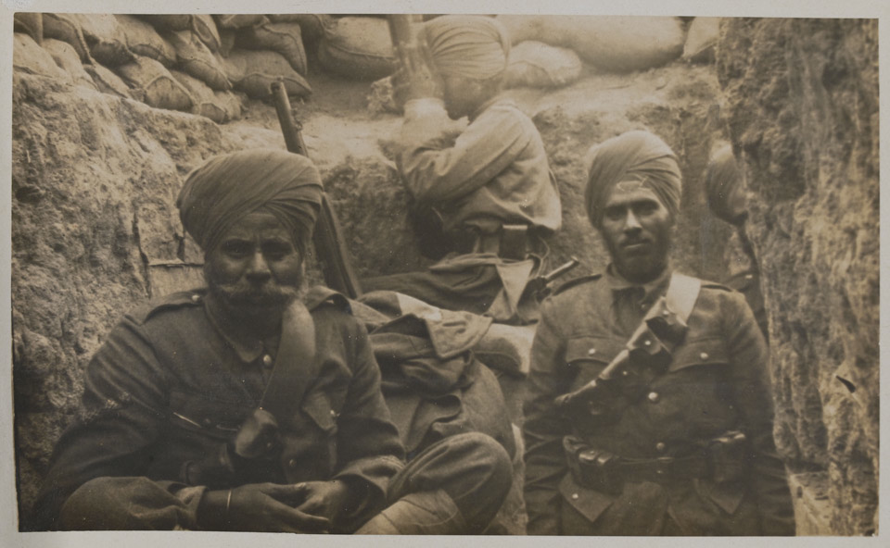
Notes:
Photograph of Indian soldiers in trench, Gallipoli, 1915
NAM. 1976-05-52-79
Sikh soldiers of the 29th Indian Infantry Brigade, Cape Helles, 1915. They are armed with Short Magazine Lee Enfield Rifles (SMLE). Their brigade landed at Gallipoli on 1 May 1915. The figure in the background uses a periscope to safely view the neighbouring Turkish positions. They were sent as reinforcements to help enable an Allied breakthrough.

Slide 17
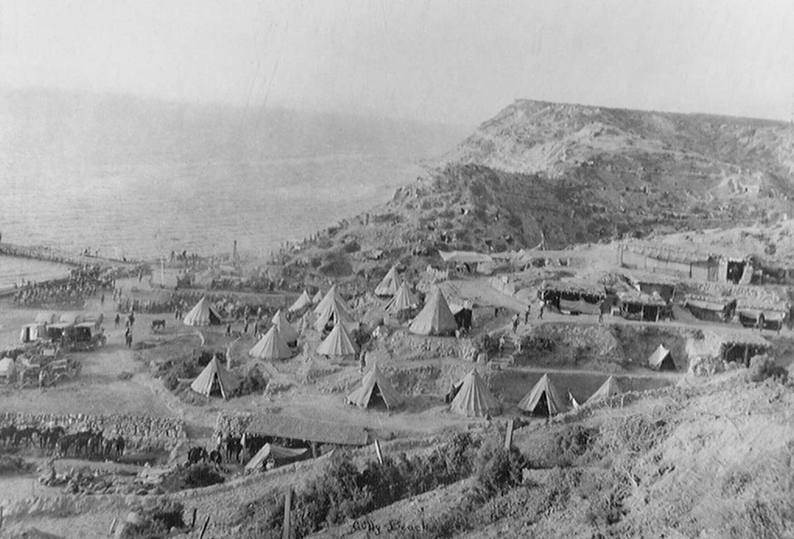
Notes:
Gully Beach (also known as Y2 Beach) at Cape Helles, 1915
NAM. 1984-07-41-1
Gully Beach (also known as Y2 Beach) at Cape Helles was the location for the headquarters of Major-General Aylmer Hunter-Weston's 29th Division. Originally, the Allies had considered landing there on 25 April 1915 but decided against this as they believed it was too well defended. In fact, there was only a small force there.

Slide 18
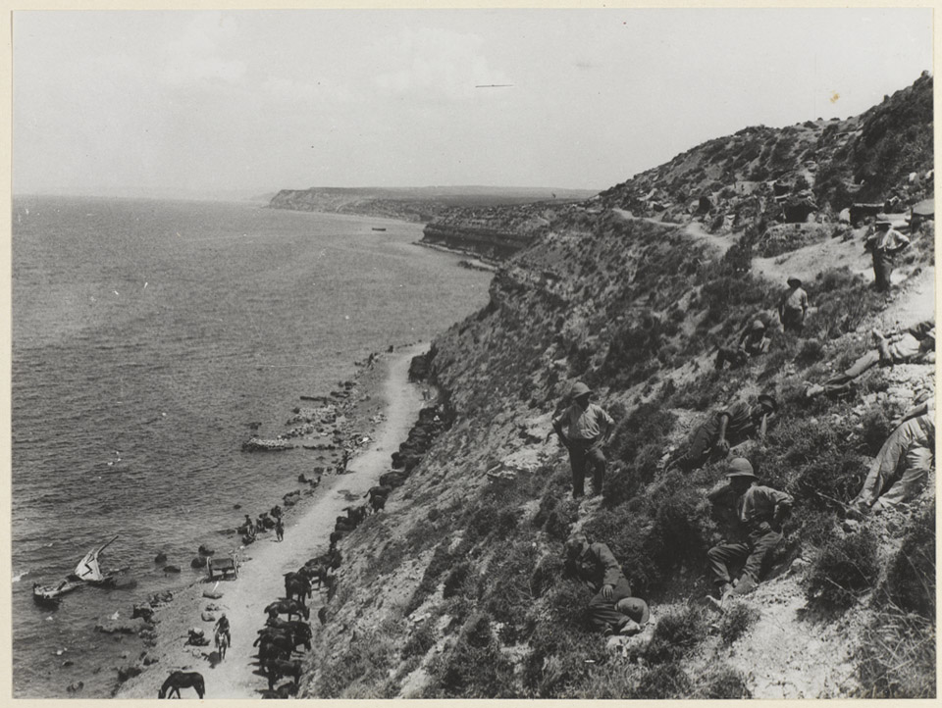
Notes:
Horses picketed on the beach between Cape Helles and Gully Ravine, 1915
NAM. 1965-10-209-8
The horses are tethered to picket spikes on the sand. Gully Ravine was located on the left of the Allied position at Cape Helles near 'Y' Beach. Well-camouflaged against the ground cover are some troops relaxing on the steep incline.
6,100 horses were embarked for the Gallipoli campaign. Australia sent 136,000 horses in total for the war effort (only one ever returned to Australia). Of the 6,100 to be sent to Gallipoli, very few were actually sent ashore, as Lieutenant General Sir William Birdwood (the British commanding officer of the ANZACs) decided there was no space and no purpose for them in the Anzac Cove area. The difficulties of foraging must also have been a huge consideration. The horses were sent back to Alexandria in Egypt.

Slide 19
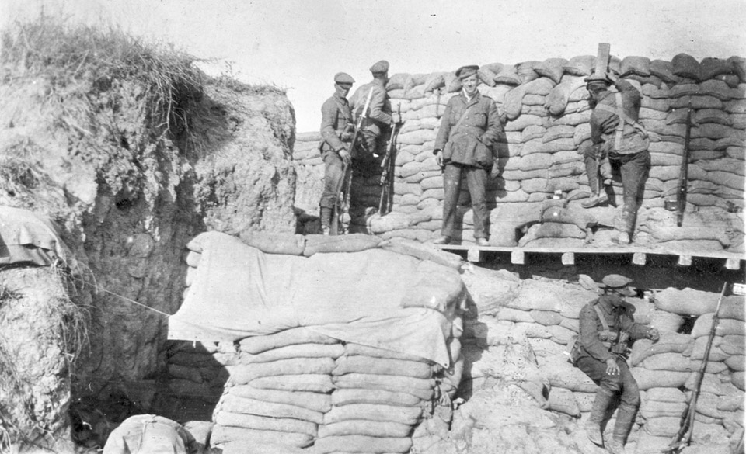
Notes:
Fortifications on the Gallipoli peninsula, 1915
NAM. 1990-06-215-9
From a collection of photographs belonging to Sergeant Archibald Favell, 2nd Battalion Royal Fusiliers Regiment.
The Gallipoli peninsula is an exposed area of land with little vegetation, and sandy soil. The Turkish troops who held the land had significantly higher ground, so the invading troops built large defences made from locally available materials – and sand was plentiful. This particular construction – it has two levels – is built across a dry gully and there are loopholes through which to view the enemy.

Slide 20
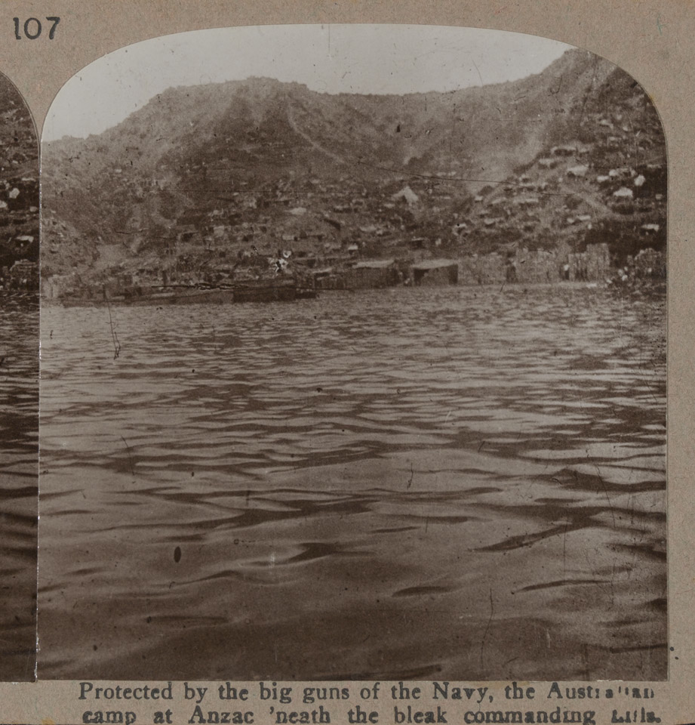
Notes:
Anzac Cove, 1915. ‘Protected by the big guns of the Navy, the Australian camp at Anzac ‘neath the bleak commanding hills.’
NAM. 1972-08-67-2-107
Despite repeated attempts to break out, the ANZACs remained trapped around their beachhead which was overlooked by high ground commanded by strong Turkish forces. Their position was under constant artillery and sniper fire. The soldiers lived and fought in appalling conditions. Casualties from heat and disease overwhelmed the inadequate medical facilities. In November it was decided to withdraw the Allied army, which was done with minimal losses by 9 January 1916.

Slide 21
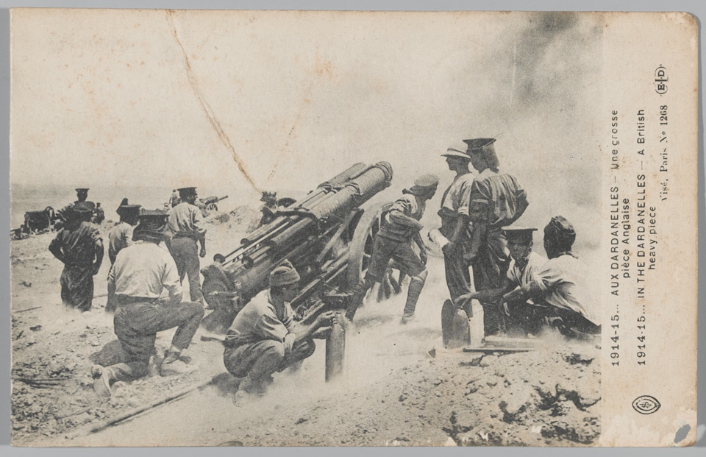
Notes:
Heavy artillery in the Dardanelles, Gallipoli, 1915
NAM. 1990-06-215-9
This howitzer is apparently named ‘Annie’ – for no known purpose, but possibly a term of affection. There is a tradition of naming favoured pieces of equipment, and often with female names. A howitzer tends to have a short barrel and propels a shell on a relatively steep angle of trajectory accompanied with a steep angle of descent. ‘Lobbing’ shells in this way can be very effective against otherwise well-protected troops in trenches.

Slide 22
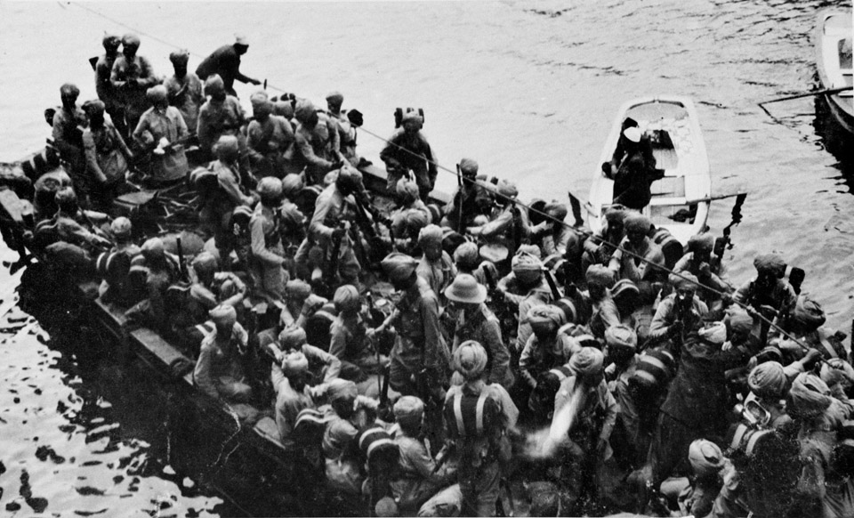
Notes:
Troops of 29th Indian Infantry Brigade disembarking from a boat at Gallipoli, May 1915
NAM. 1976-05-52-1
29th Indian Infantry Brigade landed at Gallipoli on 1 May 1915 having been shipped from Port Said in Egypt. Commanded by Major-General Vaughn Cox, it was sent to Cape Helles to support the British 29th Division's attempts to break out.

Slide 23
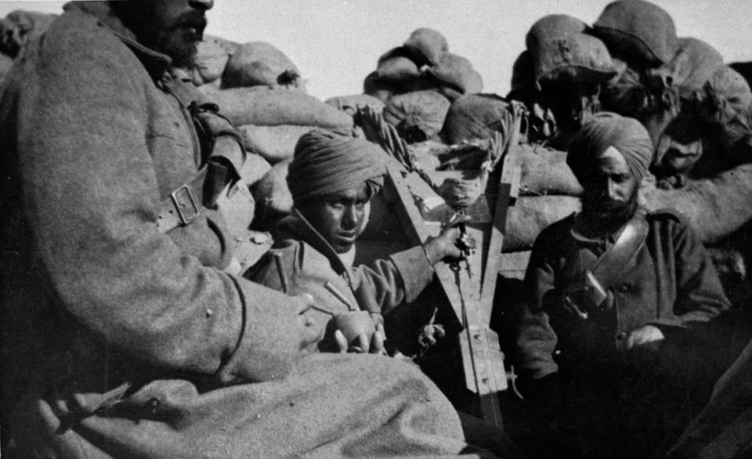
Notes:
Troops of 29th Indian Infantry Brigade in the Trenches, Gallipoli, 1915
NAM. 1976-05-52-39
29th Indian Infantry Brigade was one of the three brigades of the 10th Indian Division, which was formed in Egypt during November 1914. In April 1915 the brigade was detached from the division and sent as reinforcements to Gallipoli.
A bomb thrower, one of the earliest devices for projecting explosive charges short distances, can be seen in the centre of this photograph. It was in effect a miniature medieval-style siege engine which used coiled springs, rubber or torsioned (twisted) wire as a catapult to hurl grenades. This equipment was really only effective over quite short distances. Grenades were not always readily available in the Gallipoli peninsula. Consequently many Allied soldiers – and those based in Gallipoli who had no access to grenades of any type – resorted to the construction of home-made, or 'jam-tin' bombs.

Slide 24
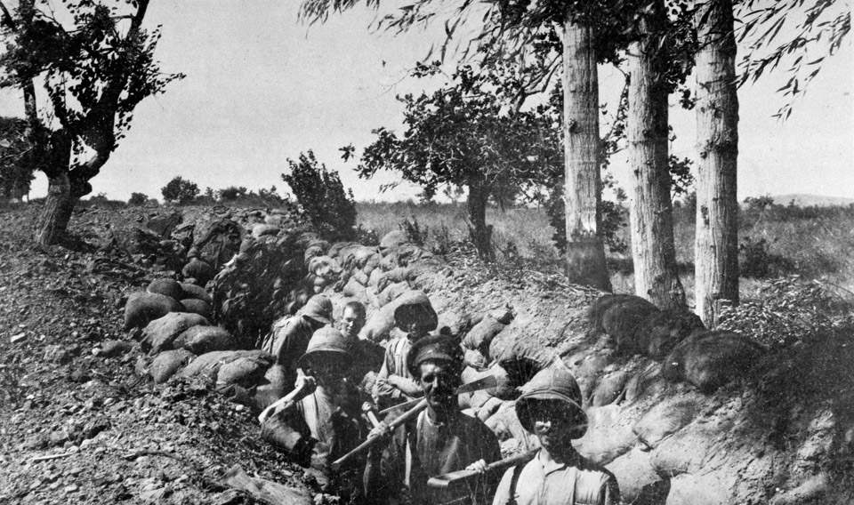
Notes:
Soldiers dug in at Chocolate Hill, Suvla Bay, Gallipoli, 1915
NAM. 2000-08-94-67
From a photograph album of 124 photographs compiled by Trooper O Ward, 1st County of London Yeomanry, 1915-1916.
Although the landing of new Allied divisions at Suvla Bay on 6 August 1915 caught the Turks by surprise, Lieutenant-General Sir Frederick Stopford's men moved inland too slowly and the Turks were able to occupy the heights overlooking their position. The stalemate at Gallipoli continued.

Slide 25
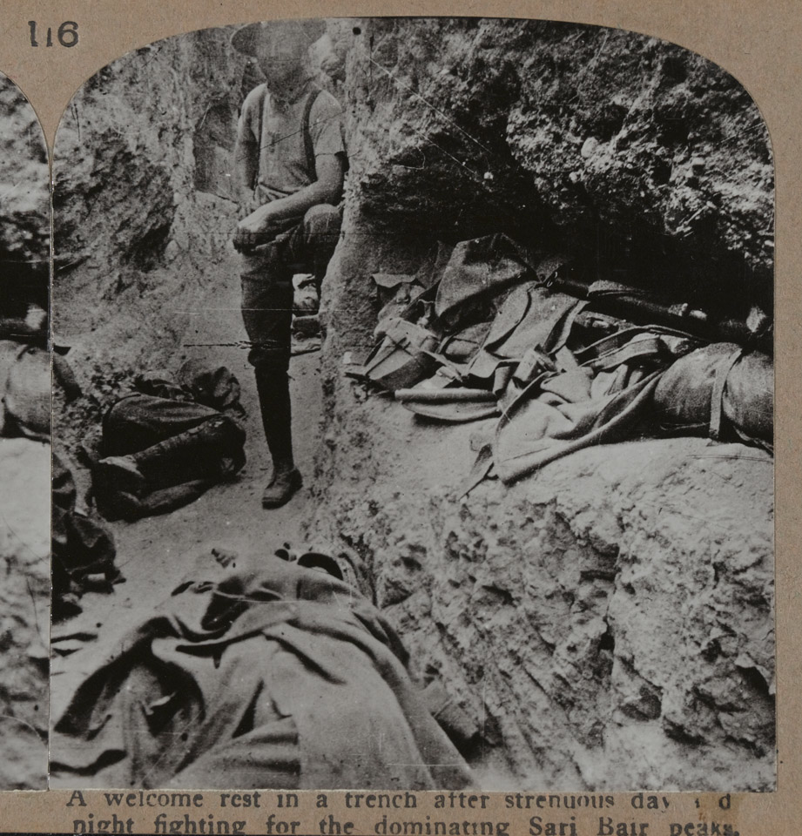
Notes:
Australian soldiers in the trenches at Anzac, 1915
NAM. 1972-08-67-2-116
A welcome rest in a trench after strenuous day and night fighting for the dominating Sari Bair peaks. There are three (?) additional figures in the picture, sleeping where they can – one to the right of the standing figure, and two obscured by their coats in the platform and at the front of the picture. The standing figure seems to be smoking a cigarette.
On 6 August 1915 there was a new Allied landing at Gallipoli at Suvla Bay in conjunction with the Australian and New Zealand Army Corps (ANZAC) mounting an attempt to capture the Sari Bair ridge, the high ground that dominated the middle of the peninsula above Anzac Cove and Sulva. Once this was captured it was hoped the ANZACs would link up with the Suvla landing force. Although they captured parts of the ridge, they could not extend these gains, largely due to fierce Turkish resistance and the slowness of the Suvla commander Sir Frederick Stopford's attempts to reinforce them. After two weeks of bitter fighting it was clear that the operation had failed. It brought to an effective end the Allied plans to break out of Anzac Cove.

Slide 26
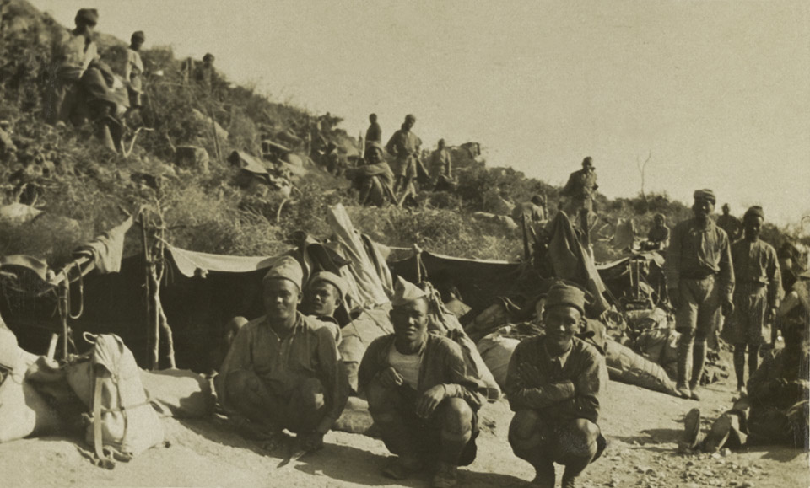
Notes:
‘5th Gurkhas’, Gurkha Rifles in bivouacs (a temporary camp without tents or cover), Gallipoli, 1915
NAM. 1976-05-52-89
Photograph from an album of 99 photographs, the second of two photograph albums compiled by Lieutenant (later Lieutenant General Sir) Reginald Arthur Savory, 14th Sikh Regiment.
Thousands of soldiers from the Indian Army fought on the Gallipoli Peninsula, yet their contribution has never received the same attention as that of the famous ANZAC troops. Gurkha units that served in the Dardanelles included 1st Battalion, 5th Gurkha Rifles, 1st Battalion, 6th Gurkha Rifles, and 2nd Battalion, 10th Gurkha Rifles.

Slide 27
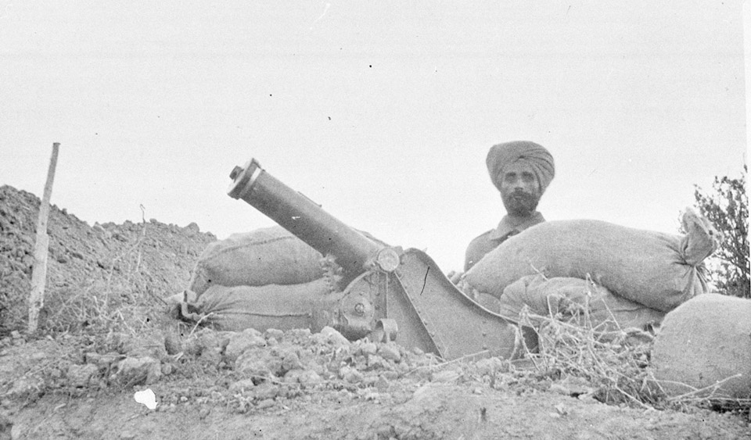
Notes:
A Sikh soldier in a sandbagged gun emplacement
NAM. 1976-05-52-37
29th Indian Infantry Brigade landed at Gallipoli on 1 May 1915 having been shipped from Port Said, Egypt. Consisting mainly of Gurkhas, Punjabi Muslims and Sikh units, the Brigade performed well, but sustained heavy losses. At the Third Battle of Krithia on 4 June 1915 the 14th King George’s Own Ferozepore Sikhs were almost wiped out, losing 380 men out of 514 and 80 per cent of their officers.

Slide 28
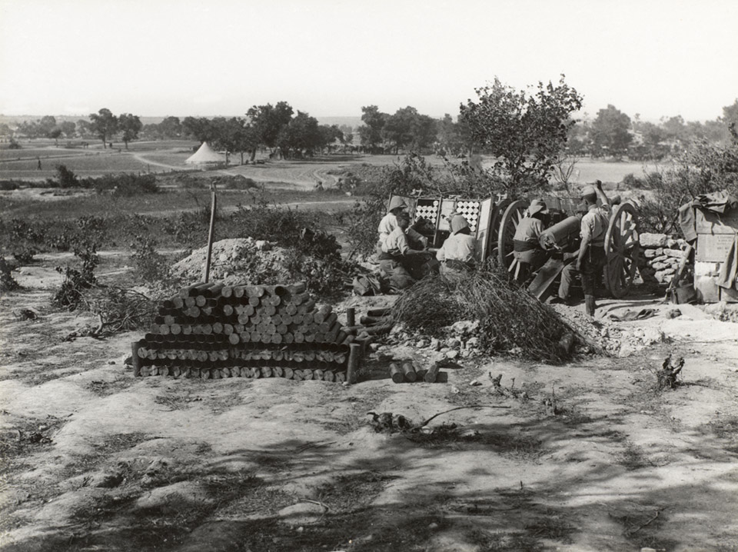
Notes:
A French 75 mm gun in action at Cape Helles, 4 June 1915
NAM. 1965-10-209-17
The 75 mm gun was the French Army's main artillery piece. This example is pictured firing near Sedd el Bahr during the Third Battle of Krithia. Introduced in 1897, it was the first fully integrated quick-firing gun. It also had an innovative recoil system that made for a smoother operation. By the end of the war, the French had produced 17,000 of these excellent guns.
The Third Battle of Krithia was the third attempt to capture the high point of the peninsula, and again was a costly failure.

Slide 29
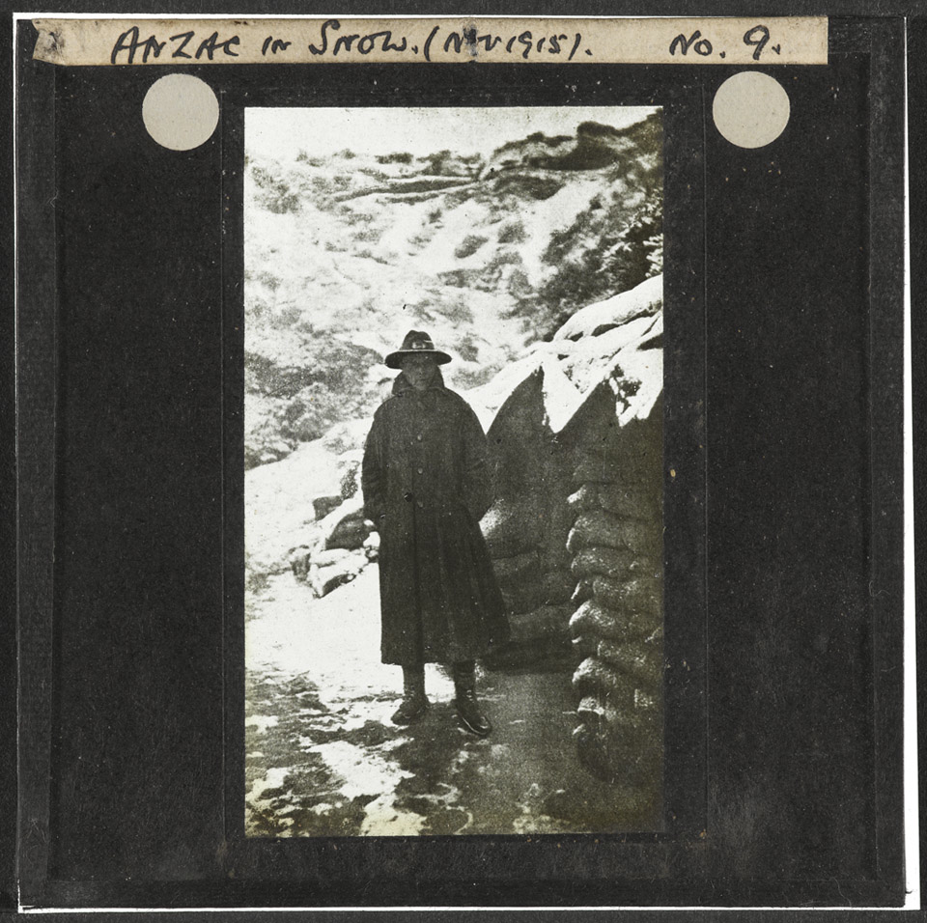
Notes:
Anzac in the snow, November 1915
NAM. 1978-11-157-15-61
Although the heat of the Turkish summer took a toll on the men at Anzac, Cape Helles and Suvla Bay, winter on the peninsula was equally debilitating, bringing gales, blizzards and flooding. Thousands of soldiers suffered frostbite and some even froze to death.

Slide 30
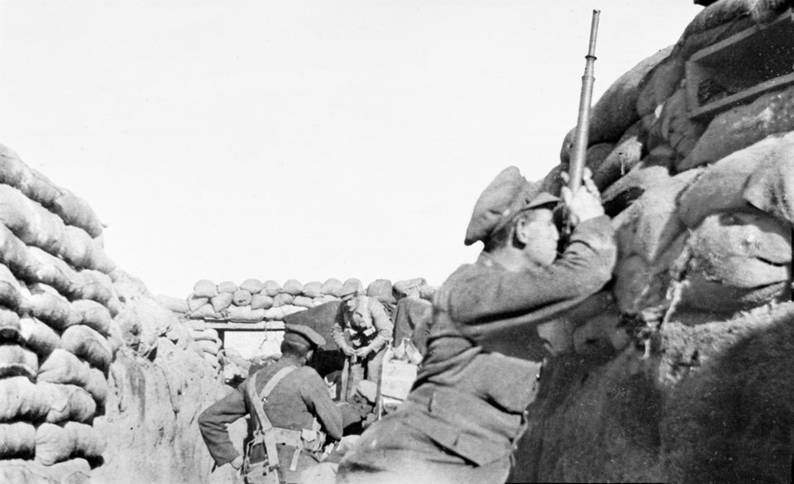
Notes:
A soldier from 2/2nd Battalion The Royal Fusiliers using a trench periscope, 1915
NAM. 1995-04-27-2
Photograph from a photograph album of 64 photographs compiled by Sergeant AJ Favell, 2nd Battalion Royal Fusiliers Regiment, World War One, Gallipoli (1915-1916).
Periscopes provided a less dangerous way of observing the Turks from the trenches. In its simplest form, a periscope could be just a stick with two angled pieces of mirror at the top and bottom. Sergeant Favell also wrote in his diary about using a periscopic rifle for the first time. This used the same principle to allow the user to sight the weapon and pull the trigger without exposing his head and upper body to enemy fire.

Slide 31
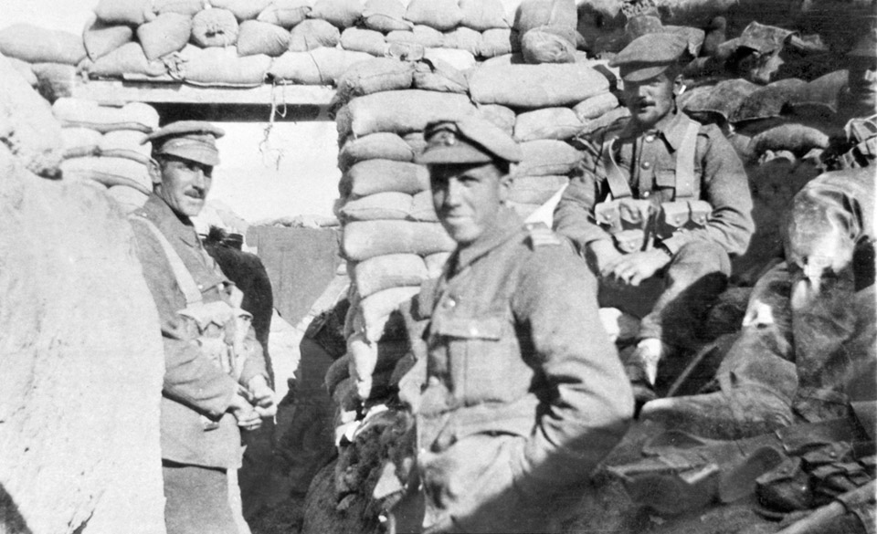
Notes:
‘Xmas Day 1915. Dardanelles’
NAM. 1995-04-27-5
Photograph from an photograph album of 64 photographs compiled by Sergeant AJ Favell, 2nd Battalion Royal Fusiliers Regiment, World War One, Gallipoli (1915-1916).
On the 27 December 1915, Sergeant Favell wrote the following:
‘It was one o’clock this am when we arrived in our new bivouac – more fatigued than ever before. Slept in long dugouts on the hill top by the side of the Dards. Got up somewhere about noon and drew rations. How weary we all are. After such a week in the firing line enduring two fierce bombardments and the rain bringing the parapets in we have had about enough of it.’
Soldiers from 2/2nd Battalion The Royal Fusiliers (City of London Regiment) pose for a photograph during a stint in the trenches. They had landed at Cape Helles on 13 October 1915 and went into the line with the Royal Naval Division.

Slide 32
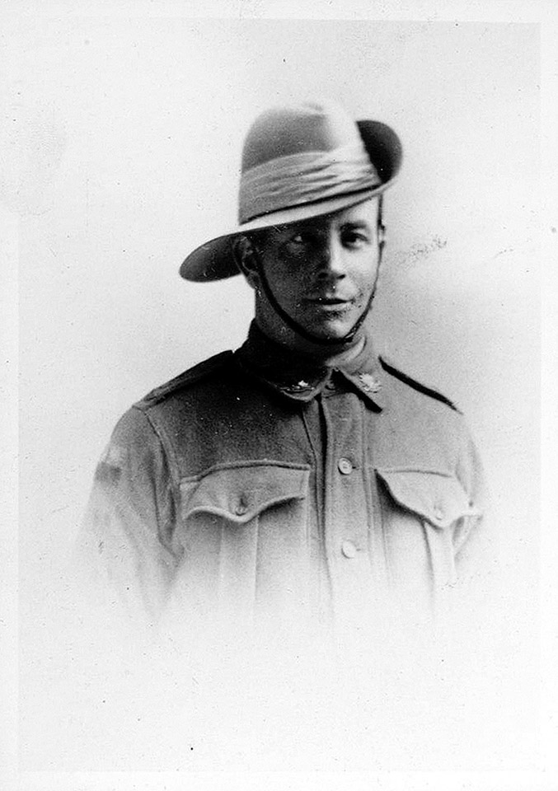
Notes:
Photographic head and shoulders portrait of Bill Hayden in service dress, c1914
NAM. 1990-04-229-2
Bill Hayden, New Zealand Army, died while serving in Gallipoli, 18 Aug 1915.
By the time the campaign ended, more than 130,000 men had died: at least 87,000 Ottoman soldiers and 44,000 Allied soldiers, including more than 8,700 Australians. Among the dead were 2,779 New Zealanders, about a fifth of all those who had landed on the peninsula. (NZ government source).
In the wider story of the First World War, the Gallipoli campaign made no large mark. The number of dead, although horrific, pales in comparison with the death toll in France and Belgium during the war. However, for New Zealand, along with Australia and Turkey, the Gallipoli campaign is often claimed to have played an important part in fostering a sense of national identity.

