Slide 1
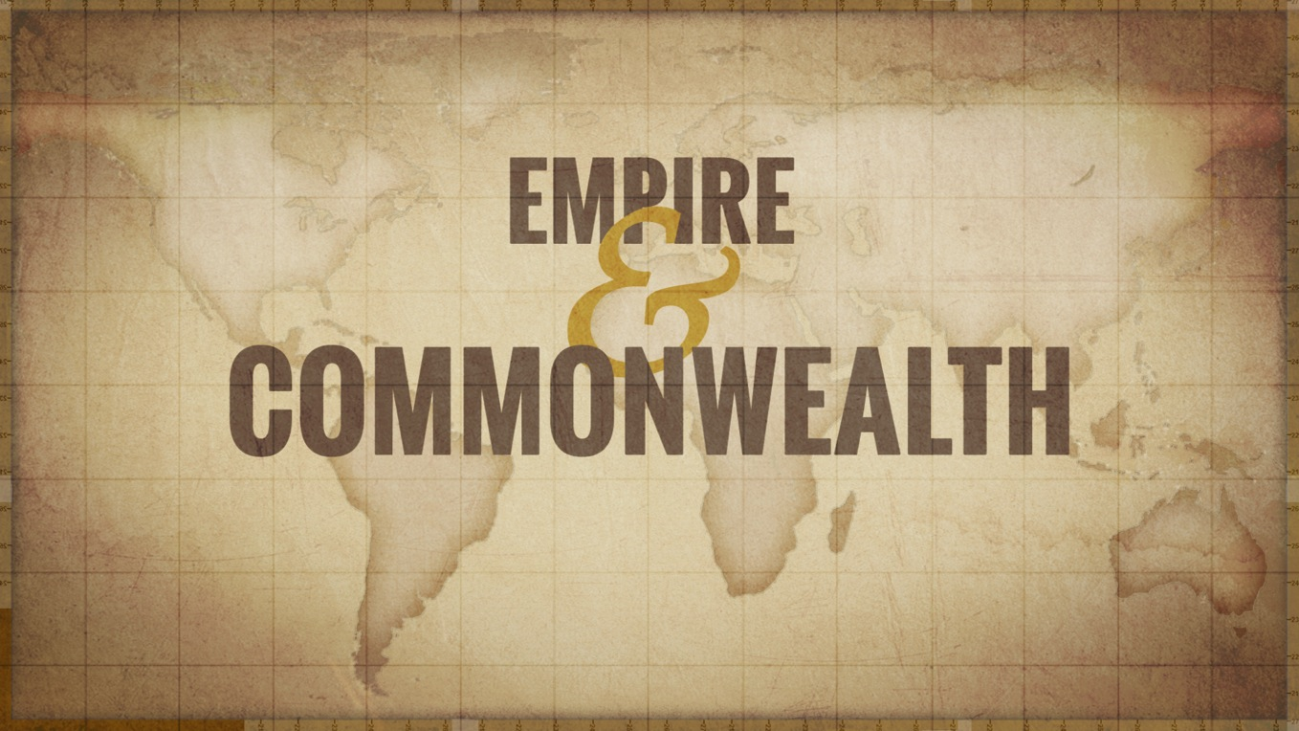
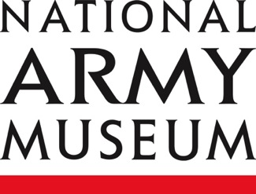
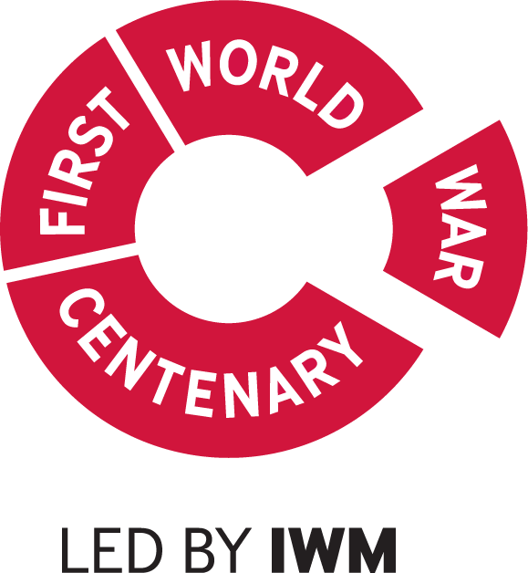
Palestine 1918
Notes:
This resource gives captioning information for the images used in the accompanying film.

Slide 2
This PowerPoint presentation contains a selection of images from the NAM’s photographic collection. The images are designed to be used in conjunction with the associated video and teachers’ notes.
Unless otherwise stated in the notes, the images can be freely used for non-commercial purposes within the classroom. You can use the entire presentation or choose individual images for use in other non-commercial contexts. When using individual images in other contexts, please always retain the attribution statements provided in this document (e.g. NAM. 2005-08-66-1).
By downloading this document and using these images you agree to these terms of use, including your use of the attribution statement specified for each object by NAM.

Slide 3
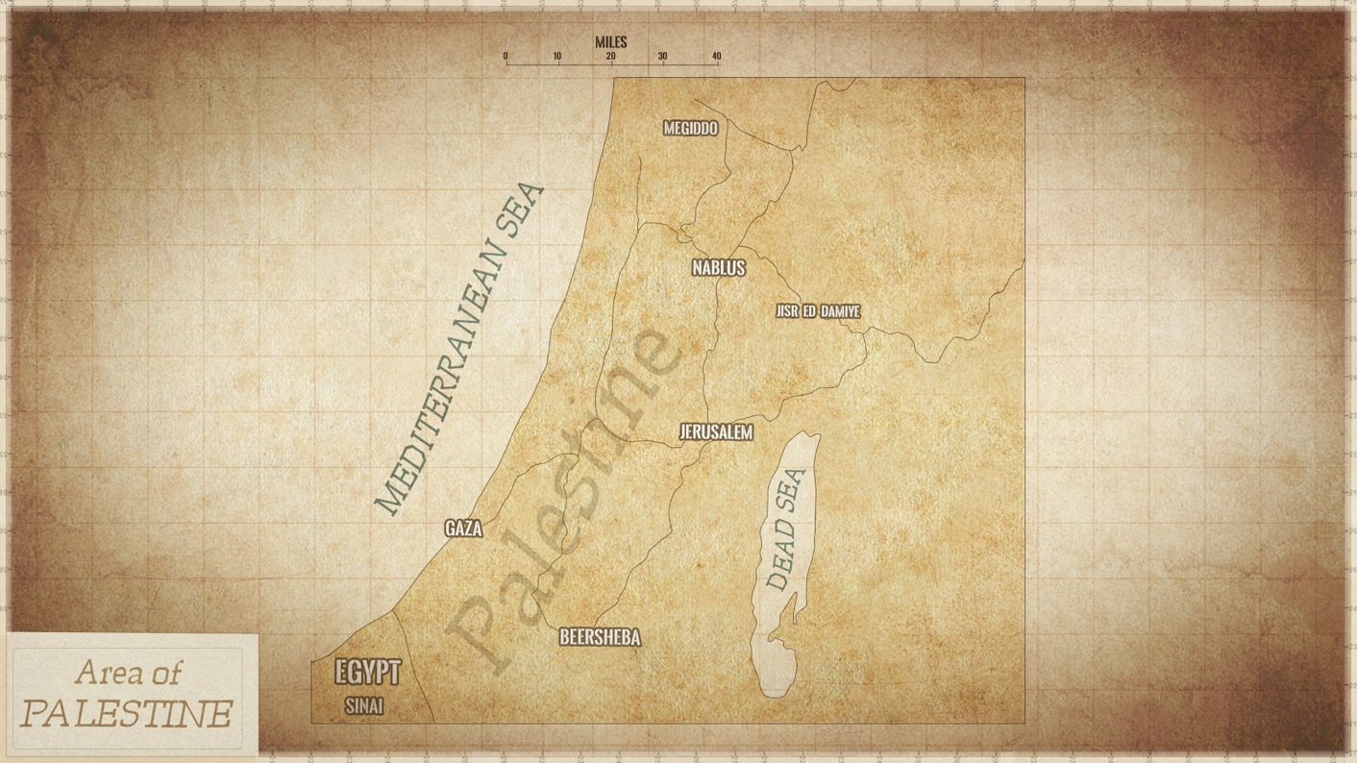

Slide 4
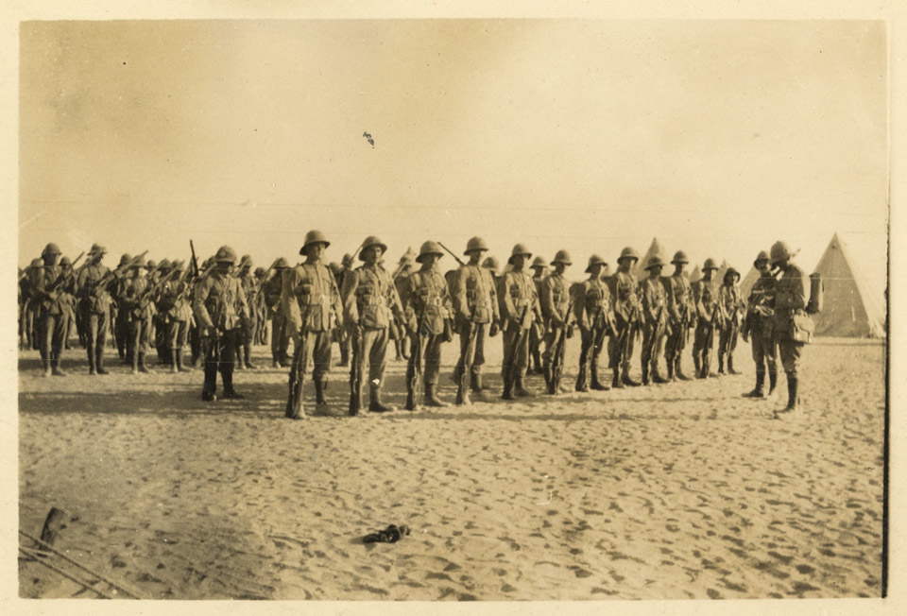
Notes:
Part of a company from the Shropshire Yeomanry on parade in Shusha, in the Libyan desert, 1916
NAM. 2002-05-1-105
The long shadows help to reveal the early start to the morning – the picture was taken by a member of the company at 6.30am.
The soldiers are wearing the distinctive ‘Wolseley Helmet’. The Wolseley helmet was named after the Army Chief of Staff during the late Victorian era, Sir Garnet Wolseley. It consisted of cloth over cork or pith (often from the sola plant). Helmets of this style continued to be used by the military until the 1940s.

Slide 5
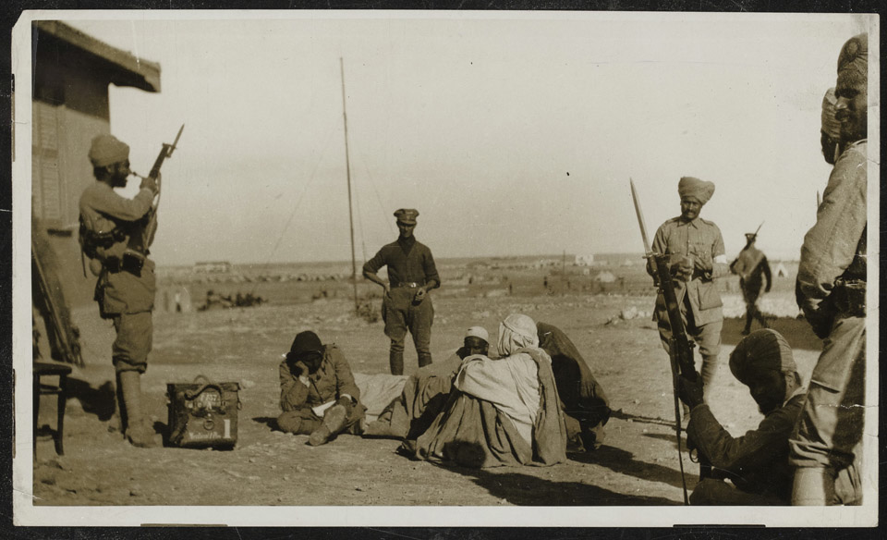
Notes:
Indian Army soldiers stand guard over a group of wounded Bedouin soldiers at Mersa Matruh in western Egypt, 1915
NAM. 2002-02-589-9
In 1915 the Ottoman Turks attempted to breach British defences on the Suez Canal and raise an Islamic revolt in Egypt. In support of these operations the Senussi Arabs attacked the British from the west, but were defeated by the Western Frontier Force under Major-General A Wallace.

Slide 6
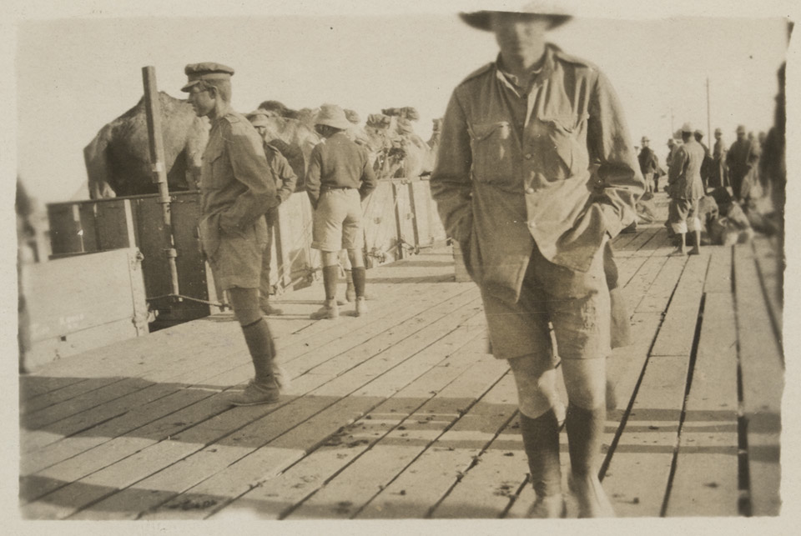
Notes:
Australian troops on a troop ship, c1917
NAM. 2002-05-1-99
As well as soldiers the troop ships also carried equipment and animals such as the camels featured in this photograph.
Despite wearing shorts to better cope with the heat, the soldiers are still wearing woollen puttees wound tightly round the lower half of the leg.

Slide 7
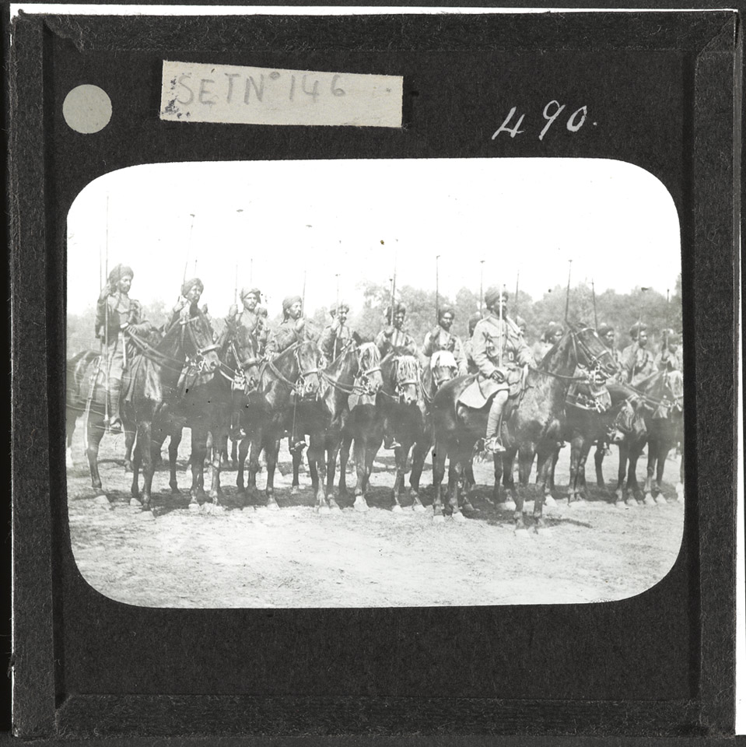
Notes:
Indian cavalry, Palestine, c1917
NAM. 1978-11-157-20-17
This is one of a series of Lantern Slides featured in this presentation. The Magic lantern, as it is commonly known, is the forerunner of the modern slide projector. Its purpose was to present a more animated image than a still photograph, in order to try and bring the subject matter alive, and one that could be viewed by many at the same time.
The officer in the foreground is holding a cavalry sword where as his men behind are armed with lances. Although the lance was somewhat dated by this period when compared to machine gun and rifle fire, it was still consider a fearful and effective weapon if the cavalry got close enough to the enemy. The cavalry were also armed with carbines (short rifle) which could be used if stationary.

Slide 8
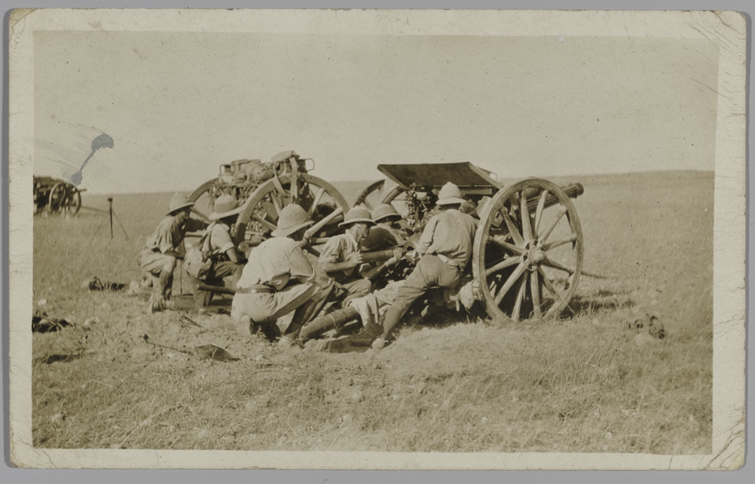
Notes:
13-pounder gun, Palestine, 1915
NAM 1981-08-56-1
In 1903 two types of Quick Firing gun - a 13-pounder and an 18-pounder - underwent extensive trials, the 13-pounder being adopted for service with the Royal Horse Artillery and the 18-pounder by the Royal Artillery. By 1906 the regular divisions of the army were equipped with the new guns, which could both be fired at a rate of 20 aimed rounds per minute. The fire was also very accurate. As the First World War (1914-1918) progressed the 13-pounder came to be considered too light for the effective delivery of high explosive shells and it was relegated to fronts in the Middle East and Salonika.

Slide 9
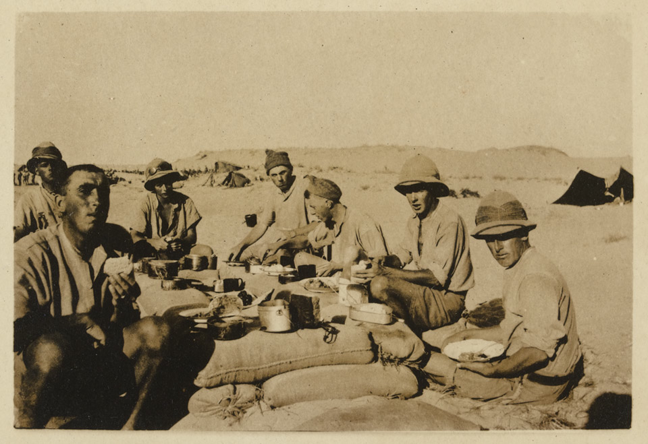
Notes:
Dinner in the desert, 1916
NAM. 2002-05-1-111
Photograph of troops eating a meal in the desert, 1916-18 (c).
Associated with Corporal Joseph Egerton, Shropshire Yeomanry, World War One, Egypt and Palestine (1914-1918), 1916-1918. Corporal Egerton took many photographs of his fellow soldiers during regular activities.

Slide 10
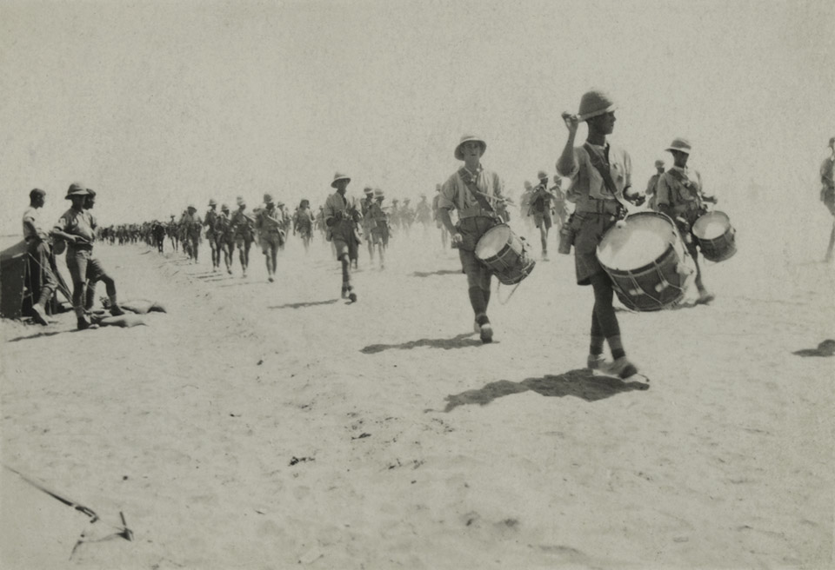
Notes:
British troops on the march in Palestine, 1917
NAM. 2002-05-1-20
Drummers are in the foreground of the picture. Drums have historically been used as communications on the battlefield, as well as a vital part of the training and discipline of troops, and the pageantry associated with military parades. These parades also have strong connections with morale, by making soldiers appear warlike and efficient, which could be seen as a deterrent to their enemies.

Slide 11
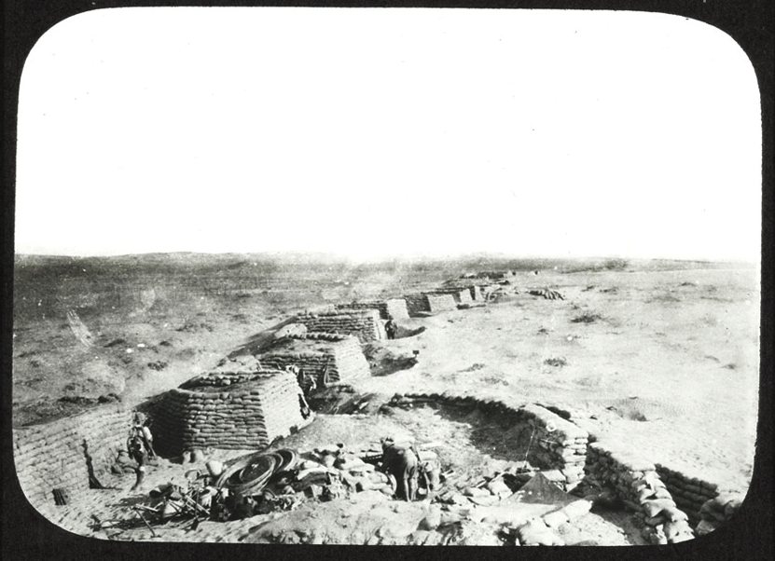
Notes:
Defensive positions, c1917
NAM. 1978-11-157-20-36
The defences are constructed from sandbags placed upon one another and form both a protective wall, as well as a series of sangars to house the soldiers. What is likely to be a communication trench is also visible running to the right of the picture. This trench would allow the troops to move around the immediate area under a certain amount of cover.

Slide 12
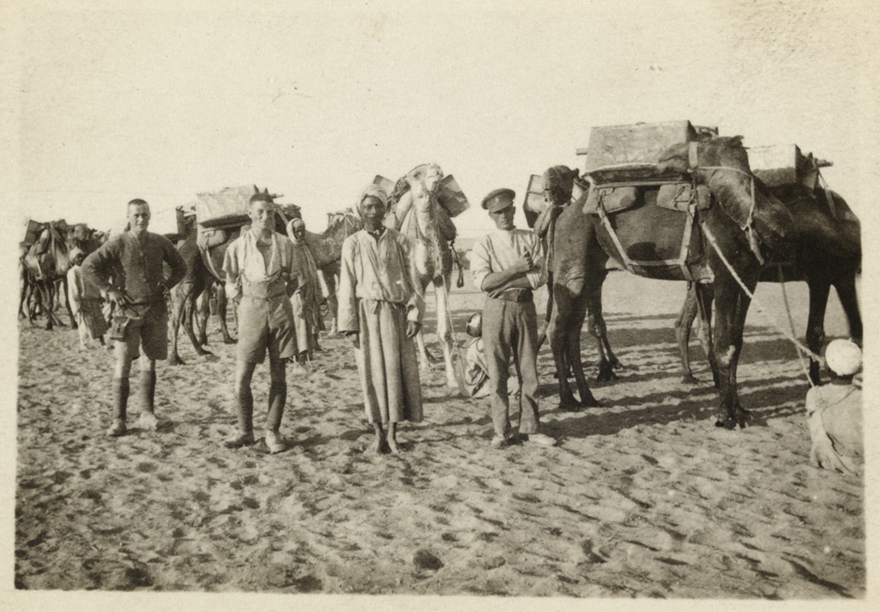
Notes:
Camels and their drivers, carrying water for troops in the desert, Palestine, 1917
NAM. 2002-05-1-88
The British Army made extensive use of camels in this region due to their natural suitability to the harsh desert conditions, as pack animals, long-range patrols and as a fighting force. The Imperial Camel Corps, a camel-mounted infantry force, was raised in 1916 for service in the Middle East, and was disbanded in 1919.

Slide 13
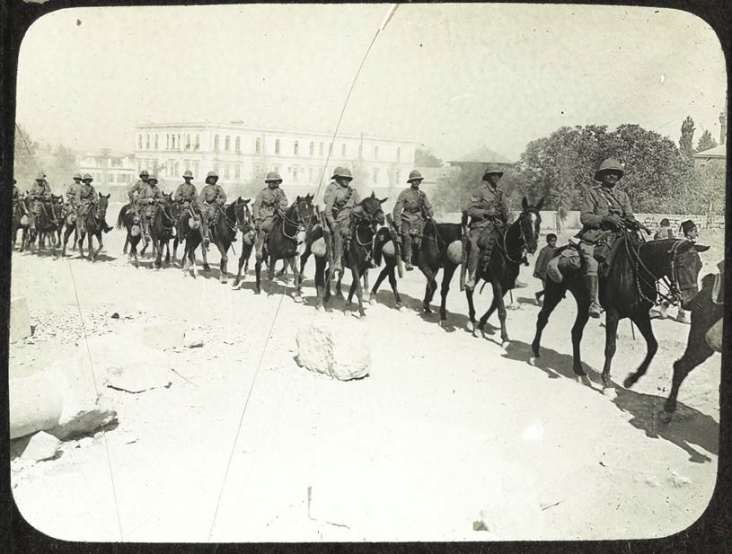
Notes:
British Cavalry armed with rifles, Palestine, c1917
NAM. 1978-11-157-20-21
Ammunition bandoliers are draped across the horses in front of the riders.

Slide 14
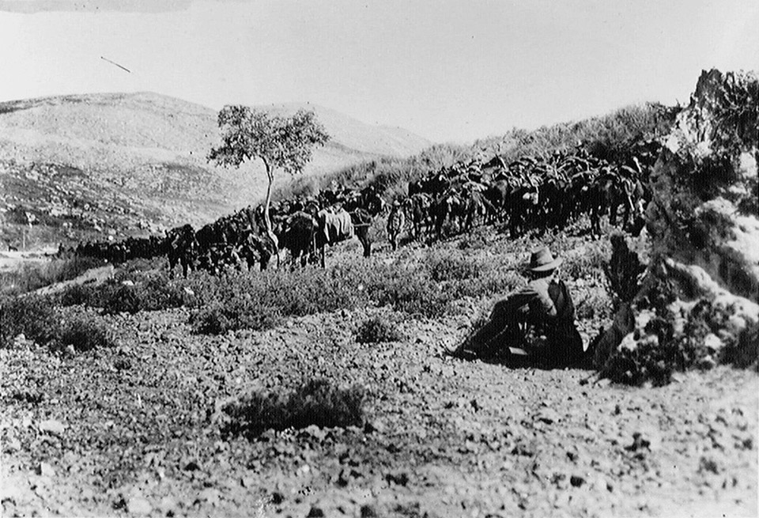
Notes:
Australian cavalry waiting just outside Nablus, 1918
NAM. 1999-10-8-8
The Battle of Nablus (19-25 September 1918) was part of General Sir Edmund Allenby's victorious Megiddo offensive. The Australian 5th Light Horse Brigade, under Brigadier-General Macarthur-Onslow, took the town on 21 September.
The Australian soldiers are wearing the slouch hat. The word ‘slouch’ refers to the sloping brim. The brim is made from rabbit-fur felt or wool felt. The hat is always worn with a puggaree – a folded band of cloth around the crown. The wide brim provided shelter from the sun, but there is the ability to fasten up the brim to the crown on one side, using a press stud. This was to allow different drill manoeuvres on the parade ground.

Slide 15
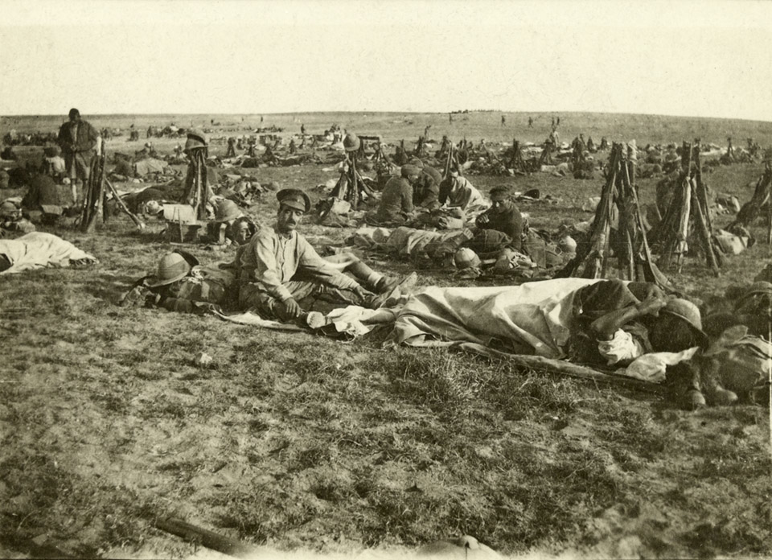
Notes:
Early morning prior to the Beersheba offensive, 1917
NAM. 2002-05-1-1
The soldiers slept in the open air prior to the upcoming battle. Their rifles (Lee Enfield SMLEs) are balanced together, vertically, in cone shapes. The camp must have been well-defended, as the soldier sleeping under his ground cover has taken his boots off and placed them next to his head. He shades his eyes from the morning sun with his steel helmet. A mixture of head wear can be seen.

Slide 16
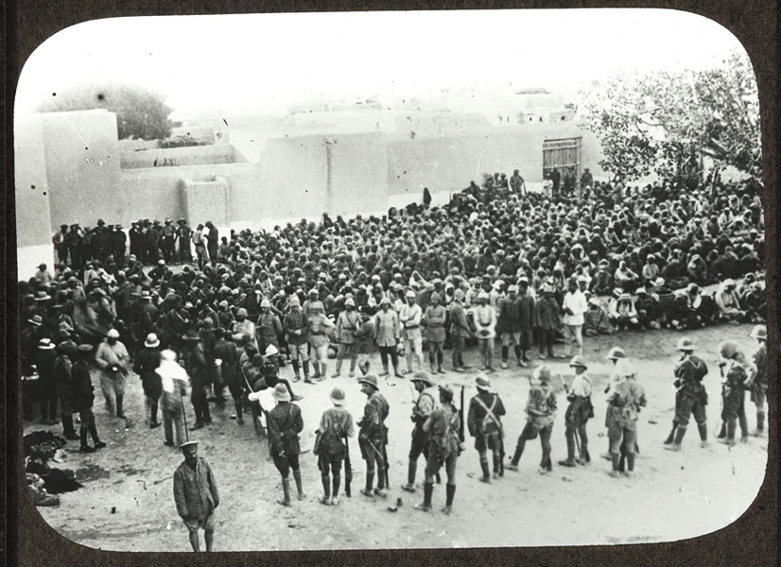
Notes:
The entry into Jerusalem, 1917
NAM. 1978-11-157-20-40
General Sir Edmund Allenby, who was appointed Commander of British forces in Egypt in June 1917, was determined to conquer Palestine, defeat the Turks and if possible, drive them out of the war altogether. He reached Jerusalem by 9 December, but was prevented by an unusually wet winter and demands for troops for the Western Front from continuing his offensive until late summer 1918.

Slide 17
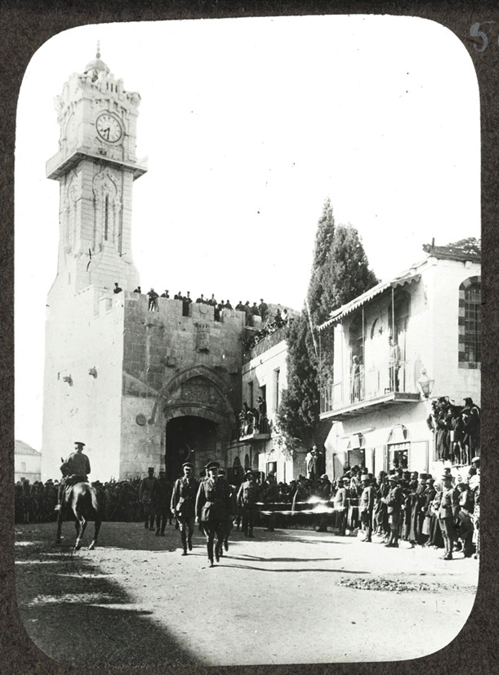
Notes:
General Sir Edmund Allenby entering Jerusalem, 1917
NAM. 1978-11-157-20-30
Allenby, the commander of the Egyptian Expeditionary Force, chose to make his entrance into the holy city on foot so as not to appear as a conqueror. He is pictured here entering via the Jaffa gate.

Slide 18
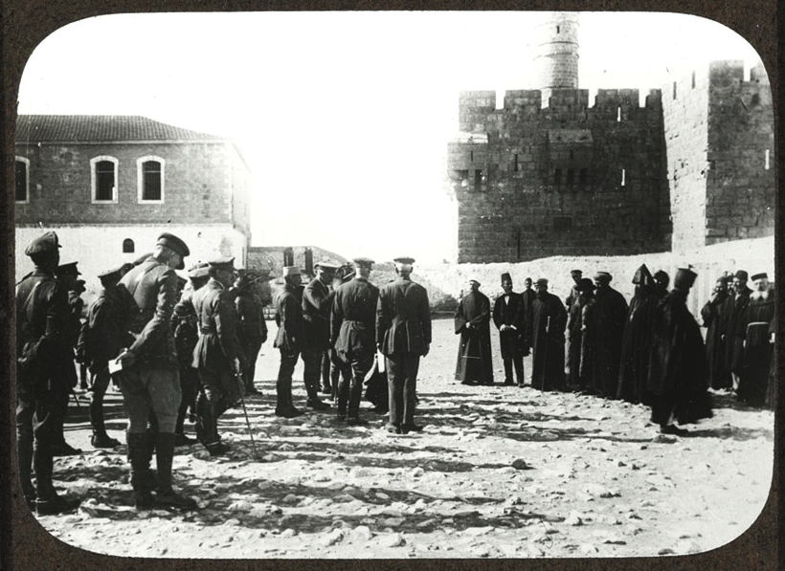
Notes:
General Sir Edmund Allenby receiving the notables of Jerusalem, 1917
NAM. 1978-11-157-20-31
Allenby, the commander of the Egyptian Expeditionary Force is pictured here with his staff meeting the notables of the city and the heads of the religious communities in the Barrack Square.

Slide 19
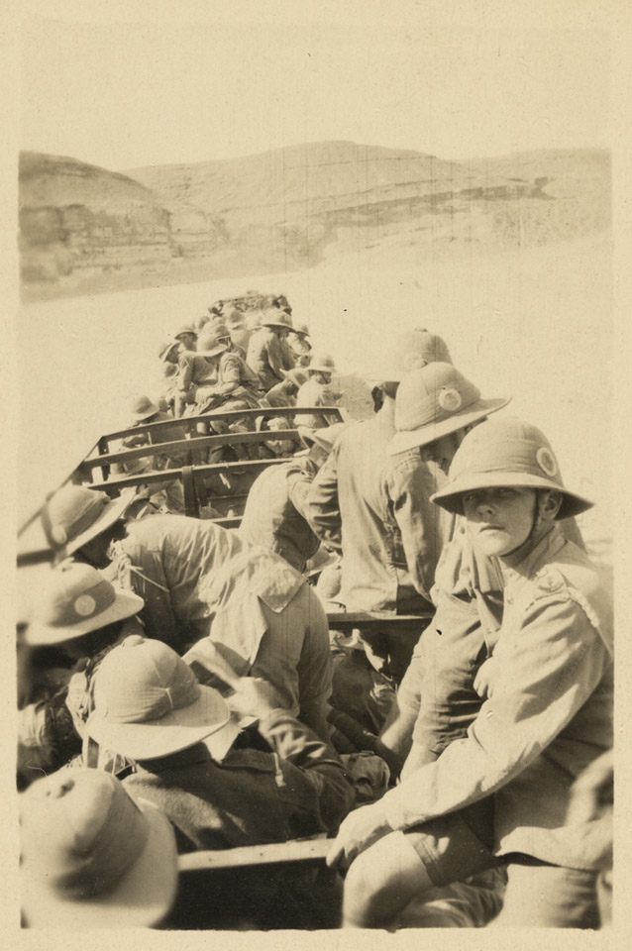
Notes:
Troops being transported across the desert, Palestine, 1917
NAM. 2002-05-1-89
Troops were transported by both trains and motor vehicles, which must have provided some relief from long marches in the hot and dusty climate. The sandy ground must have caused some difficulty to the mechanical equipment, however.

Slide 20
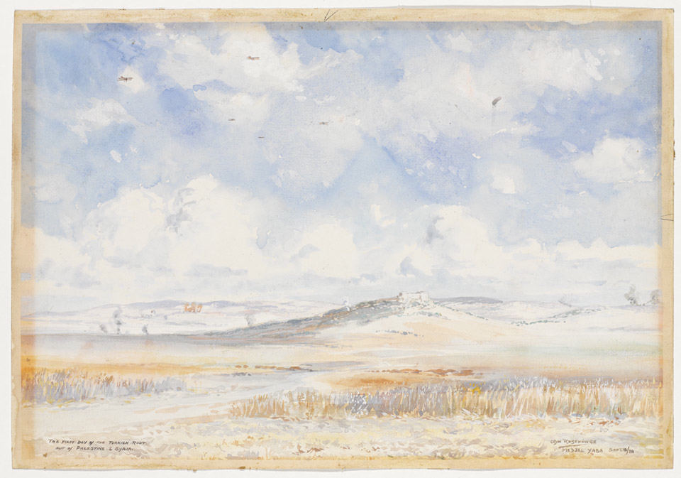
Notes:
Medjel Yaba - The First Day of the Turkish rout out of Palestine and Syria, before the Battle of Meggido, 1918
NAM. 2011-06-2-1
Medjel Yaba - The First Day of the Turkish rout out of Palestine and Syria.
Watercolour by Private Odin Rosenvinge, Army Service Corps, 1918.
The action at Medjel Yaba was a preliminary operation to the Battle of Meggido, which started the following day. This battle was the key Allied victory of the Sinai and Palestine campaign. Achieved with relatively few casualties, it involved a series of skilful manoeuvres and the co-ordinated use of aeroplanes, artillery, infantry and cavalry.
In this watercolour you can see several aircraft in the sky. Waves of British and Australian aircraft supported General Allenby's attacks, bombing and strafing the Ottoman columns as they retreated.

Slide 21
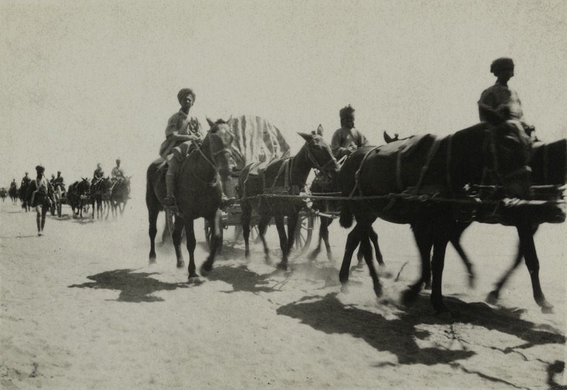
Notes:
Indian transport crossing the desert in Palestine, 1917
NAM. 2002-05-1-28
Horse drawn wagons and mules were used to transport ammunition and guns across the desert. The soldiers are mounted on the animals in order to maximise the supplies taken on board the wagons. Others soldiers are on foot, and could be useful if needed to defend the supplies from attack.

Slide 22
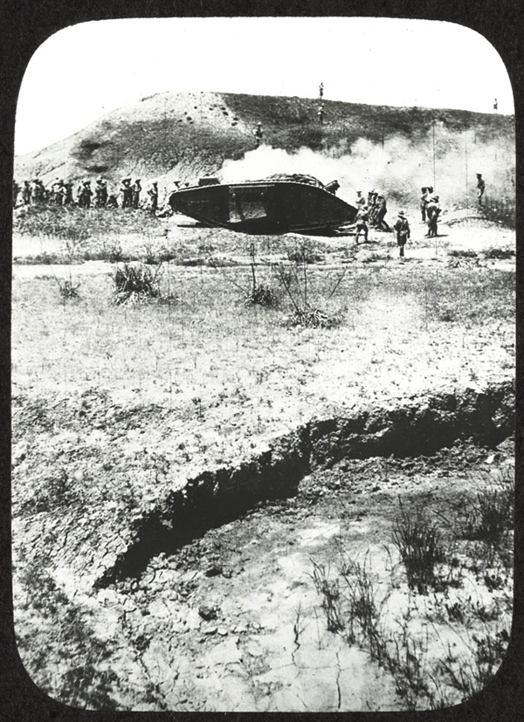
Notes:
Tank advance, c1918
NAM. 1978-11-157-20-47
Tanks were still a relatively new technology. While powerful weapons, they were slow and had very poor visibility which made them vulnerable to anti-tank measures unless they had infantry in support, as can be seen here.

Slide 23
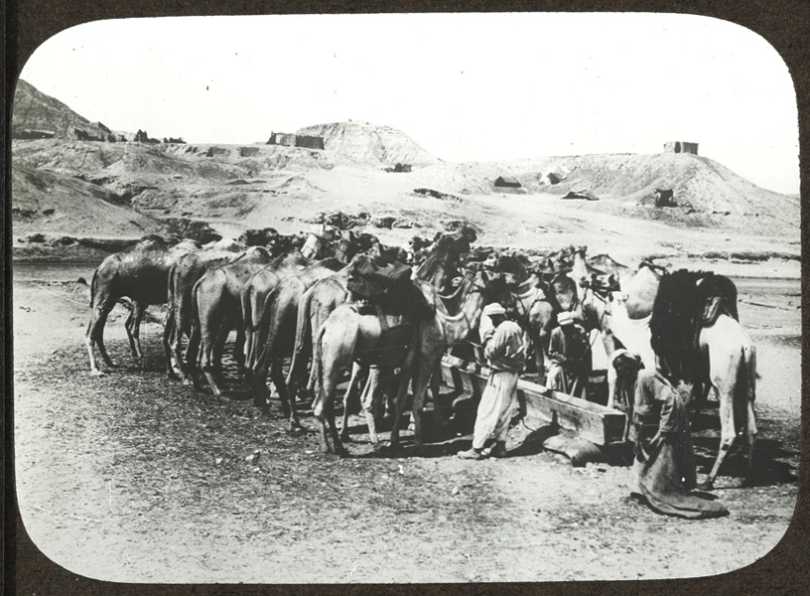
Notes:
Camel transport using a water trough, c1918
NAM. 1978-11-157-20-42
Although camels could travel further than horses without water, they needed to drink a good quantity before starting the journey. Transport camels often had local handlers who were more used to dealing with the animals.

Slide 24
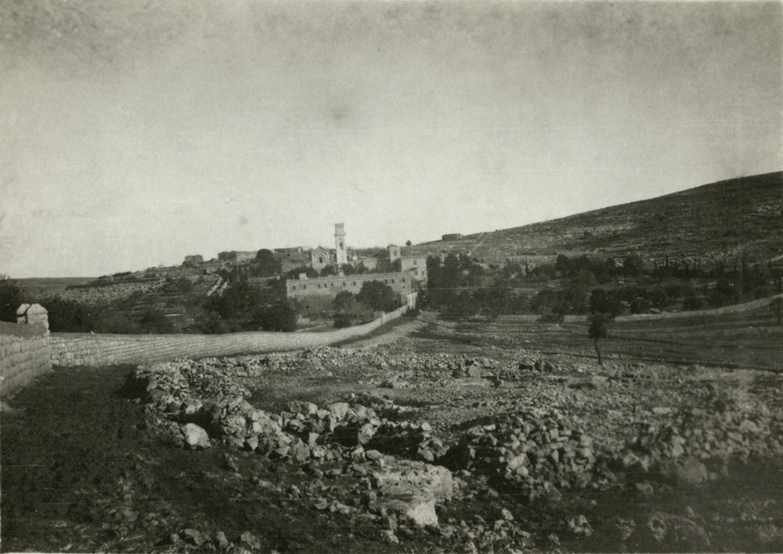
Notes:
A view of Emmaus [Imwas], Palestine, showing the French monastery, 9 Jan 1918
NAM. 2002-05-1-23
The terrain was not all sand. There was a lot of rocky ground with hills and sparse covering of trees and bushes.

Slide 25
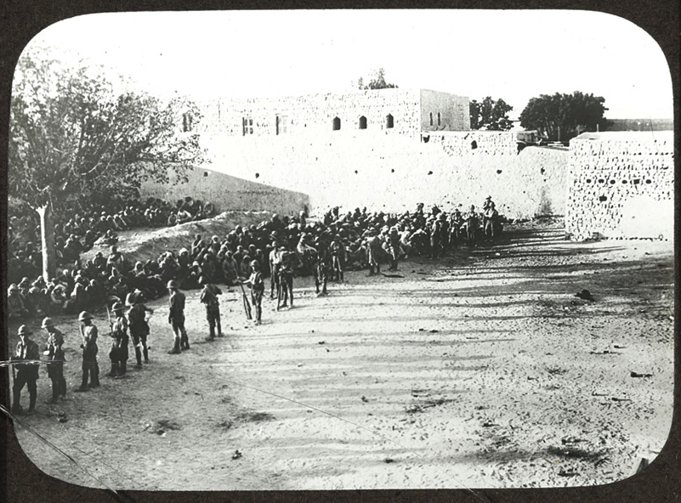
Notes:
British troops in Jerusalem, 1917
NAM. 1978-11-157-20-39

Slide 26
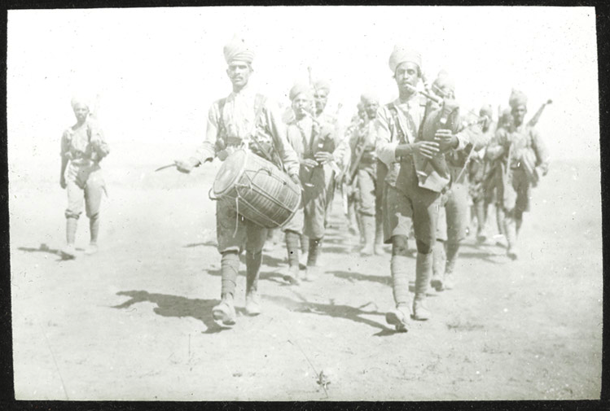
Notes:
Indian pipes and drums, Palestine, c1917
NAM. 1978-11-157-20-18
Indian regiments had their own bands which often feature drums and their own form of bagpipes. Martial music was a form of communication and presentation, and would assist troops to maintain speed and consistency in marching.

Slide 27
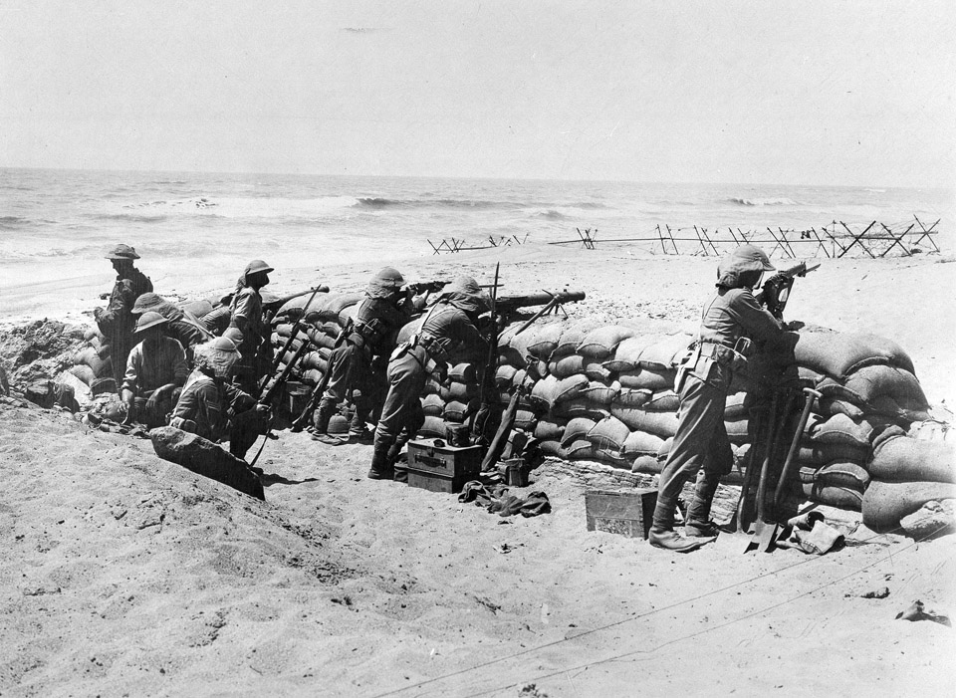
Notes:
Manning defences on the coast near Arsuf in Palestine, 1918
NAM. 1999-10-8-10
2nd Battalion Black Watch behind sandbag defences on the coast near Arsuf, June 1918
As well as rifles (Lee Enfield SMLEs) with fixed bayonets the soldier in the centre is using a Lewis Machine Gun.
The Lewis Gun, with its distinctive barrel-cooling shroud and top-mounted drum magazine, was the British Army's most widely used machine gun during the First World War (1914-18). Each Lewis Gun required a team of two gunners, one to fire and one to carry ammunition and reload. All of the members of an infantry platoon would be trained in the use of the Lewis Gun so that they could take over if the usual gunners were killed or wounded.
These soldiers are wearing the normal steel helmet more associated with the Western Front, with a neck cover added.
After the capture of Jerusalem in December 1917, General Sir Edmund Allenby’s army had to remain on the defensive as further advances were temporarily delayed as troops were transferred from Palestine to France in the wake of the German Spring Offensive.

Slide 28
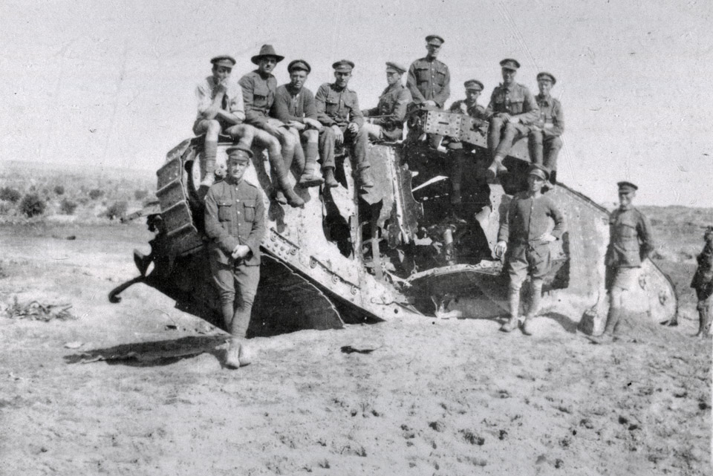
Notes:
Wrecked British Mark I tank, ‘War Baby’, outside Gaza, 1918
NAM. 1999-07-93-8
A Mark I male tank weighed 28 tons and had a top speed in fourth gear of only 6km/h (3.7mph). Within the tank, temperatures of over 45C (113F) could be reached. With little ventilation, crews would gradually begin to feel sick from the fumes building up inside. The Daimler engine also made so much noise that talking was impossible; the crew communicated through hand signals or banging the side of the tank. The damage to the side of the tank suggests it was struck with artillery fire.

Slide 29
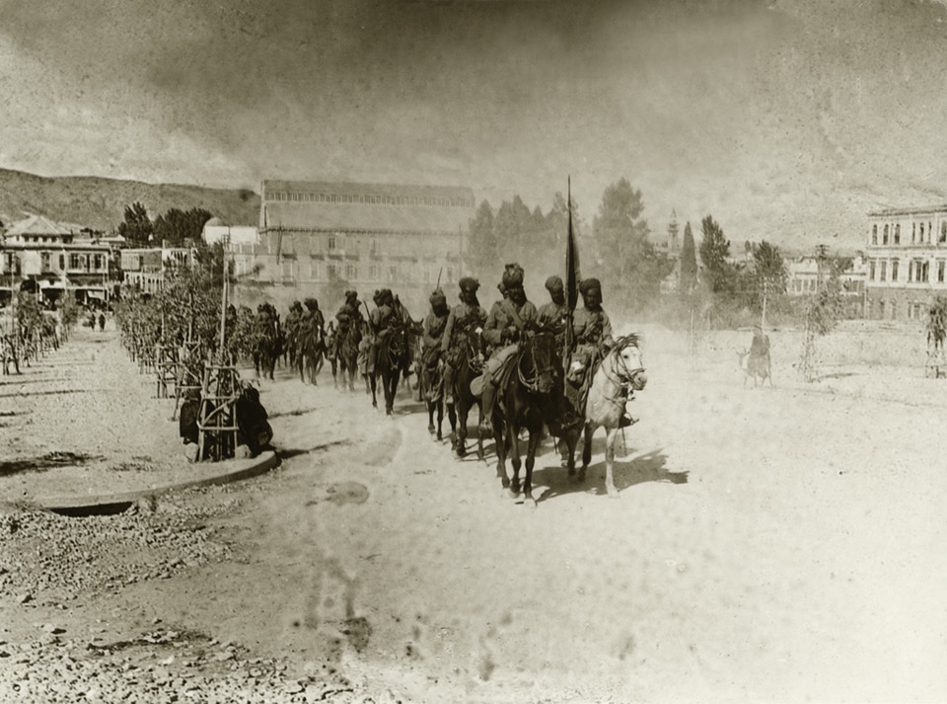
Notes:
9th Hodson's Horse in General Chauvel's march through Damascus, 1918
NAM. 1953-07-25-31
General Sir Edmund Allenby, who was appointed Commander of British forces in Egypt in June 1917, was determined to conquer Palestine, defeat the Turks and if possible, drive them out of the war altogether. He reached Jerusalem by 9 December, but was prevented by an unusually wet winter and demands for troops for the Western Front from continuing his offensive until late summer 1918.
The cavalry, part of General Sir Henry Chauvel's Desert Mounted Corps, played a prominent role in the final major battle of Megiddo (19-21 Sept 1918), and Allenby swept on into Syria, occupying Damascus, Beirut and, on 25 October, Aleppo. A composite squadron from each regiment took part in a formal and official march through Damascus on 2 October. It was intended as a show of force rather than a triumphal entry.

Slide 30
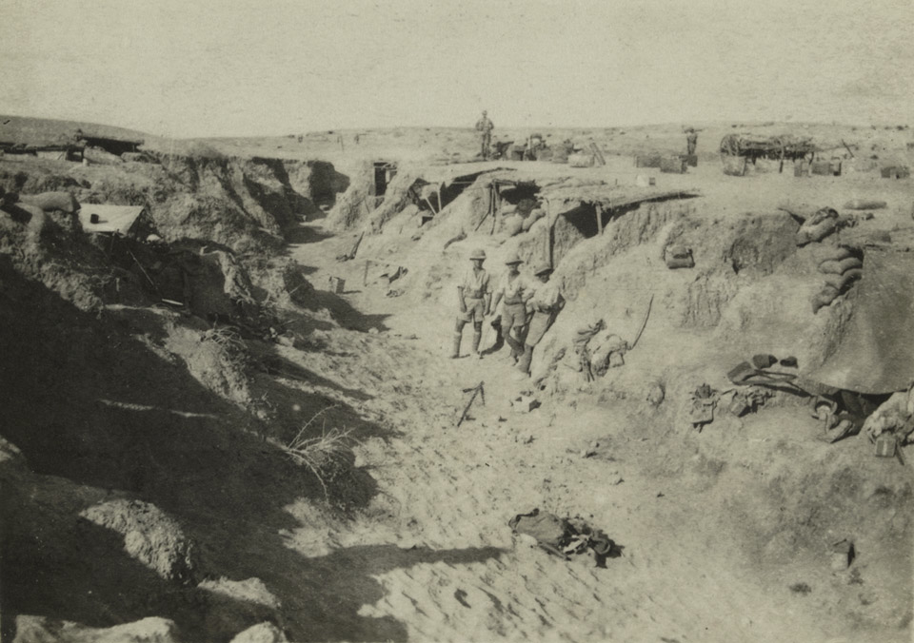
Notes:
Troops in a wadi, c1917
NAM. 2002-5-1-30
Some of the terrain lent itself to natural defensive positions, such as the wadi (dried river bed) depicted. Dugouts have been constructed on the side of the wadi to provide extra cover for the soldiers.

Slide 31
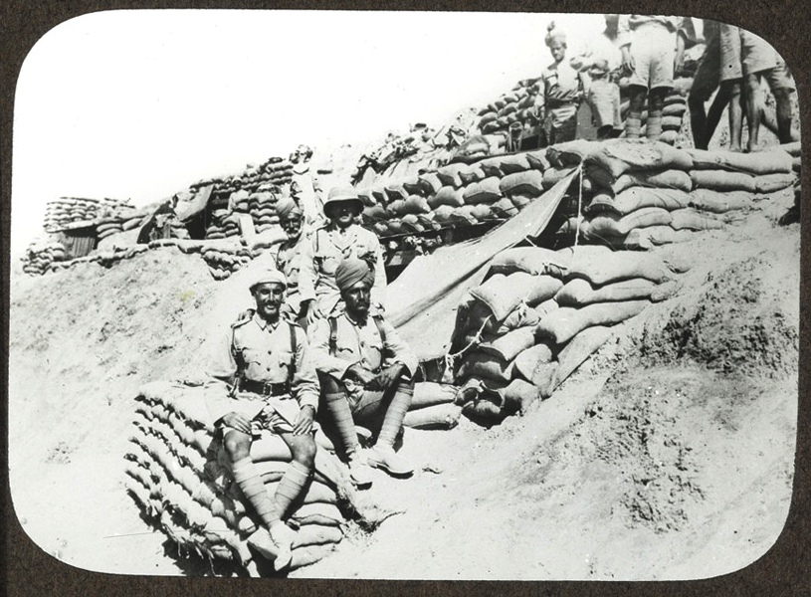
Notes:
Indian troops in the line, c1917
NAM. 1978-11-157-20-16
Sand bags were an easy source of defensive material which meant the troops did not have to always dig trenches. Solidly constructed walls made of many stacked sandbags were bullet resistant, and could withstand blasts from artillery.

Slide 32
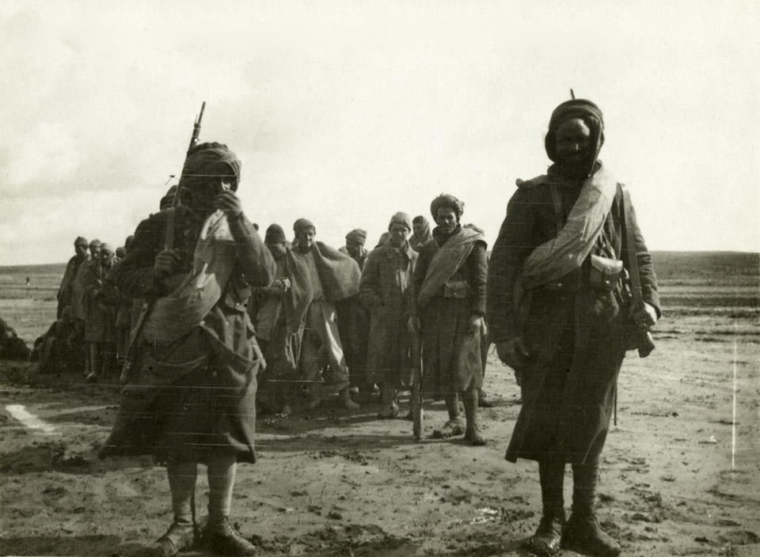
Notes:
Turkish prisoners escorted by French Algerian soldiers, 1917
NAM. 2002-05-1-5
The French allies also recruited from their empire, as was the case with Algeria. Algeria was a French colony from 1830 until 1962 when it became independent. The majority of the Algerian population was Muslim, and they were subject to a form of selective conscription. Citizens of French origin were expected to undertake two years of compulsory military service.

Slide 33
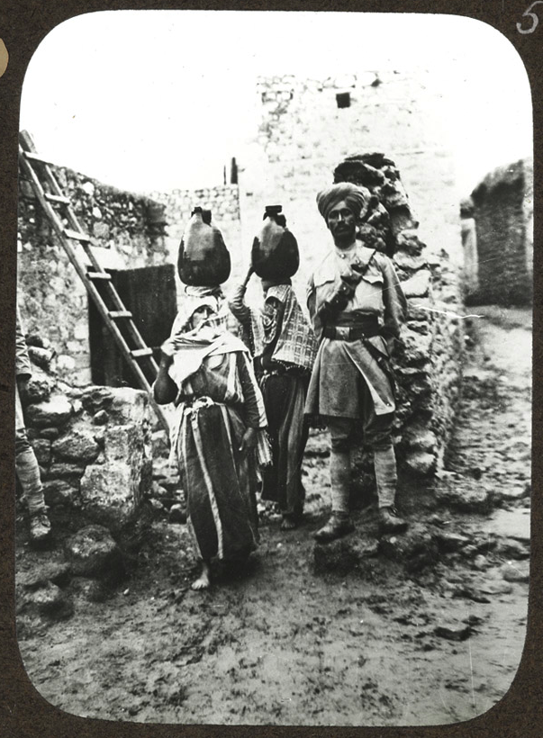
Notes:
A Sikh soldier in a village, c1917
NAM. 1978-11-157-20-25
The chance to explore new countries and interact with new cultures was a key draw for many recruits. Some were excited by visiting new places, as can be seen here. The photographer was clearly keen to capture some ‘exotic’ sights, even though the women in the photograph are keen not to have their picture taken, and conceal their faces. They are going about their daily chore of collecting water.

Slide 34
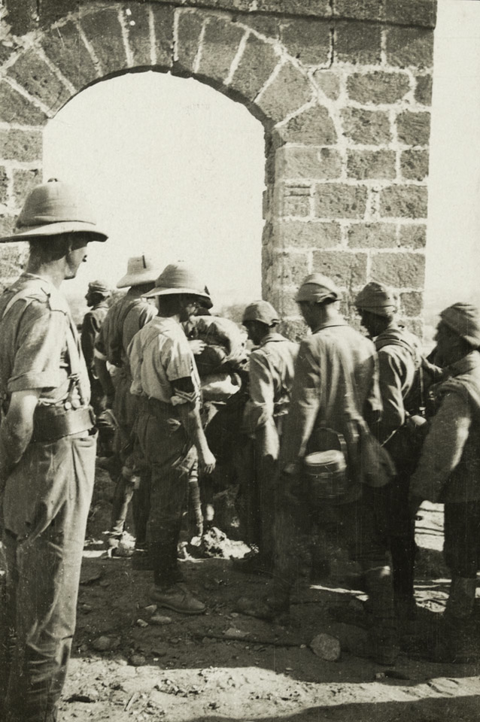
Notes:
Turkish prisoners, Gaza, 1917
NAM. 1990-07-188-32

Slide 35
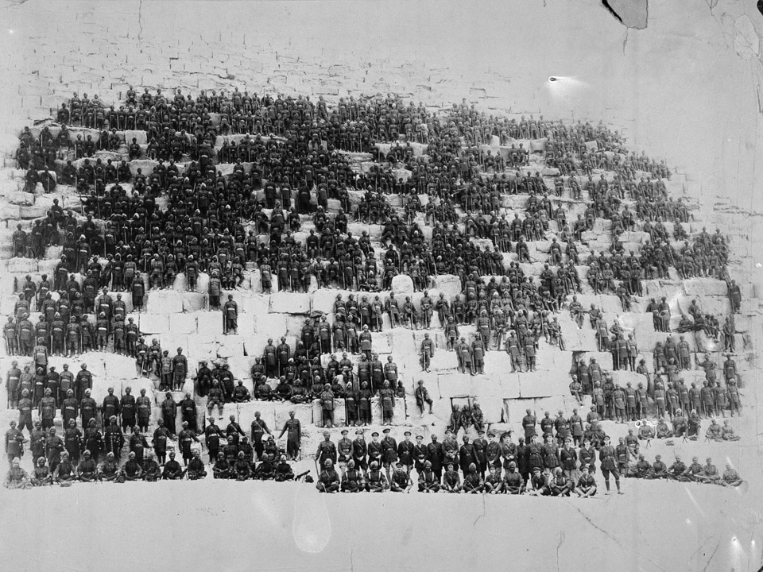
Notes:
38th Dogras on the Great Pyramid, Egypt, 1918
NAM. 1959-11-355-1
The 38th Dogras arrived in Egypt in April 1918 where they joined the 10th Division. The 10th was then undergoing a major reorganisation with many British units being replaced by Indian ones. The regiment went on to serve in Palestine, taking part in the battles of Megiddo and Nablus before helping capture Damascus (1918).
As many tourists do today, the soldiers and officers were keen to have a photograph in a place many would only ever have heard about, and been unlikely to visit before the war afforded them the opportunity. Some unfortunately chose to leave a more permanent mark of their visit, including carving graffiti into the site. It is not currently possible to climb the Great Pyramid in Giza, Egypt, so that it may be preserved.

Slide 36
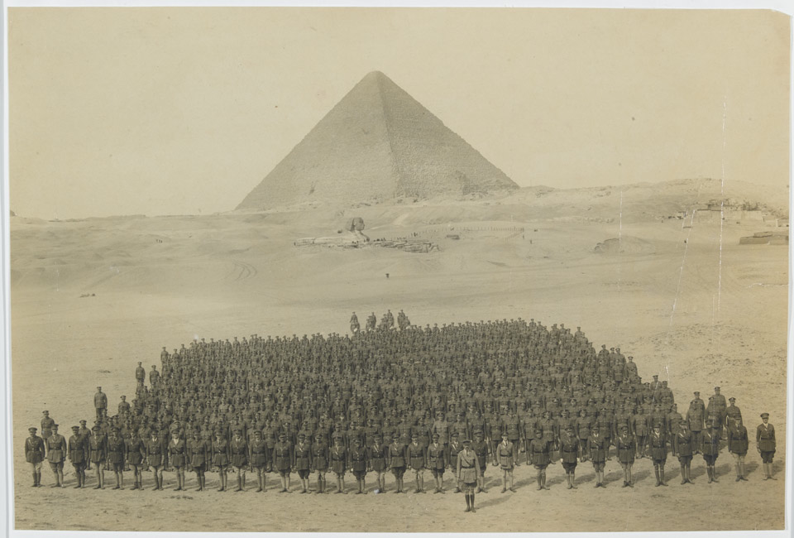
Notes:
Royal Irish Regiment, Giza, c1916
NAM. 1950-10-28-1
Soldiers serving in Egypt were always keen to visit and photograph its historic landmarks. In this image, the officers and men of the Royal Irish Regiment pose for a photograph next to the mysterious Sphinx at Giza. The Great Pyramid of Cheops can be seen in the distance.

Slide 37
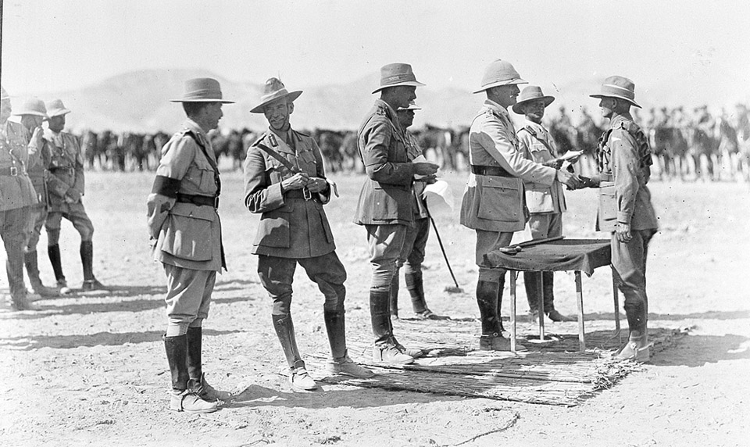
Notes:
The presentation of medals to troops of ANZAC Mounted Division by General Sir Edmund Allenby, 1918
NAM. 1990-11-13-1-274
The Australian and New Zealand (ANZAC) Mounted Division was formed in Egypt in March 1916 from units that had returned from the Dardanelles where they had fought in a dismounted role. During the subsequent Sinai and Palestine campaign the division, commanded by Major General Sir Harry Chauvel and then Major General Edward Chaytor, played a leading role in the defeat of the Ottoman Turks in that theatre.

