Slide 1
Western Front
Notes:
This resource gives captioning information for the images used in the accompanying film.

Slide 2
This PowerPoint presentation contains a selection of images from the NAM’s photographic collection. The images are designed to be used in conjunction with the associated video and teachers’ notes.
Unless otherwise stated in the notes, the images can be freely used for non-commercial purposes within the classroom. You can use the entire presentation or choose individual images for use in other non-commercial contexts. When using individual images in other contexts, please always retain the attribution statements provided in this document (e.g. NAM. 2005-08-66-1).
By downloading this document and using these images you agree to these terms of use, including your use of the attribution statement specified for each object by NAM.

Slide 3
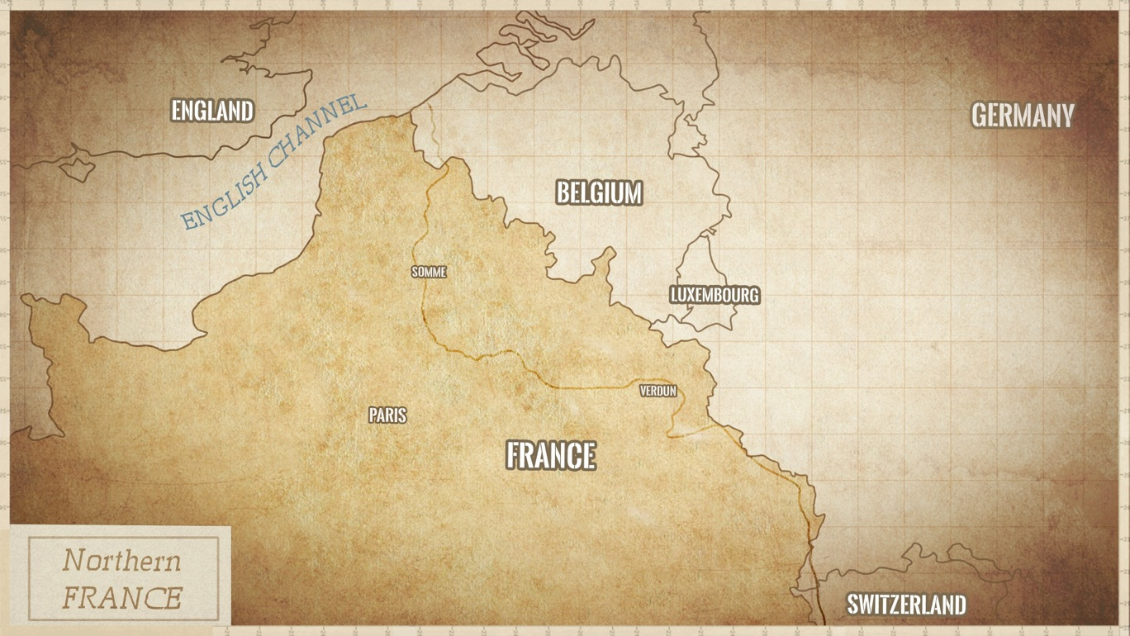

Slide 4
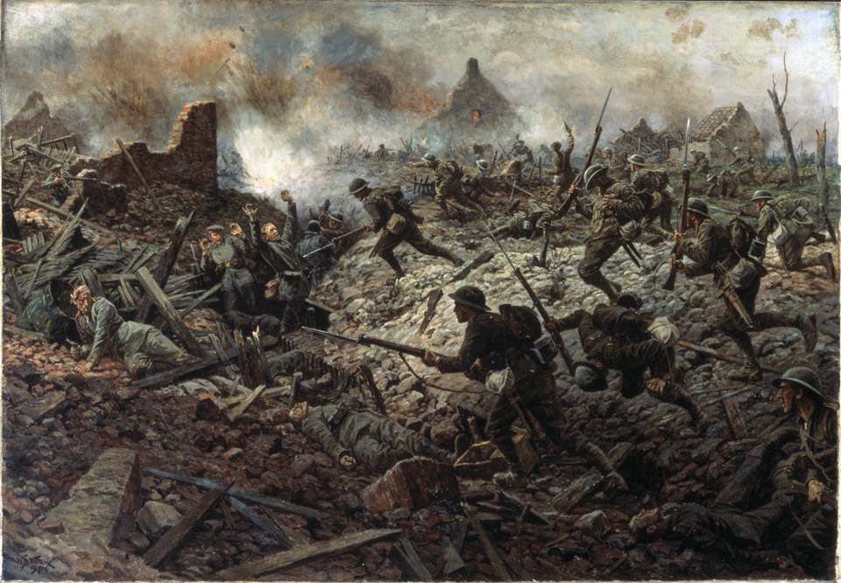
Notes:
Battle of Pozières, 1916
NAM. 1959-11-303-1

Slide 5
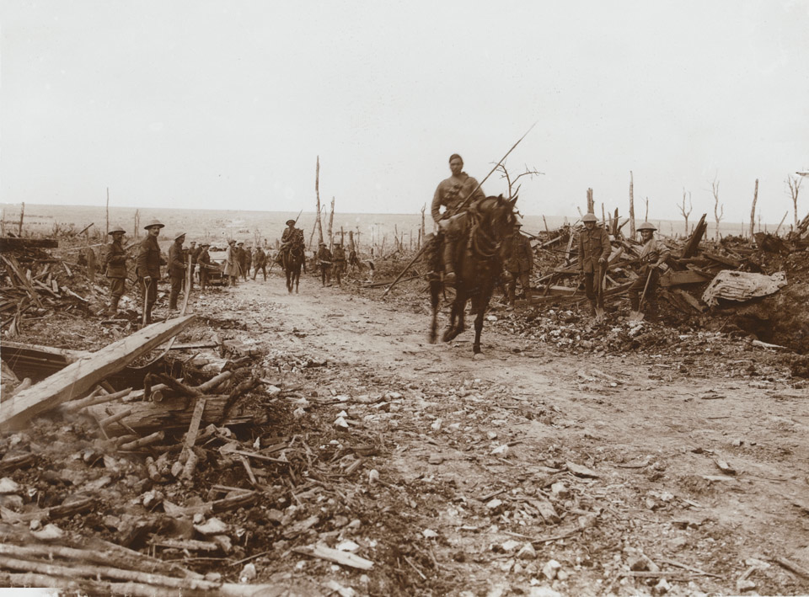
Notes:
A sowar of 9th Hodson’s Horse on the Western Front, c1917
NAM. 1953-07-25-25

Slide 6
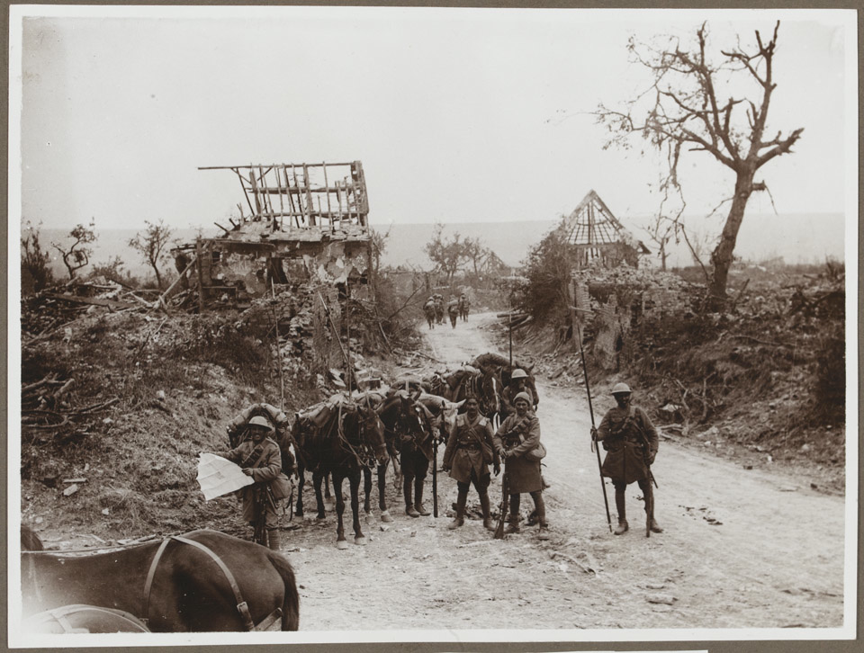
Notes:
9th Hodson’s Horse on the Western Front, c1916
NAM. 1953-07-25-28
Dismounted sowars of 9th Hodson’s Horse consult a map with the war-ravaged landscape of the Western Front visible in the background. In 1916 the regiment served on the Somme as part of the Ambala Cavalry Brigade, 5th Cavalry Division. A small squad of heavily laden infantry are walking down the road in the distance.

Slide 7
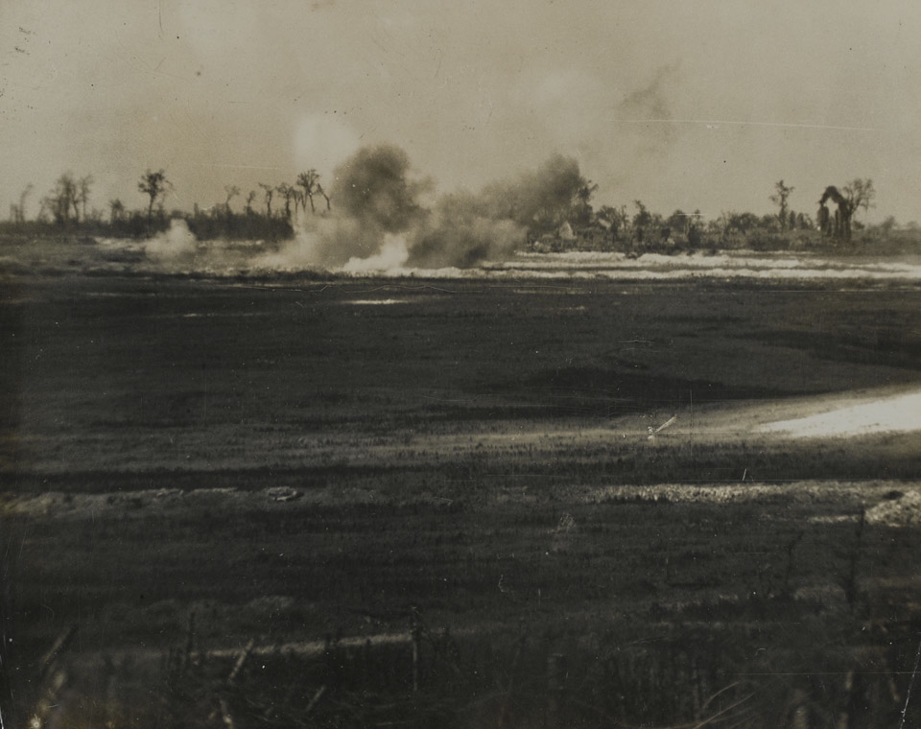
Notes:
Artillery bombard the German trenches prior to the attack, Beaumont Hamel, 1916
NAM. 1952-01-33-55-280

Slide 8
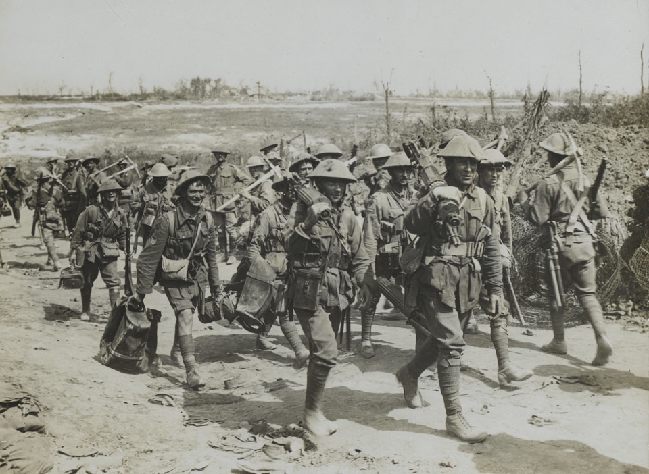
Notes:
Soldiers of 2nd Australian Division returning from the trenches, September 1916
NAM. 1952-01-33-55-13

Slide 9
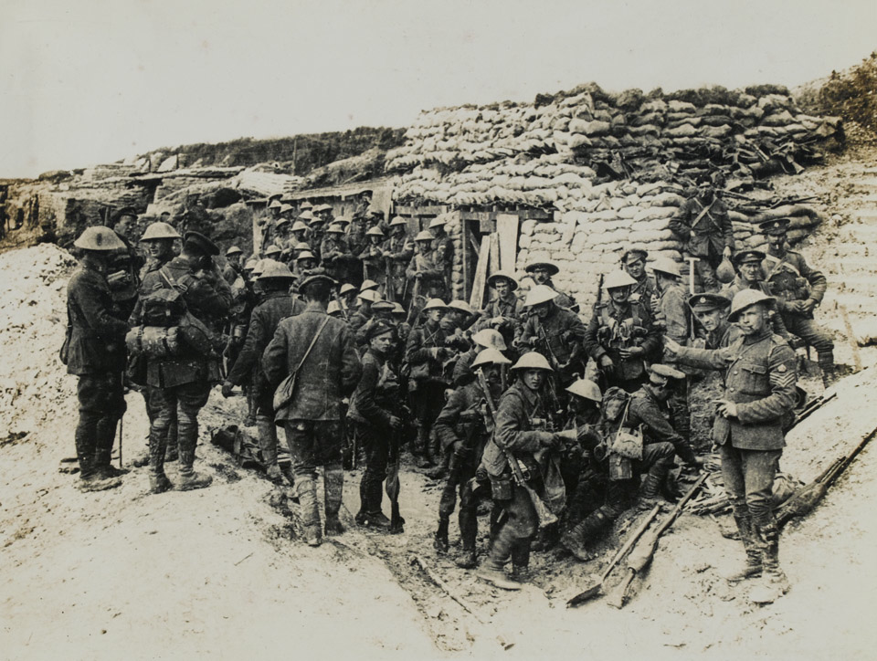
Notes:
16th (Public Schools) Battalion, The Middlesex Regiment, at ‘White City’ opposite Hawthorn Ridge, 1916
NAM. 1992-08-130-1

Slide 10
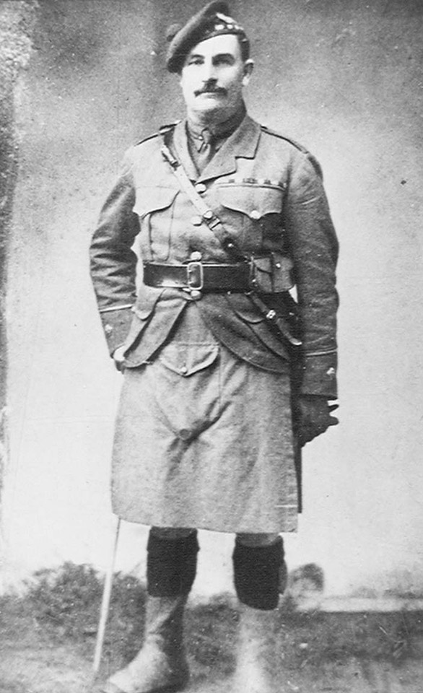
Notes:
Lieutenant Alexander Young VC, South African Scottish, 1916
NAM. 1961-12-662-1

Slide 11
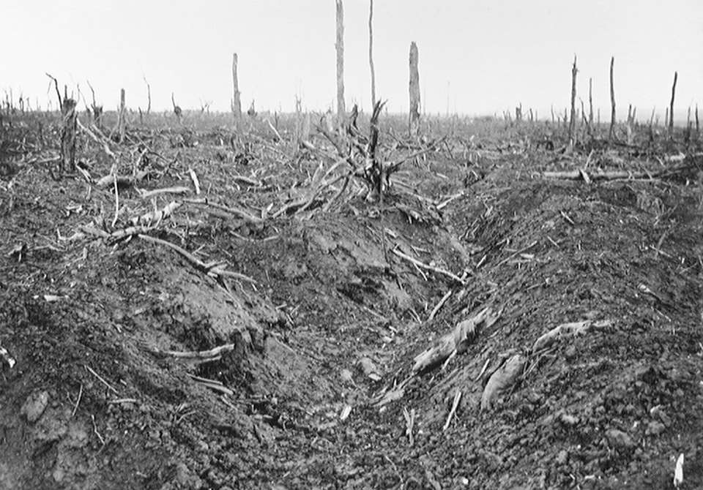
Notes:
An abandoned German trench in Delville Wood near Longueval, September 1916
NAM. 1965-10-209-32

Slide 12
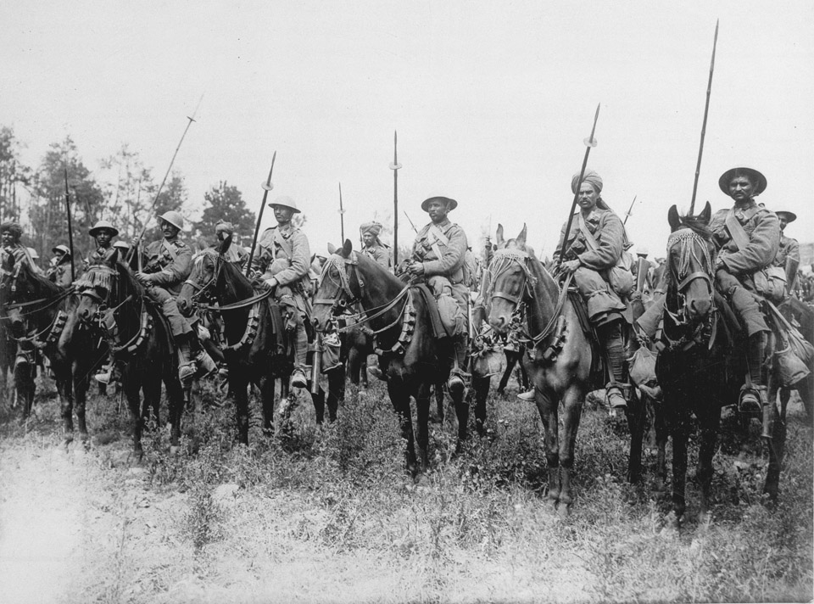
Notes:
Indian cavalry await the order to advance on the Somme, 1916
NAM. 2001-01-279-77

Slide 13
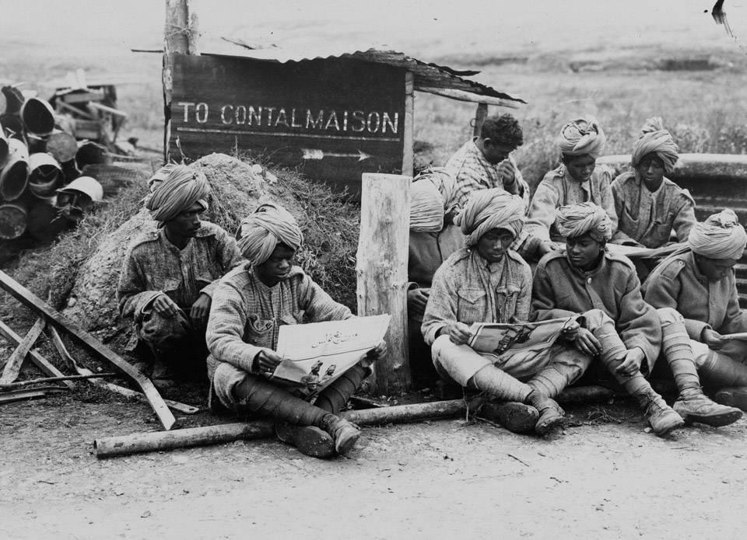
Notes:
Indian cavalry await the order to advance on the Somme, 1916
NAM. 2001-01-277-6

Slide 14
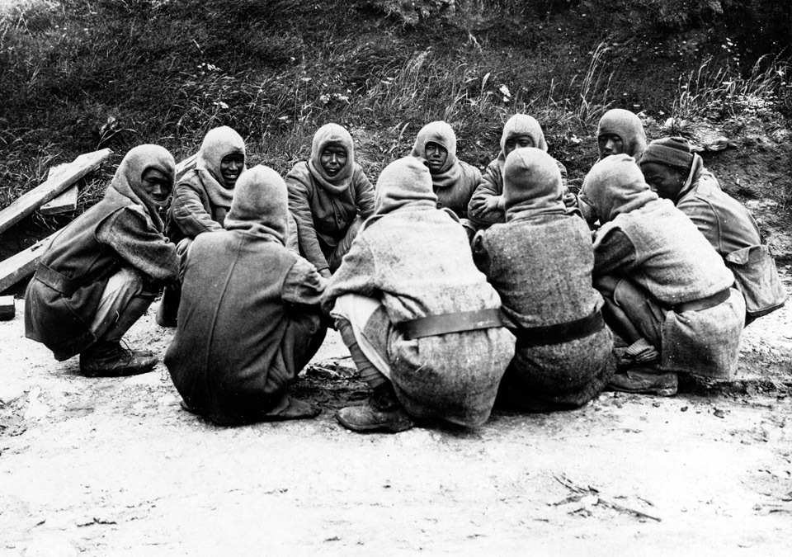
Notes:
‘This year's war at Contalmaison. Burmese troops hold a council of war upon rats.’
NAM. 2001-01-277-7

Slide 15
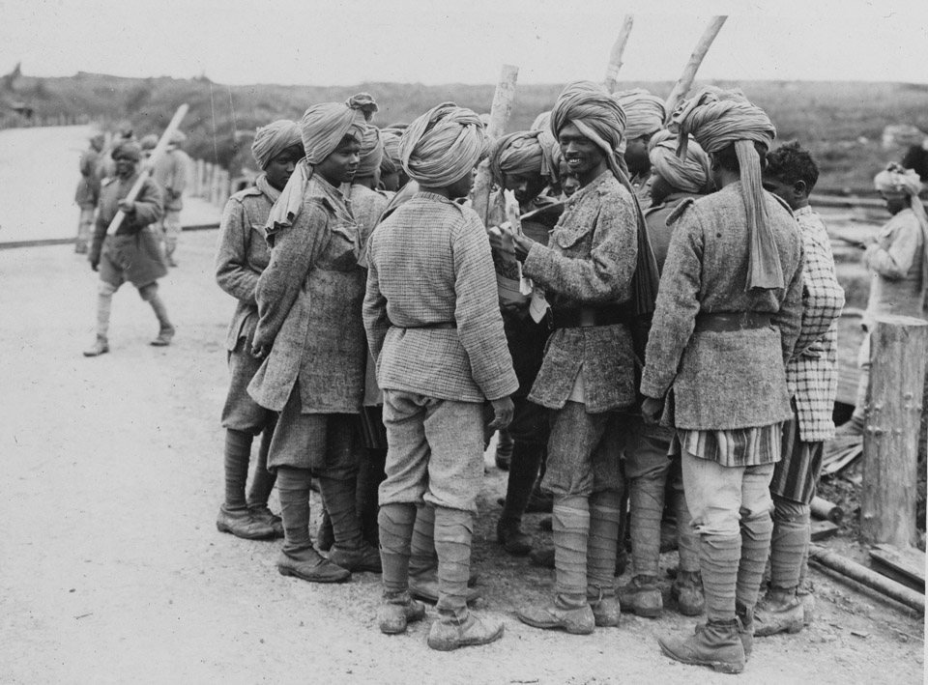
Notes:
'Contalmaison. Autumn 1917. Burmese troops receive their mail. A year ago no one could stand in this area with impunity.’
NAM. 2001-02-277-8

Slide 16
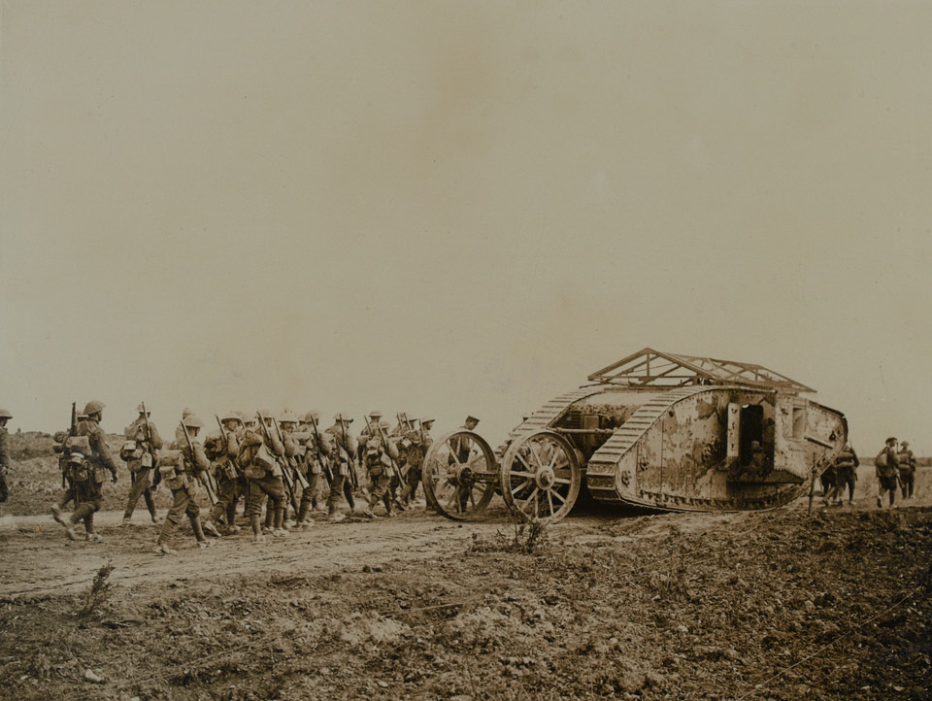
Notes:
Mark 1 tank, ‘C19’, 'Clan Leslie' with infantry following behind
NAM. 1999-11-70-64

Slide 17
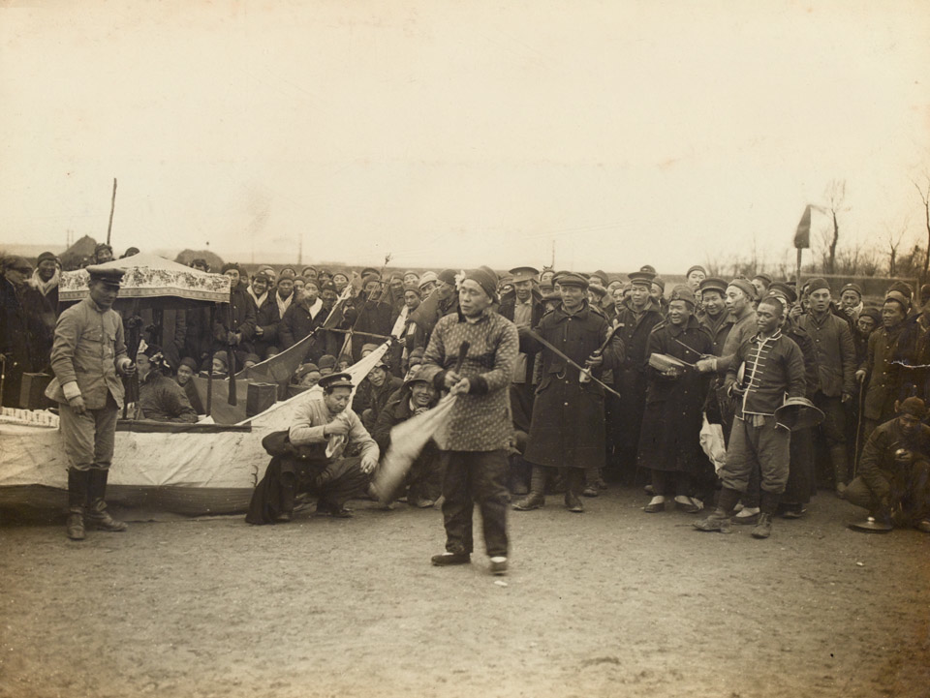
Notes:
A Chinese juggler at Chinese New Year day (Feb 11th) celebrations in a labour camp in France
NAM. 2001-02-121-1

Slide 18
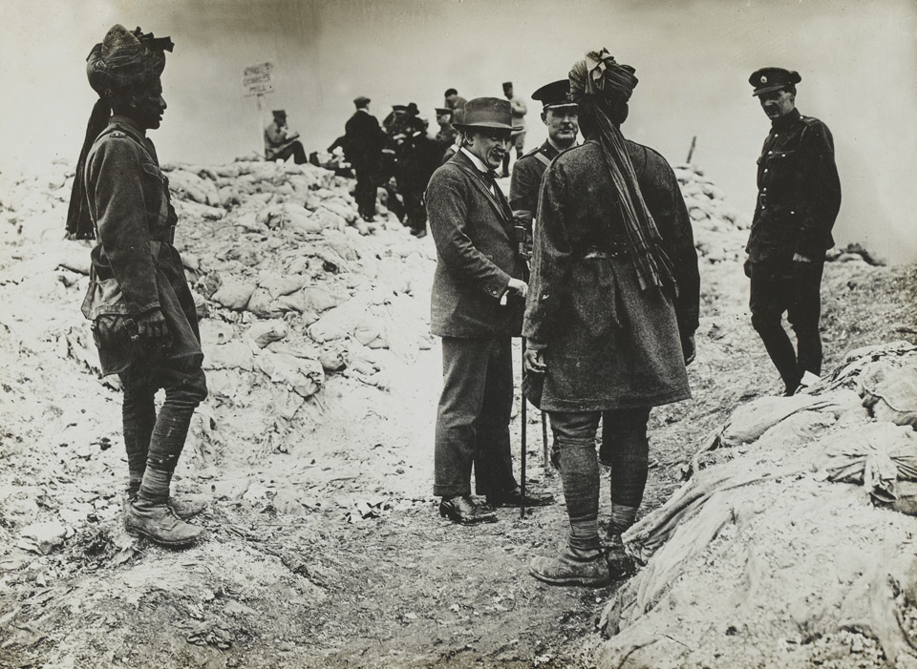
Notes:
David Lloyd-George, Minister of Munitions, Secretary of State for War and Prime Minister during the war, visiting Indian soldiers, 1916
NAM. 1995-03-88-14

Slide 19
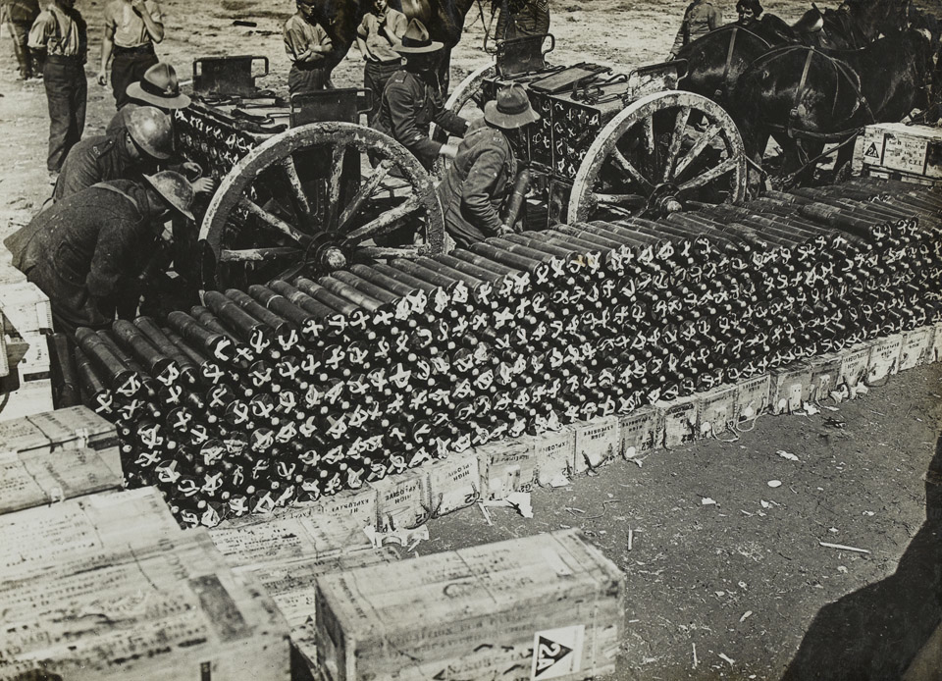
Notes:
American troops loading ammunition limbers
NAM. 1995-03-88-17

Slide 20
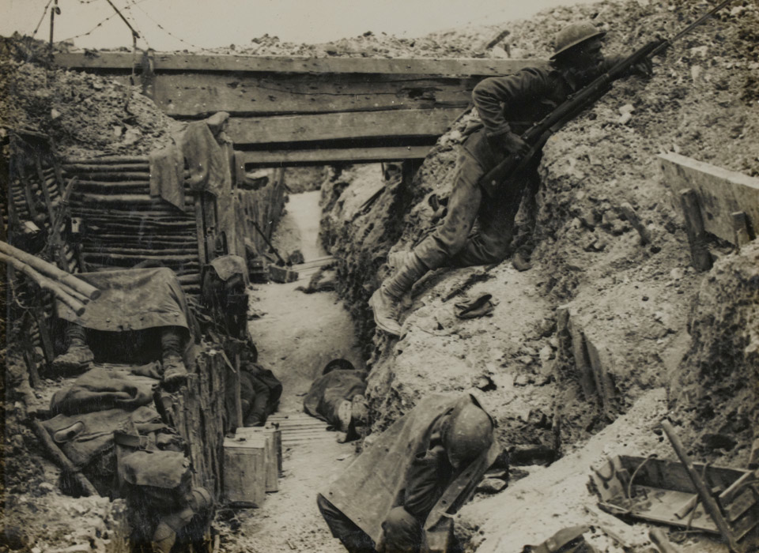
Notes:
Men of the 11th Battalion, The Cheshire Regiment, man a trench near La Boisselle.
NAM. 1995-03-86-2
The 11th Battalion was part of 34th Division and suffered very severe casualties during its part in the attack on La Boisselle during the opening phase of the Somme offensive.

Slide 21
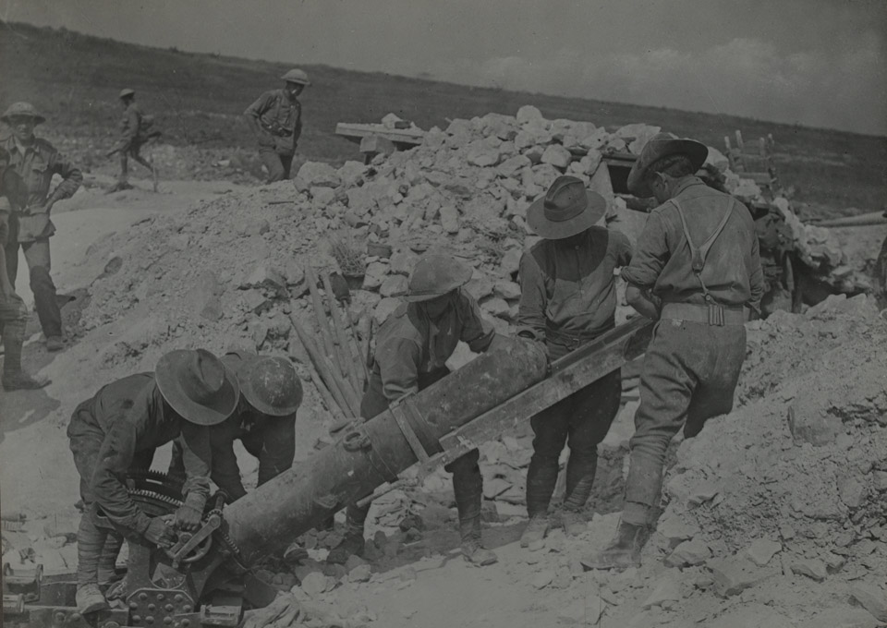
Notes:
Australian troops loading a 9.45 inch trench mortar on the Somme, August 1916
NAM. 1995-03-86-10

Slide 22
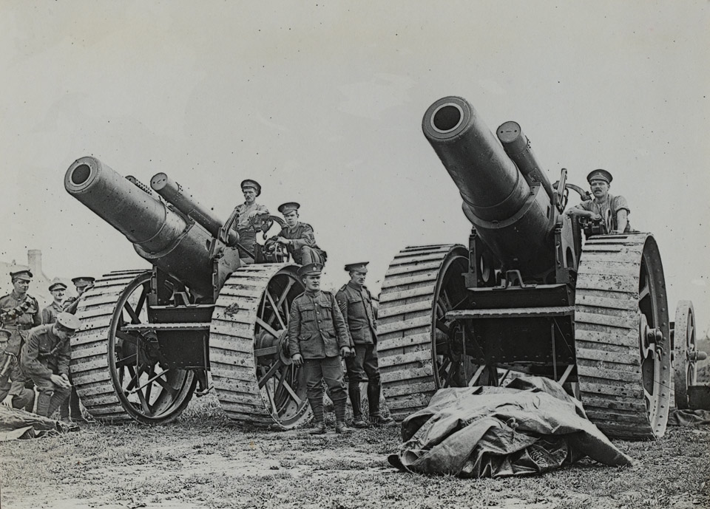
Notes:
A pair of 8-inch howitzers of the Royal Garrison Artillery, c1917
NAM. 1995-03-86-12
The 8-inch howitzer had a range of about 12,300 yards (11.24 km), and fired a 200lb (90.8kg) shell.

Slide 23
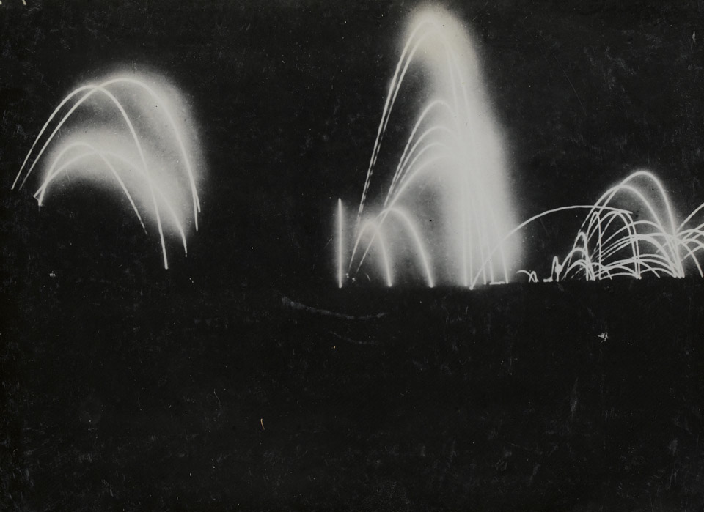
Notes:
The bombardment of Beaumont Hamel, 2 July 1916
NAM. 1995-03-86-15

Slide 24
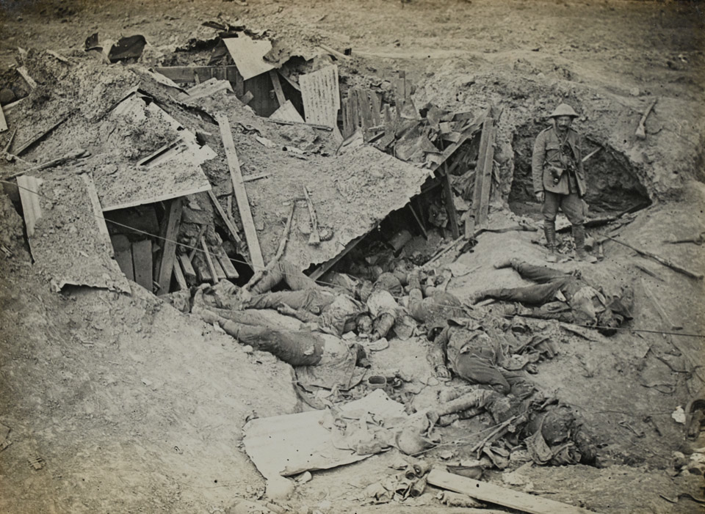
Notes:
German dead on the Somme, 1916
NAM. 1995-03-86-21

Slide 25
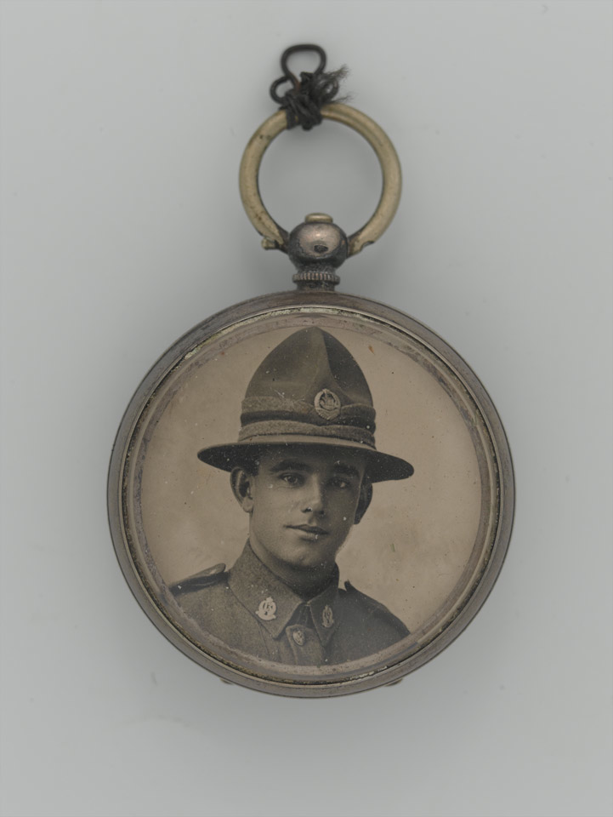
Notes:
Pocket watch portrait photograph of 23307 Private William Henry Ellen, 1st Battalion Auckland Regiment, New Zealand Expeditionary Force, c1916
NAM. 2001-03-194-2
Ellen was killed on the Somme, 27 September 1916, and is buried at the Caterpillar Valley (New Zealand) Memorial, Somme, France.

Slide 26
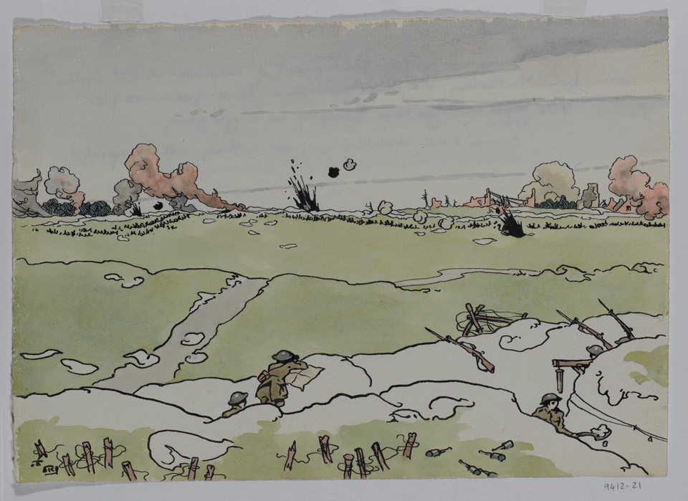
Notes:
‘Somme July 1916 - Bombardment of Longueval on '2nd system' seen from Montauban. Very large no-mans-land 900-1200yds. Note 77mm cartridge case hung up as a gas gong. Gunner F.O.O. observing fire; wire cutting with shrapnel.’
NAM. 1994-12-21-1
Pen and ink and watercolour by Lt Richard Barrett Talbot Kelly MBE, MC, RI (1896-1971), Royal Field Artillery, 1916

Slide 27
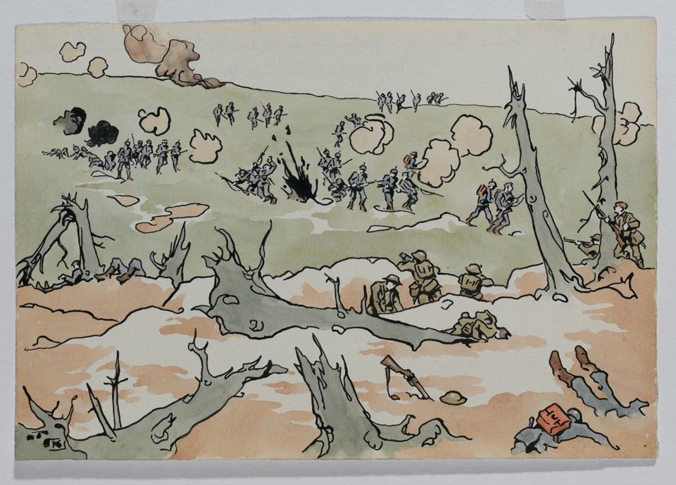
Notes:
‘Somme - July 1916 - German counter attack on S. Africans in Delville Wood.’
NAM. 1994-12-26-1
Pen and ink and watercolour by Lt Richard Barrett Talbot Kelly MBE, MC, RI (1896-1971), Royal Field Artillery, 1916

Slide 28
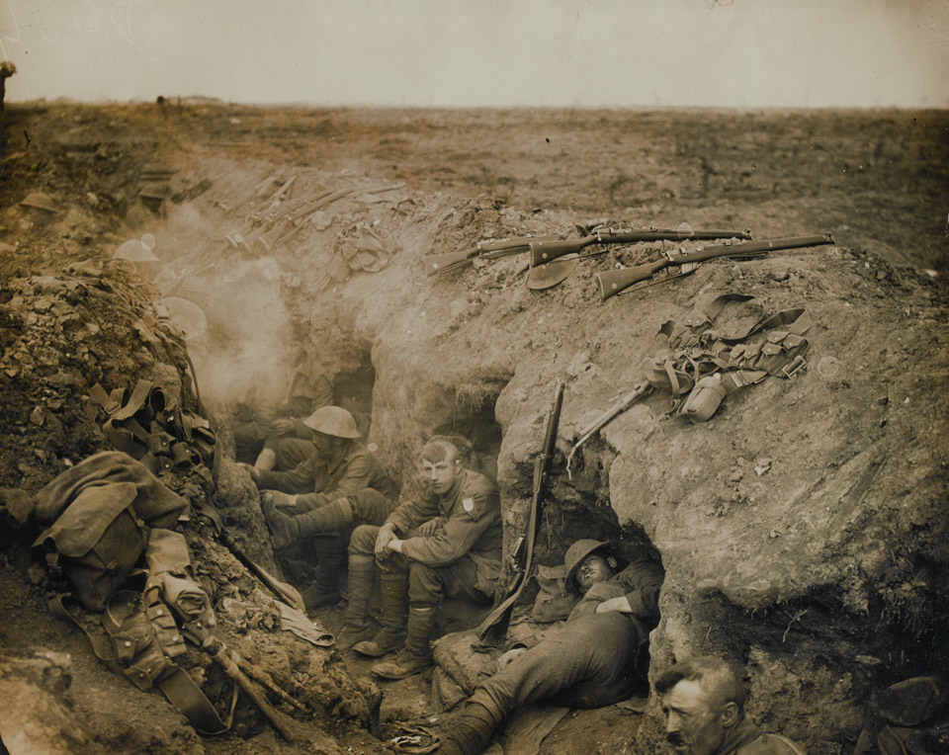
Notes:
Soldiers of the Welsh Guards in a reserve trench at Guillemont, Western Front, c1914 - c1918
NAM. 2002-02-589-6

Slide 29
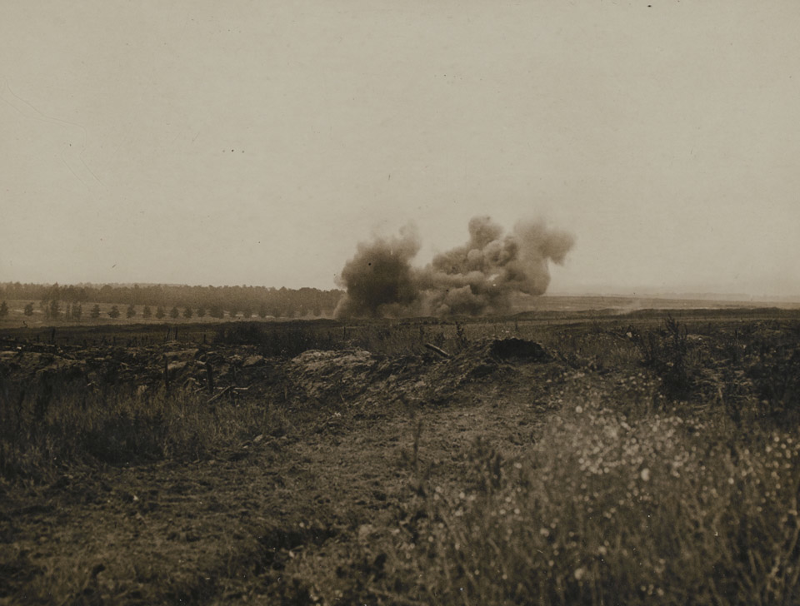
Notes:
Shell bursting
NAM. 1952-01-33-55-282

Slide 30
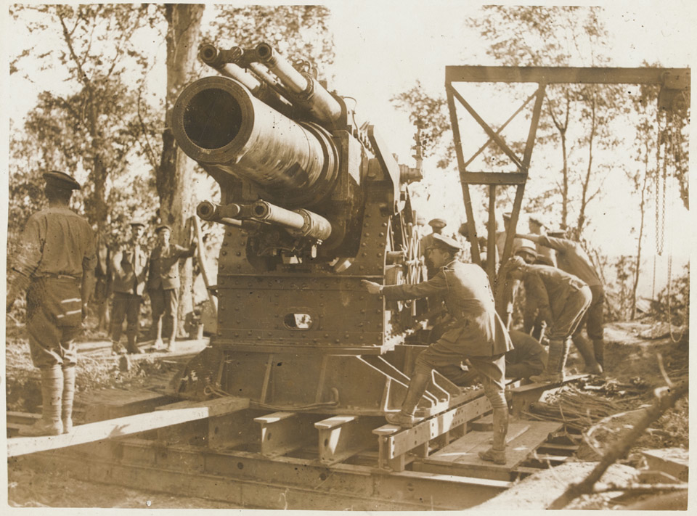
Notes:
A 15-inch howitzer being prepared for action on the Somme, 1 July 1916
NAM. 2001-01-279-13

Slide 31
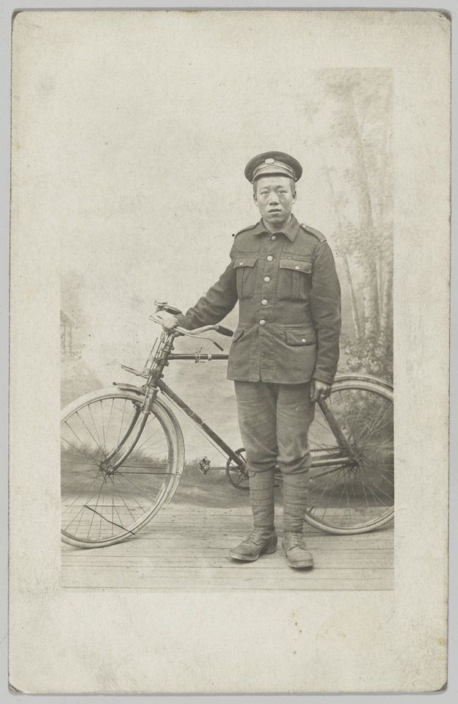
Notes:
Studio portrait of unidentified Chinese soldier of 55th Company, Chinese Labour Corps, France, c1918
NAM. 2007-08-13-5

Slide 32
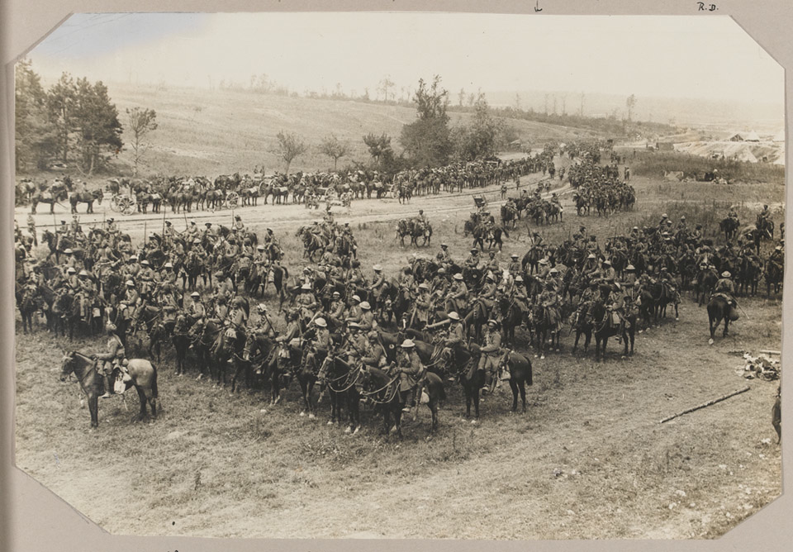
Notes:
18th King George's Own Lancers in ‘Sausage Valley’ near Mametz, Somme, 15 July 1916
NAM. 1960-06-80-1-92

Slide 33
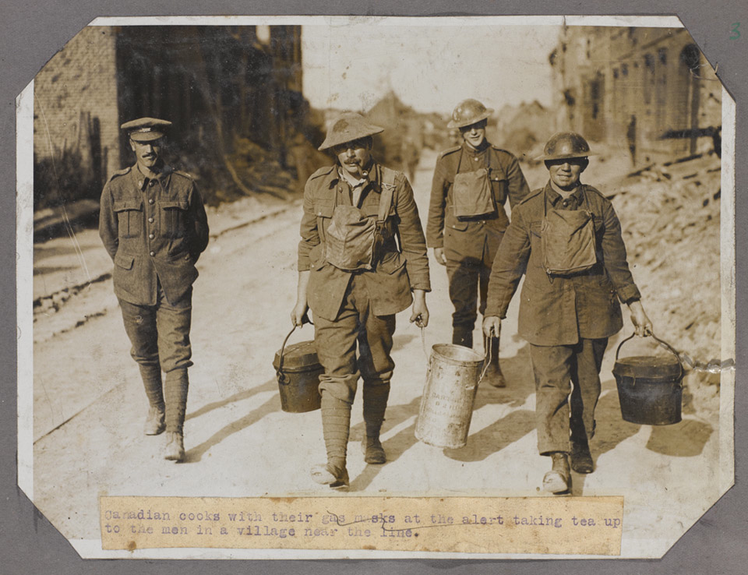
Notes:
Canadian cooks with their gas masks at the alert taking tea up to the men in a village near the line
NAM. 2010-01-56-3

Slide 34
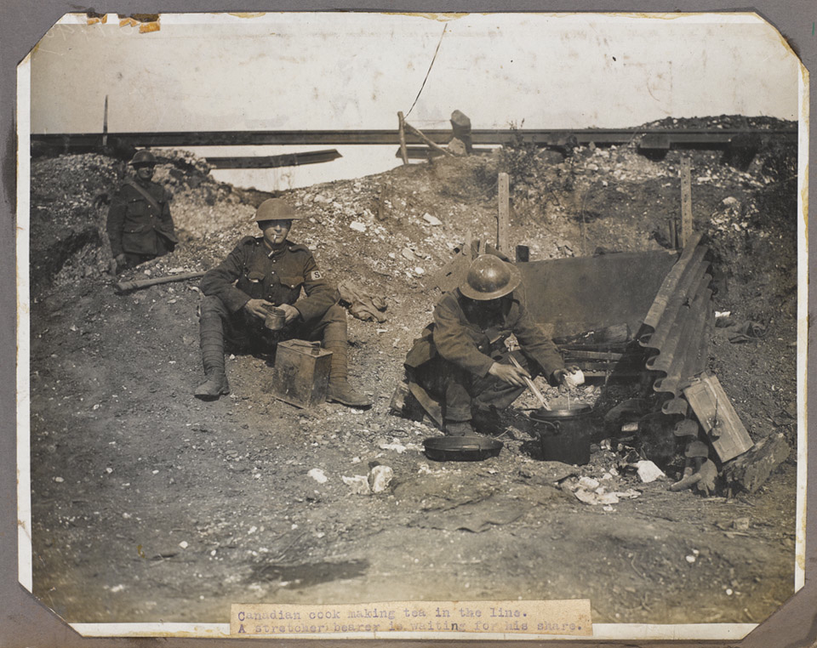
Notes:
‘A Canadian cook making tea in the line. A stretcher bearer is waiting for his share’, c1916
NAM. 2010-01-56-11

Slide 35
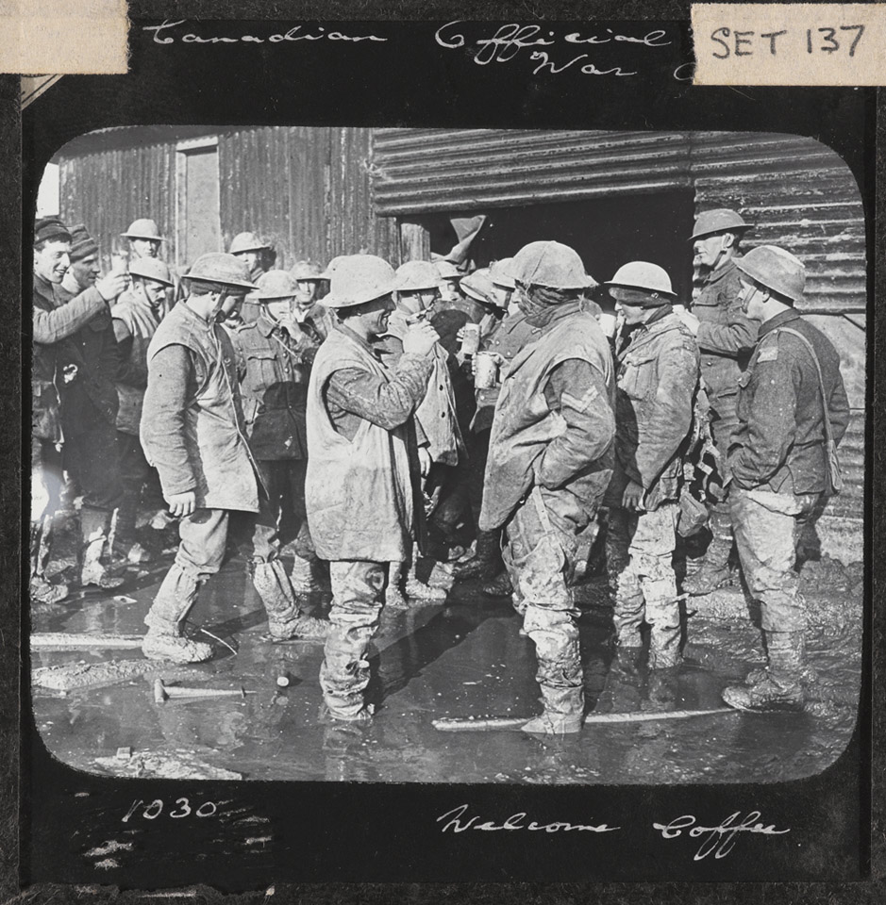
Notes:
‘Welcome Coffee’. Canadian soldiers, some wearing trench waders, enjoy a coffee during a break from duties on the Somme front, November 1916
NAM. 1978-11-157-4-38

Slide 36
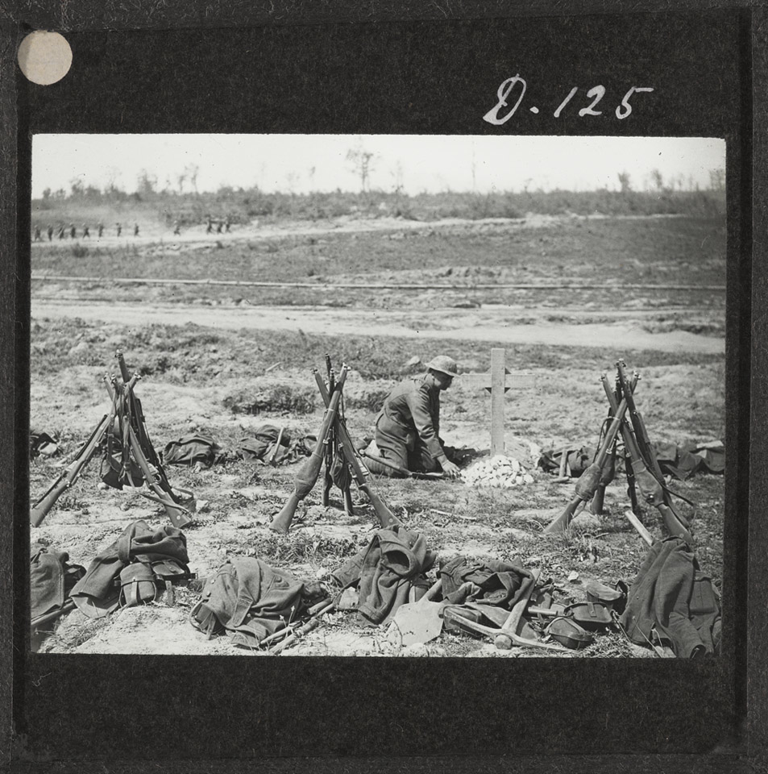
Notes:
Tending a grave near Mametz Wood, August 1916
NAM. 1978-11-157-4-57

Slide 37
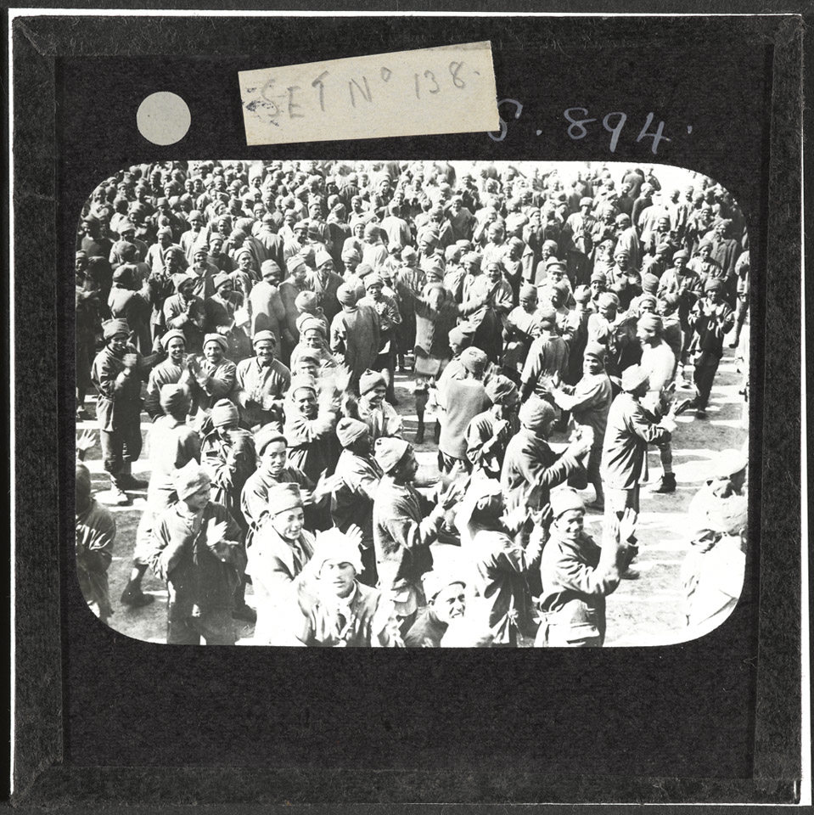
Notes:
Men of the Egyptian Labour Corps at Boulogne, 12 August 1917
NAM. 1978-11-157-24-33

Slide 38
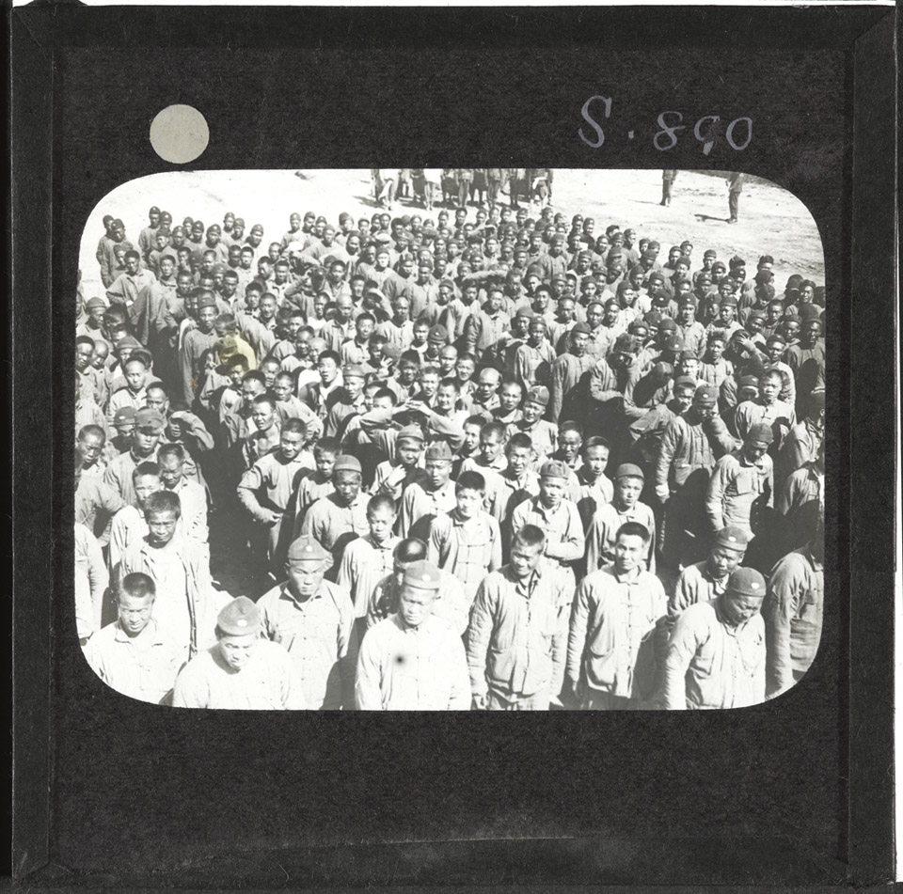
Notes:
Members of the Chinese Labour Corps, 1917
NAM. 1978-11-157-24-34

Slide 39
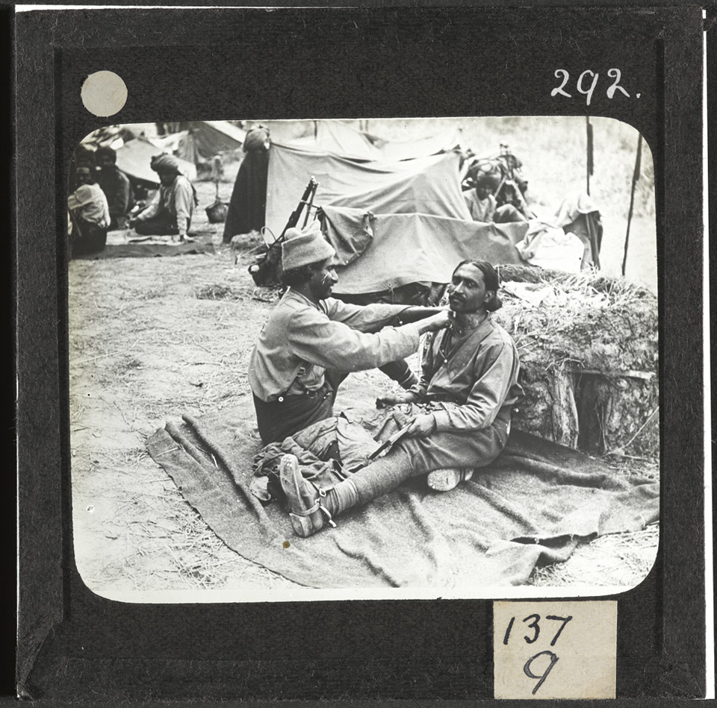
Notes:
Shaving in camp, 29 July 1916. An Indian barber goes to work at the Indian Cavalry camp near Querrieu, located on the Albert-Amiens road.
NAM. 1978-11-157-24-48

Slide 40
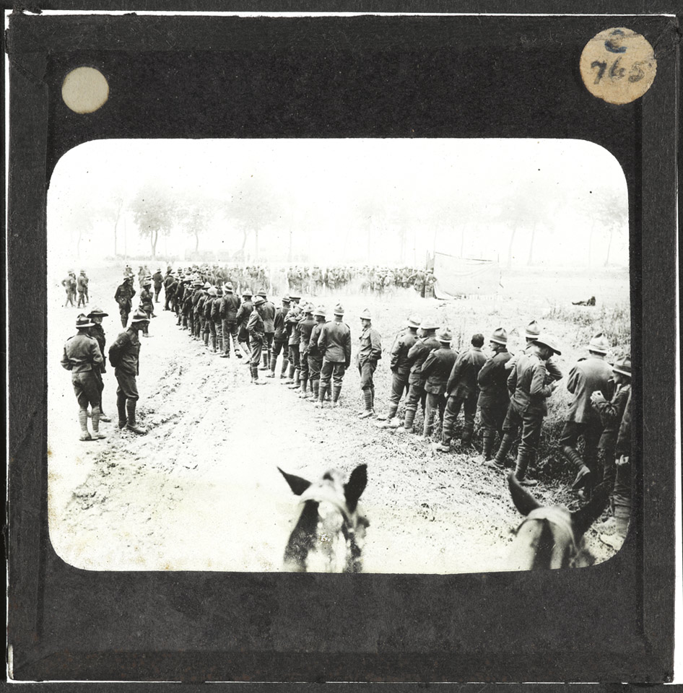
Notes:
New Zealanders waiting to buy goods from a field canteen on the Amiens-Albert Road, September 1916
NAM. 1978-11-157-24-49

Slide 41
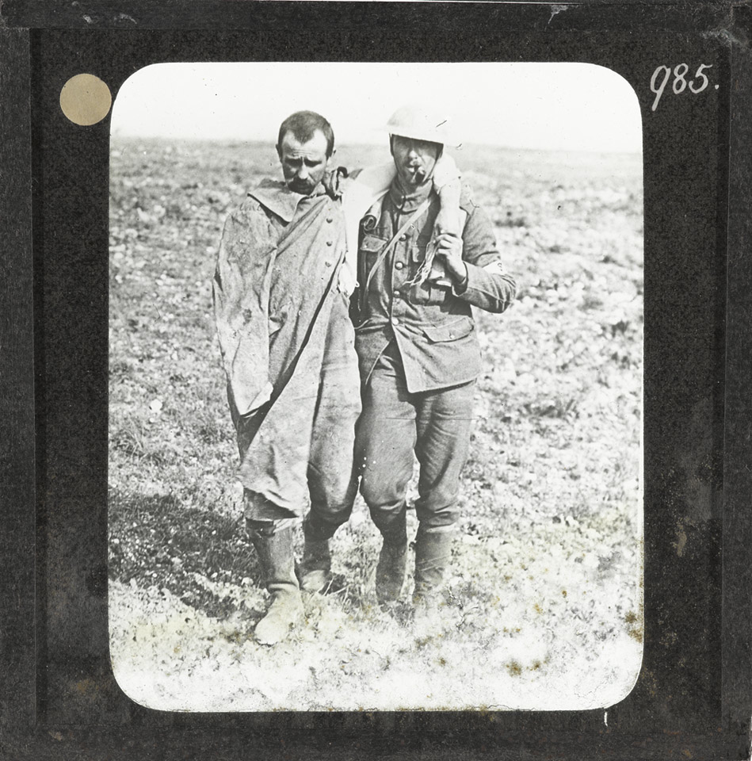
Notes:
A British soldier helping a wounded German prisoner, 25 September 1916
NAM. 1978-11-157-25-20
The British soldier’s white armband shows he is a stretcher bearer. The location is Ginchy on the Somme. The German prisoner was wounded during the Battle of Morval (25-28 September 1916). This was a relatively successful attack by XV Corps on Morval, Gueudecourt and Lesboeufs, objectives that advanced the British line to the slopes of the Transloy ridges.

Slide 42
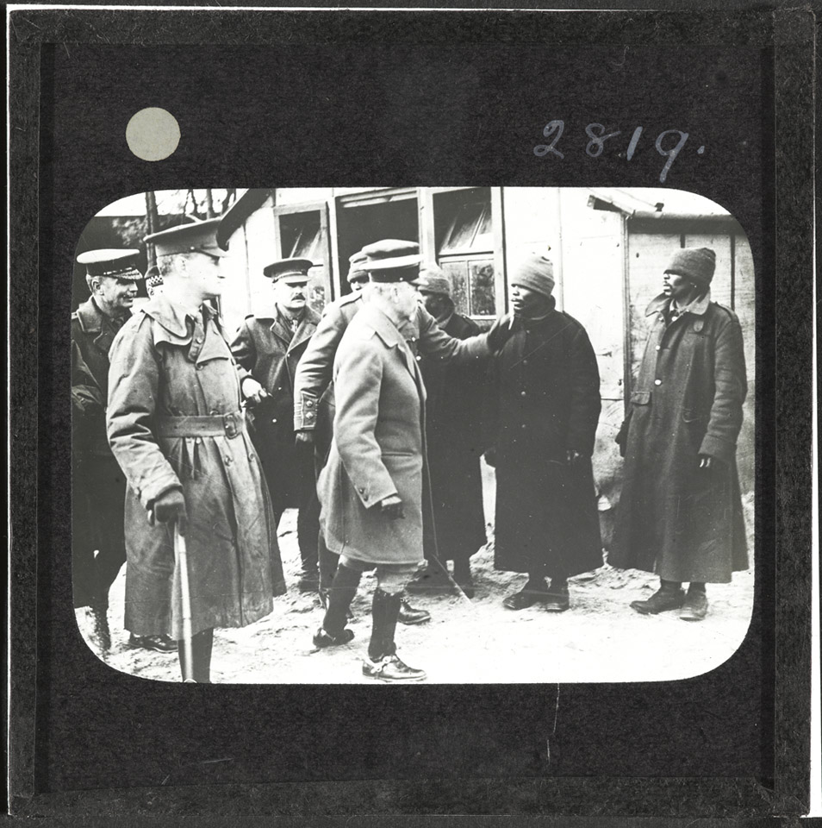
Notes:
General Jan Smuts visiting African labourers on the Western Front, c1917
NAM. 1978-11-157-25-50

Slide 43
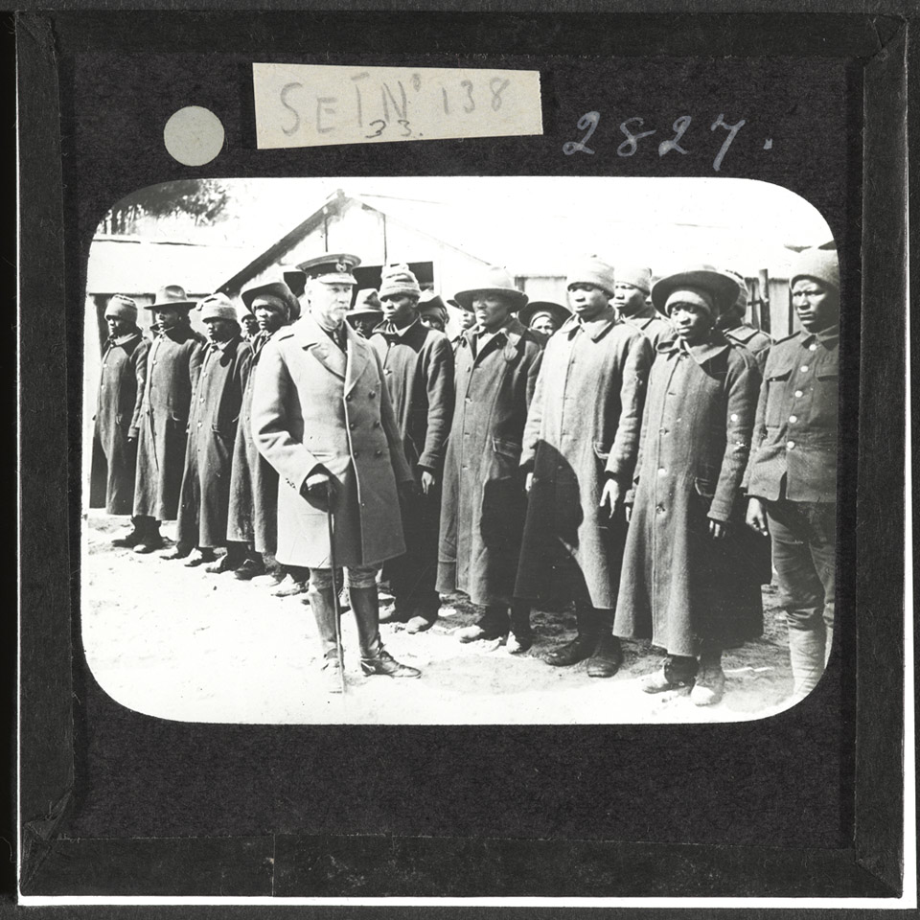
Notes:
General Jan Smuts visiting African labourers on the Western Front, c1917
NAM. 1978-11-157-25-51

Slide 44
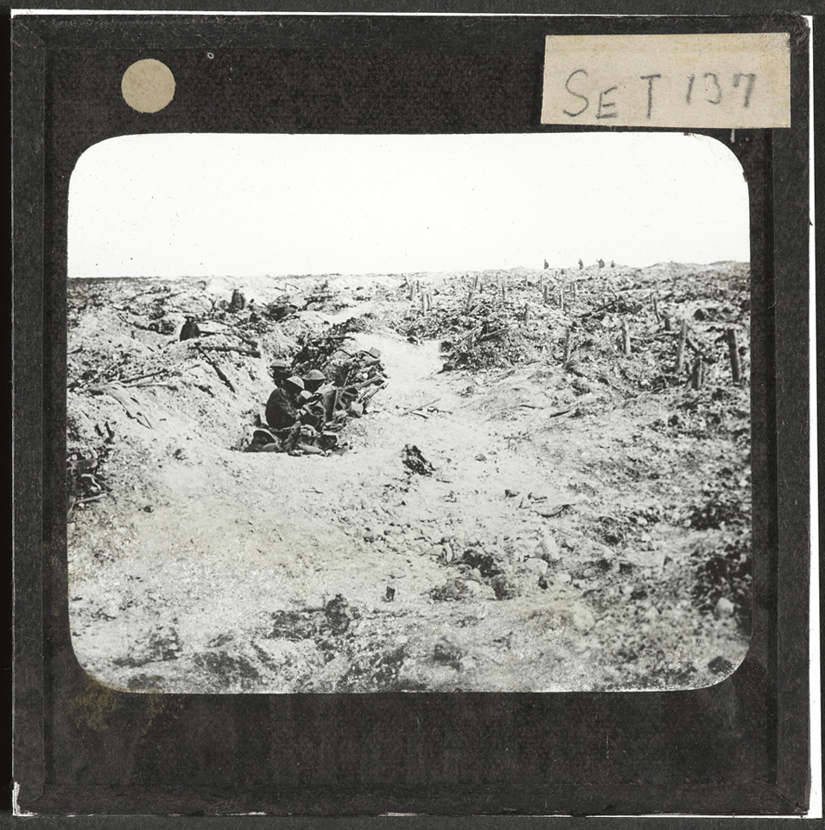
Notes:
Occupying an old German trench, September 1916
NAM. 1978-11-157-29-2
British troops occupy an old shallow German trench in blasted woodland near Guillemont on the Somme. The village of Guillemont was attacked by the 16th and 20th Divisions on 3 September 1916 and finally secured three days later after a bitter struggle.

Slide 45
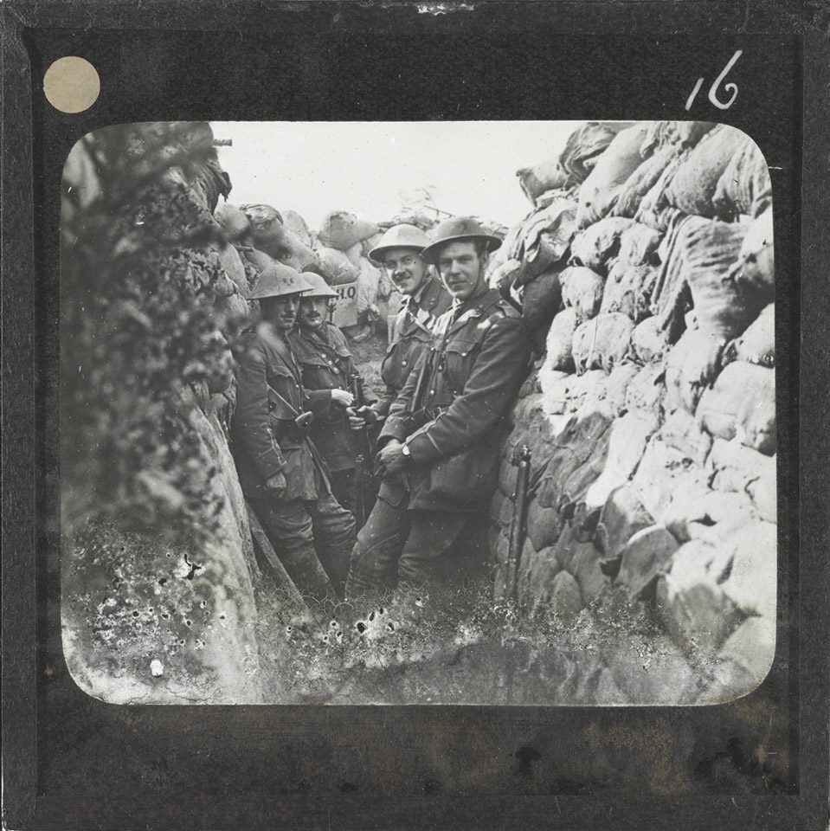
Notes:
Officers of the Royal Engineers in a communication trench on the Somme, 1 July 1916
NAM. 1978-11-157-29-4

Slide 46
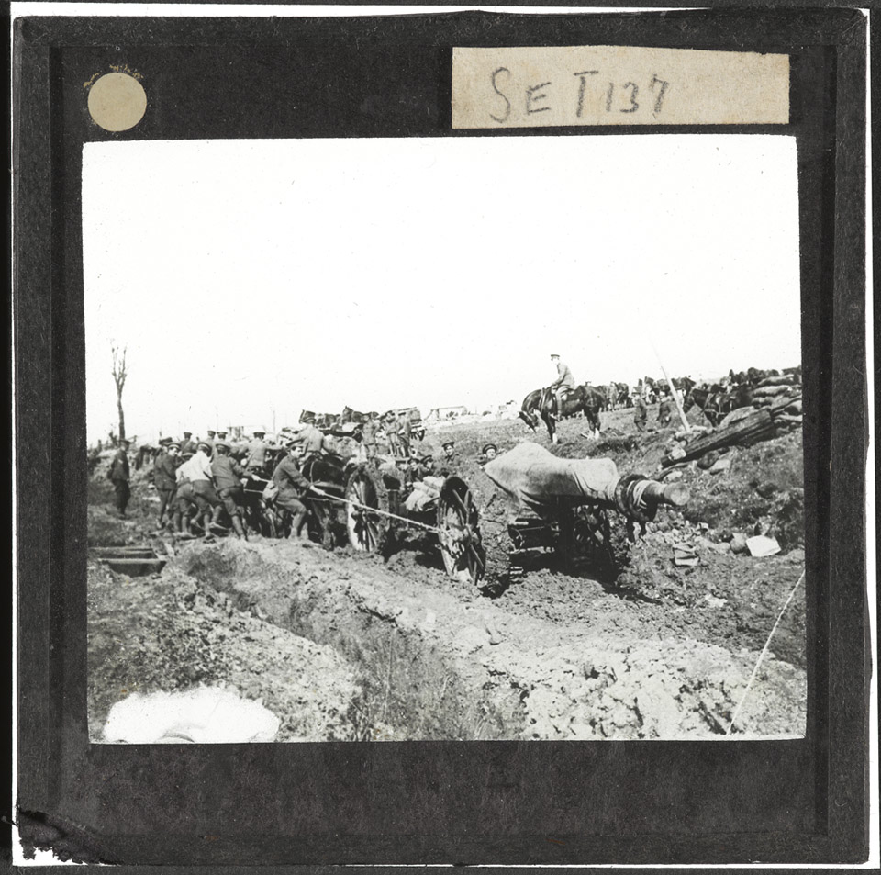
Notes:
Hauling a 60-pounder on the Somme, October 1916
NAM. 1978-11-157-29-25
Members of the Royal Garrison Artillery use a 12 horse gun-team to move a 60 pounder gun to a new position at Bazentin-le-Petit during the Battle of Transloy Ridges (1 October-11 November 1916). The latter was one of the final offensives mounted by the British Fourth Army during the Battle of the Somme.

Slide 47
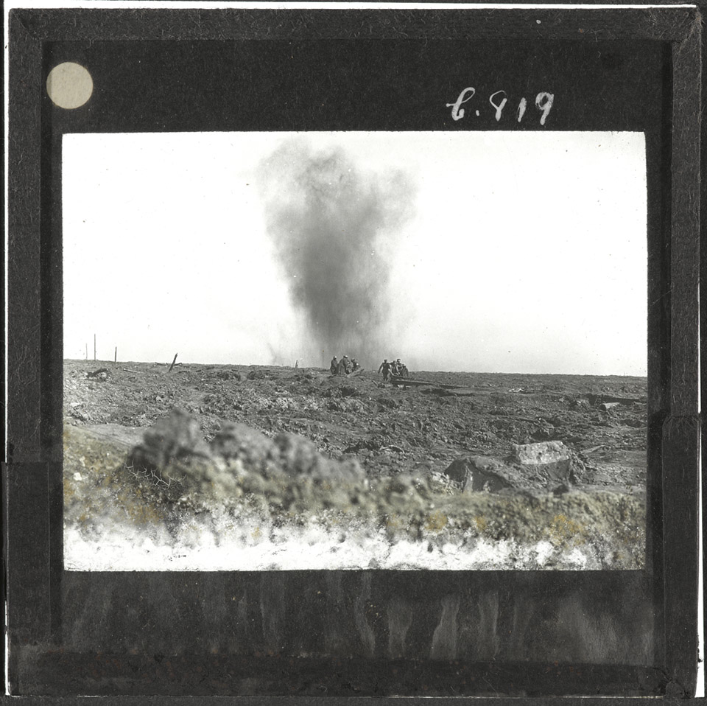
Notes:
The Battle of Ginchy, 9 September 1916
NAM. 1978-11-157-29-49
British and German soldiers, presumably German prisoners of war, carry wounded across the battlefield while under shell fire. German-held Ginchy was attacked by the 16th (Irish) Division on 9 September 1916 during the Battle of the Somme.

Slide 48
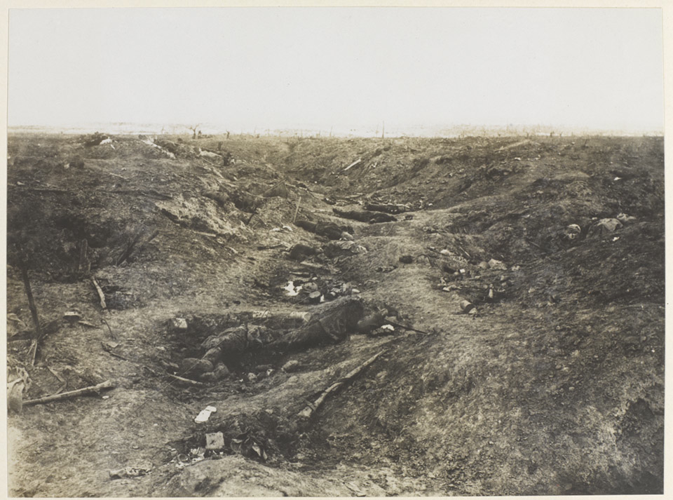
Notes:
German dead on the Somme, 1916
NAM. 1965-10-209-37

Slide 49
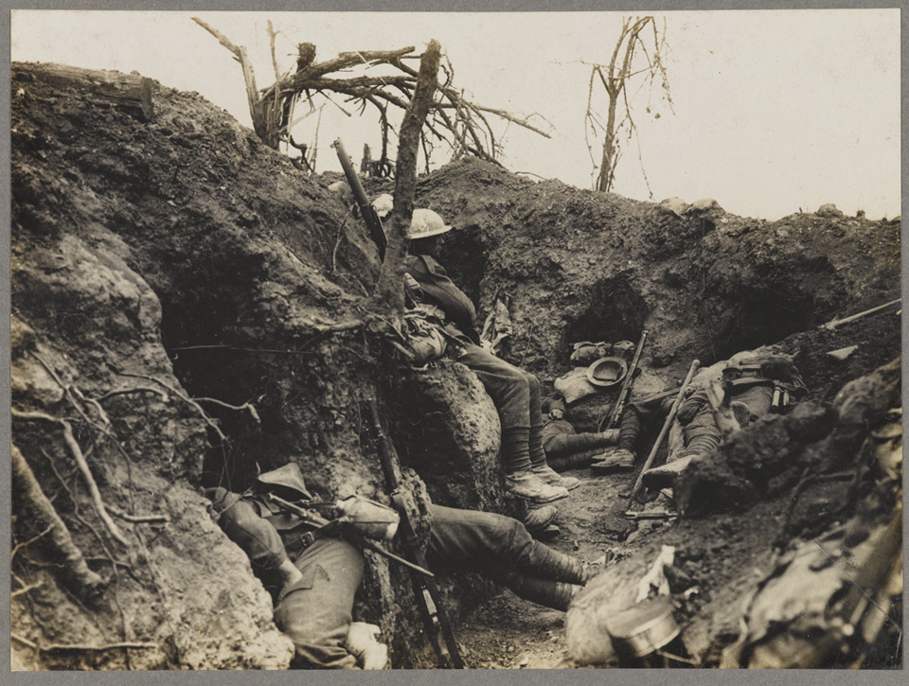
Notes:
Soldiers of the Border Regiment resting in a front line trench, Thiepval Wood, August 1916
NAM. 1963-03-110-1
Five soldiers are sleeping, while one remains awake, as lookout.

